Slide 1
MEBT Tuning System and Amplifiers
By
Saad AlSari
August 28th 2013

Slide 2
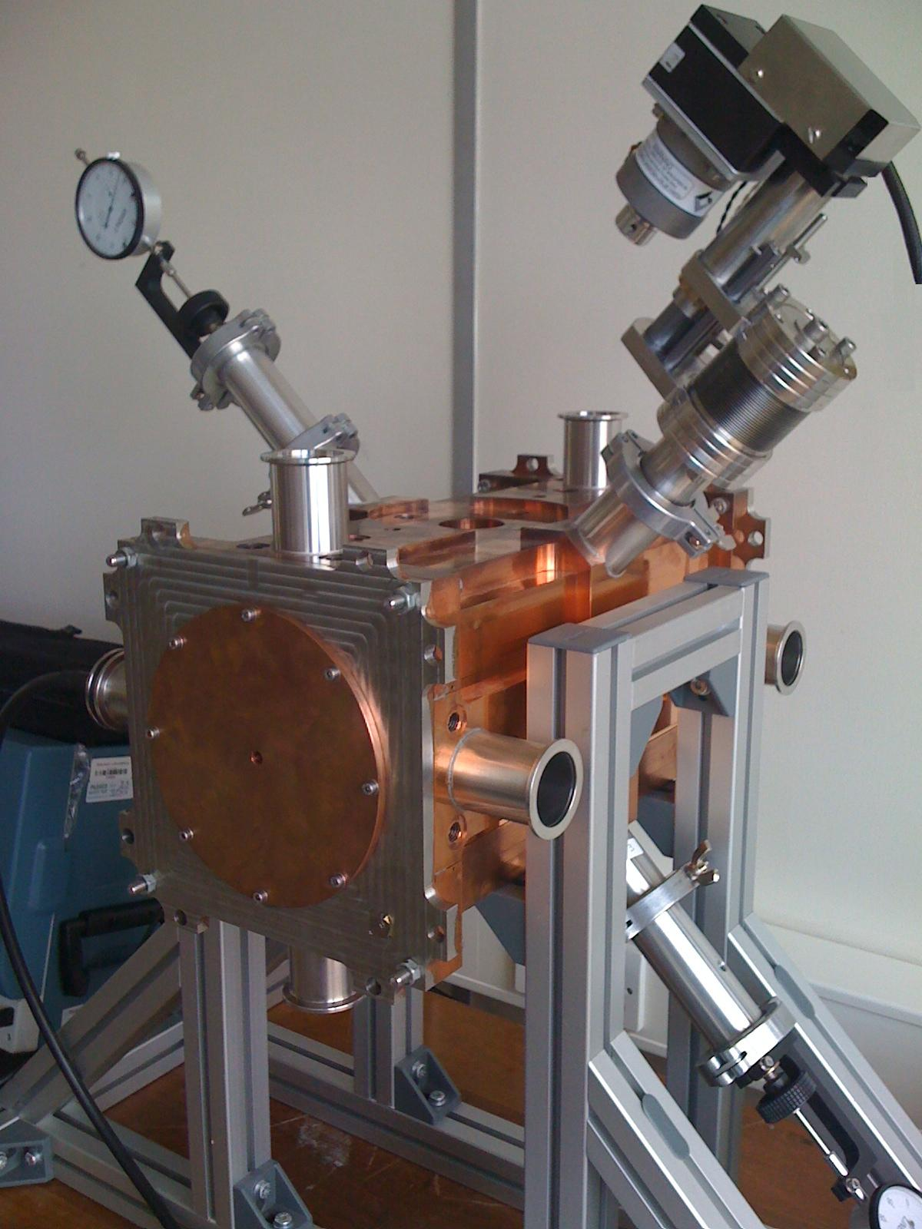
The Tuning System
The automatic tuning system has been developed for the main FETS 324MHz 4-vane RFQ accelerator.
The system been tested to fine tune the frequency changes due to temperature variation in the resonant frequency of a 324MHz 4-vane cold model RFQ (1). The cold model RFQ also included manual tuners(4).
The mechanism of the motorized tuners are based on linearly shifting the tuners copper plugs using a stepper motor (2) and an edge welded bellows (3).
The concept of the motorised tuners make use of phase change of the coupled RF power (5) as an indicator of swing as it will include information of direction as well as frequency.
2
4
5
3
1

Slide 3
THe Tuning System
System Concept
A feedback loop circuit is used to provide information of phase changes combined with the Cavity resonant frequency change .
Cavity field phase changes is used as it provide details of direction for the frequency variation.
Forwarded RF
Power
Phase | On/Off | Direction
0 | Off | Off
+ve | On | Off
-ve | On | On
Directional
Coupler
RF Coupler
Phase
Detector
Control
Stepper
Motorised Tuner
Field Detector
Drive

Slide 4
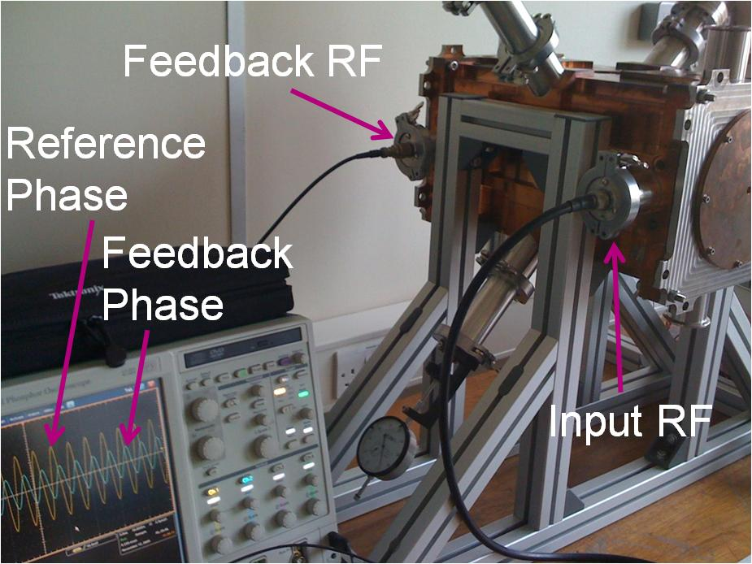
The Tuning System
Any phase variation occur to the field of the RFQ would be directly reflected as phase change on the feedback RF signal
The system compares between the reference input phase which is represented by the input RF signal and the feedback RF signal of the RFQ.
Constant phase deference ∆Ѳ need to be upheld by the system throughout the tuning process.
AD8302 RF/IF Gain and Phase Detector were used to build the phase detector circuit in our workshop at Imperial College.
The output of the phase detector is a DC voltage of 0 to 1.8 V and phase range of 0° to 180° scaled in a linear slope of 10mV/degree .

Slide 5
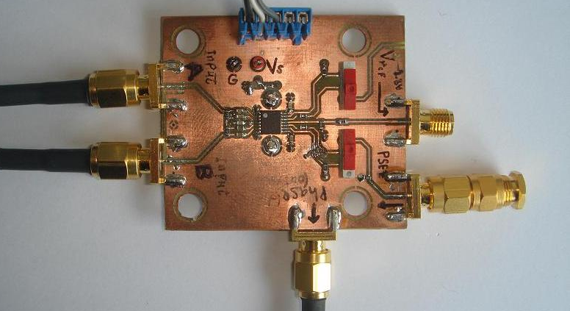
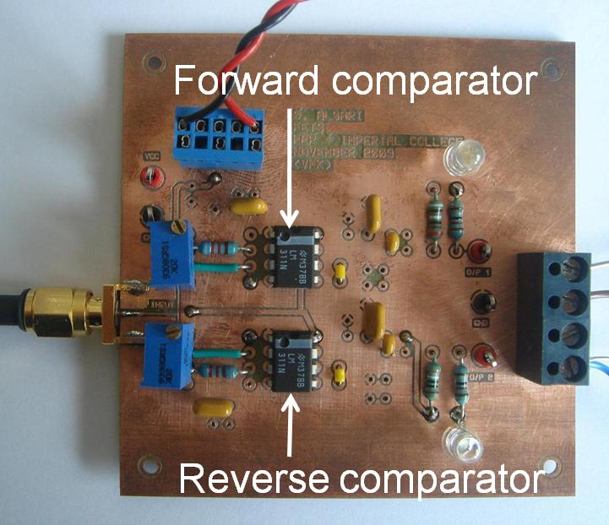
The Tuning System
The phase accuracy measurement of the phase detector is independent of input signal level over a wide range.
The controller circuit consisting two voltage comparators, one for each direction in a form to allow enabling the stepper motor to move forward and backward.
The output of the controller board is connected to the stepper motor drive to control the movement of the stepper motor. The drive can be modified to have a fixed speed or variable ramp settings through the onboard oscillator.
The output of the controller board is connected to the stepper motor drive (PM546 Bipolar Stepper Motor Translator, by Mclennan Servo Supplied Ltd.)
Motor scale has two safety limiting switches to protect the mechanical arm in case of shifting to the far ends of the scale. These switches were connected in serial to the controlling circuit to disable the motor once it reaches the far edges.
Reference Phase
Feedback Phase

Slide 6
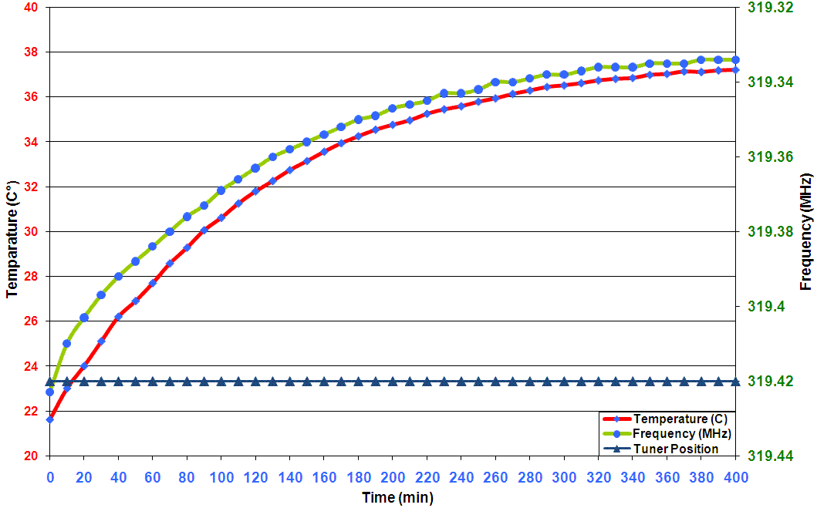
The Tuning System
Measurements and Results
Corresponding frequency shift been correlated to the rise in the temperature of the cold model RFQ
The relation of the resonant frequency against the RFQ body temperature feeding the 60W RF power without using our tuning system is presented.
In order to keep our desired resonant frequency unchanged through this temperature increment, we have used our tuning system to re-tune the RFQ accordingly to maintain the frequency throughout that scale.

Slide 7
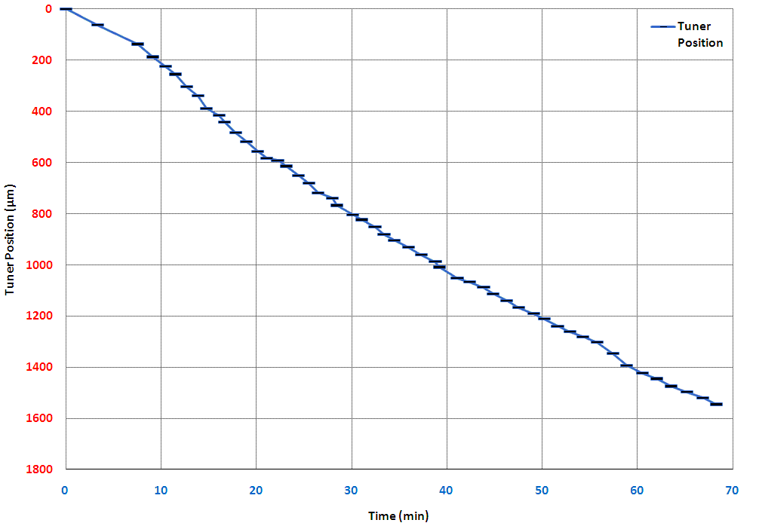
the Tuning System
Measurements and Results
The motorised tuning system were used to re-tune the RFQ accordingly in order to maintain the original RF resonant frequency throughout the time scale even while temperature rising.
Tuner position were in move linearly with time to maintain constant phase difference between the two signals which preserving the original RFQ resonant frequency.

Slide 8
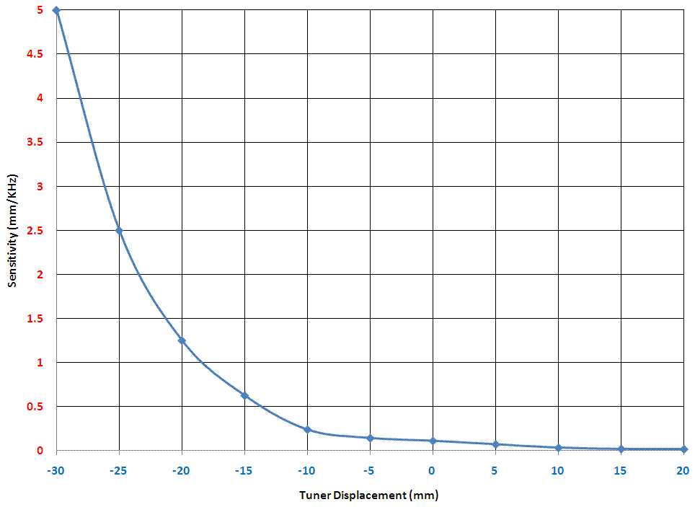
the Tuning System
Measurements and Results
An important mechanical design fact to keep in mind with the tuners is that the optimum region for the tuner position is in the range where it just in line with the internal surface of the RFQ in order to get a good tuning sensitivity as well as minimum effect to the RFQ field and therefore the reflected power and the RFQ quality factor .
In the case that the tuner is far out from the surface, it would not have much tuning effect, on the other hand if it’s too far deep, it will affect the electric field of the RFQ and therefore will increase the reflected power as well as reducing the quality factor of the RFQ even if it’s in the resonant region.

Slide 9
the Tuning System
Conclusions and Required Improvements
An automated tuning system has been built and tested on the FETS cold model RFQ. Measurements and results presented showed that the resonant frequency been kept constant during a continues wave CW RF power coupling at 60W during a period of time which would have caused considerable frequency shifting due to RFQ temperature increment if the tuning system was not in use.
CW RF signal is not the case for the real system power, therefore, an improvement to the current system need to be applied in order to make possible to detect the phase deference and give enough time to the stepper motor to respond to the output to maintain the RF frequency.
Suggested scenario is to expand the RF pulse signal throughout the “no pulse time” to give a continuous output to the phase detector circuit.

Slide 10
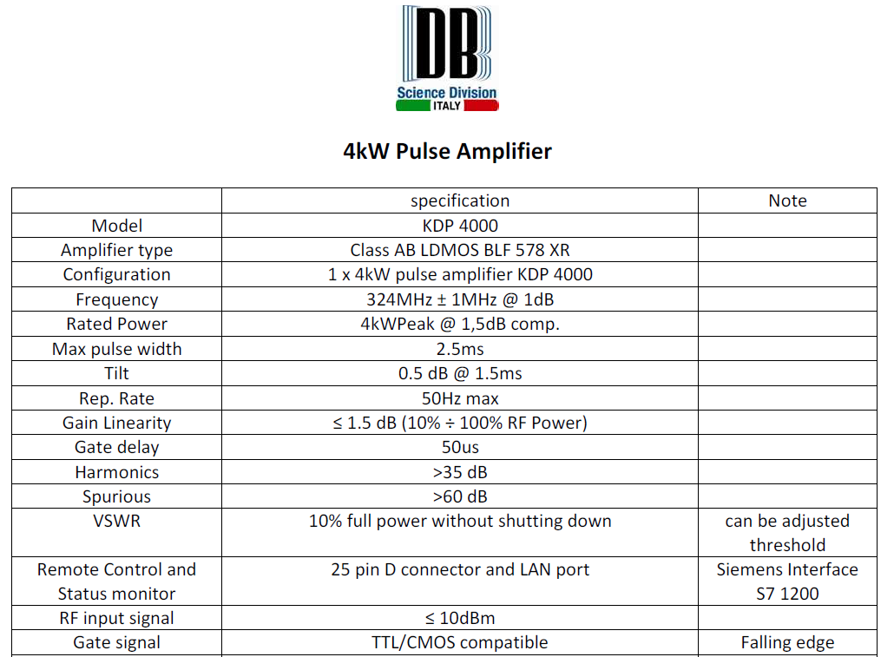
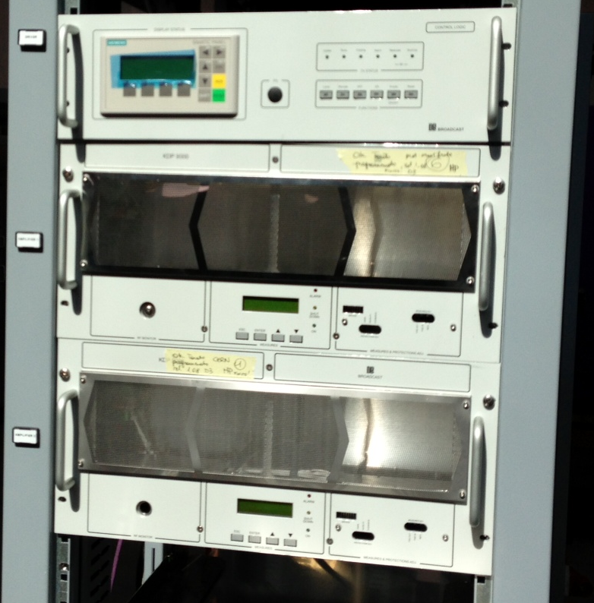
DB Power Amplifiers

Slide 11
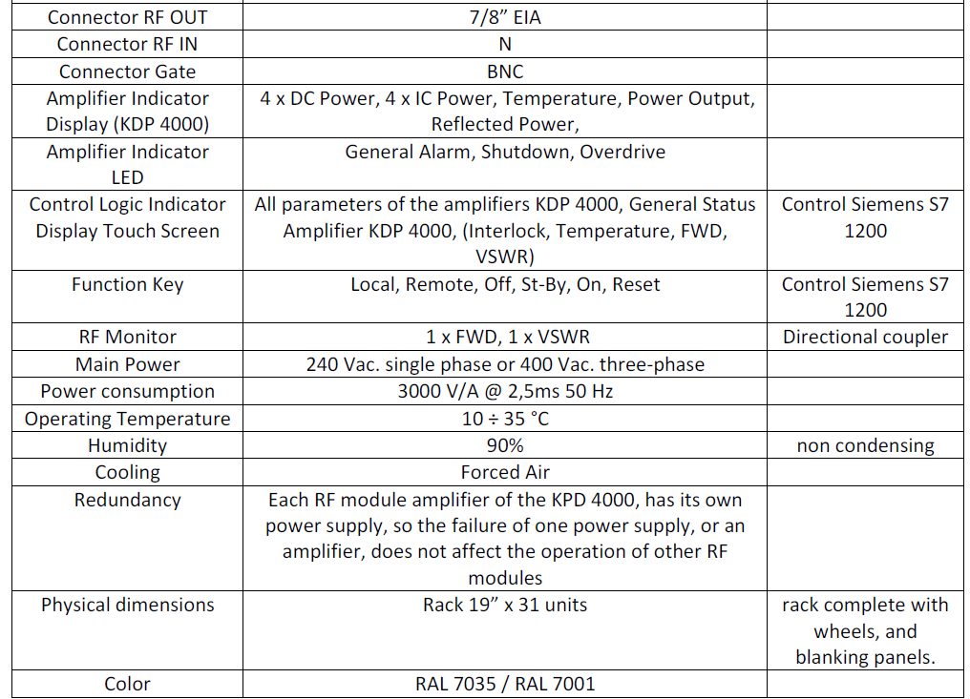
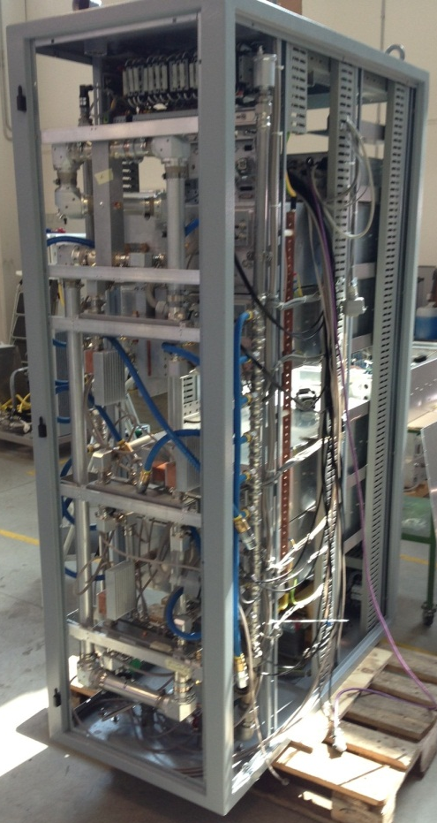
DB Power Amplifiers

Slide 12
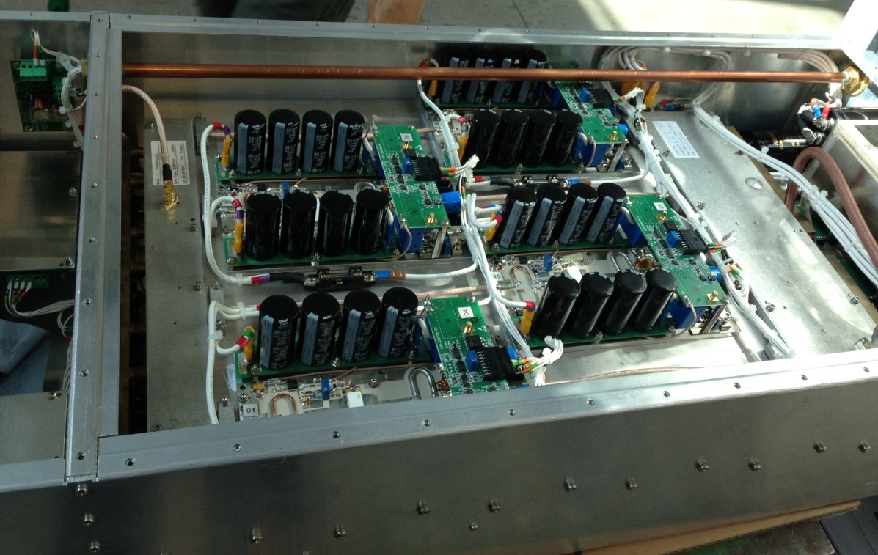
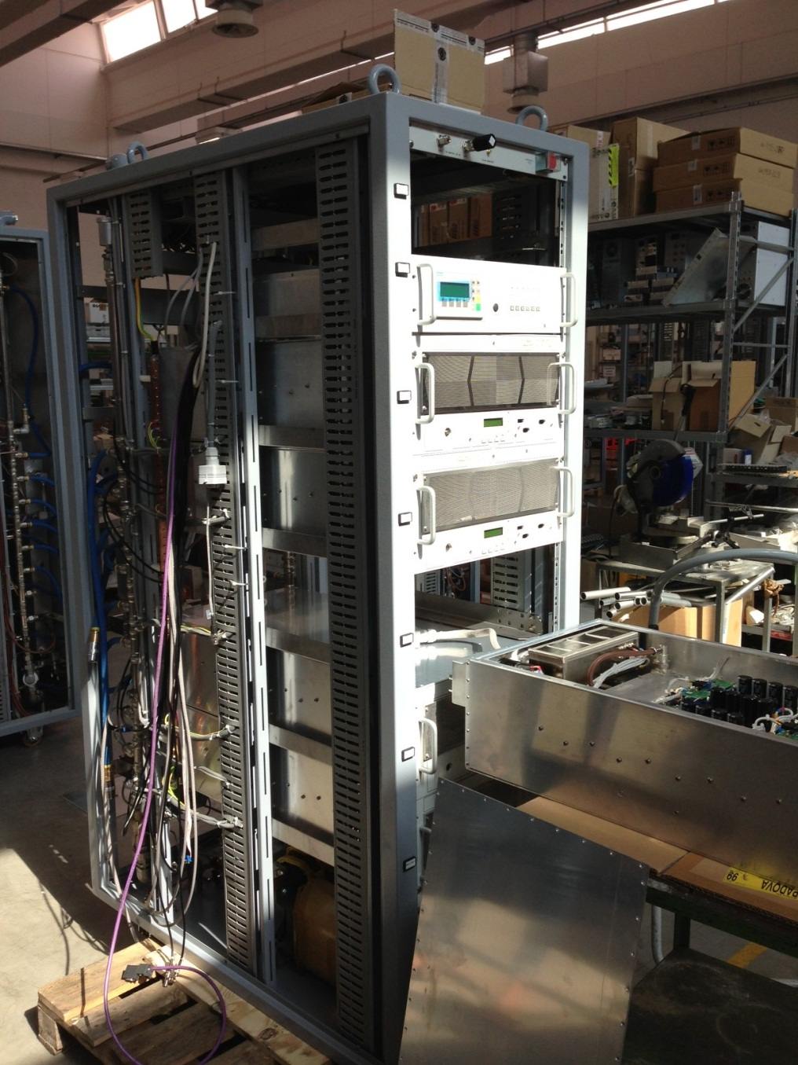
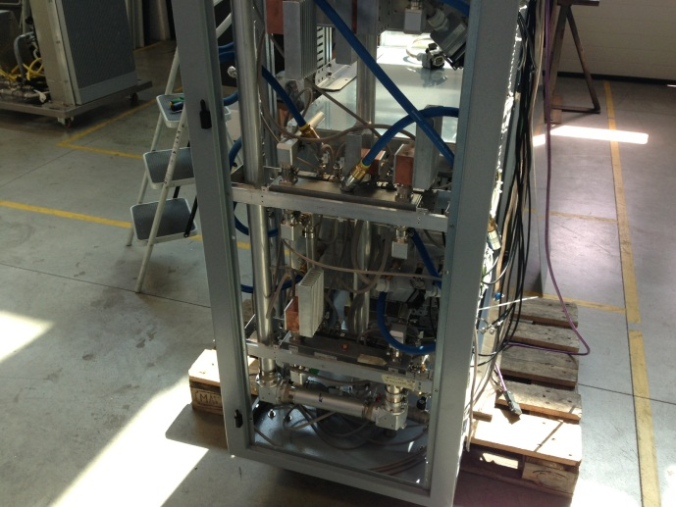
DB Power Amplifiers

Slide 13
Power Options | DB Italy |  | TOMCO Australia |  | CPC Amps USA
7.493kW | 8kW | £24,000 | 7.5kW | £37,800 | 7.5kW | £38.650
2.948kW | 4kW | £21,000 | 5.6kW Ch1: 3kW Ch2: 2kW | £29,300 | 3kW | £18,950
1.9415kW | 2.5kW | £18,000 |  |  | 2kW | £16,450
Total | £63,000 - 3% |  | £67,100 |  | £74,050
5.56kW | 6kW | £22,000 | 5.6kW | £21,100 | 6kW | £31,250
3.72kW | 4kW | £21,000 | 3.7kW | £18,800 | 4kW | £22,250
3.42kW | 4kW | £21,000 | 5.6kW Ch1: 3.6kW Ch2: 2.0kW | £29,300 | 4kW | £22,250
1.6kW | 2.5kW | £18,000 |  |  | 2kW | £16,450
Total | £82,000 |  | £69,200 |  | £92,200
10.31kW | 2x 6kW | £34,000 | 2x 5.6kW | £39,500 | 10.5kW | £47,700
9.52kW | 2x 6kW | £34,000 | 2x 5.6kW | £39,500 | 10.5kW | £47,700
4.54kW | 6kW | £22,000 | 5.6kW | £21,100 | 5kW | £26,350
2.86kW | 4kW | £21,000 | 3.0kW | £16,600 | 3kW | £18,950
Total | £111,000 |  | £116,700 |  | £140,700

Slide 14
The End…

