Slide 1
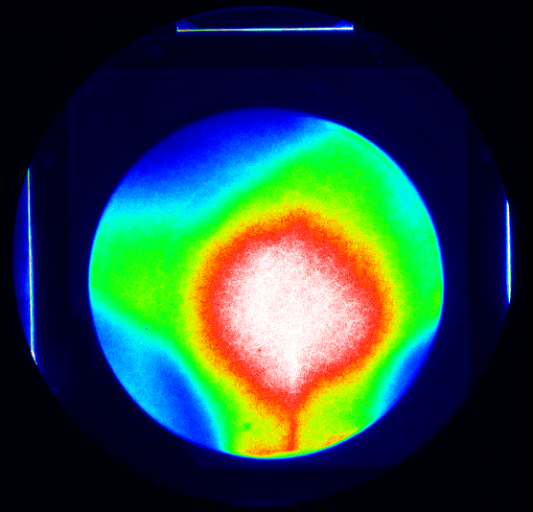
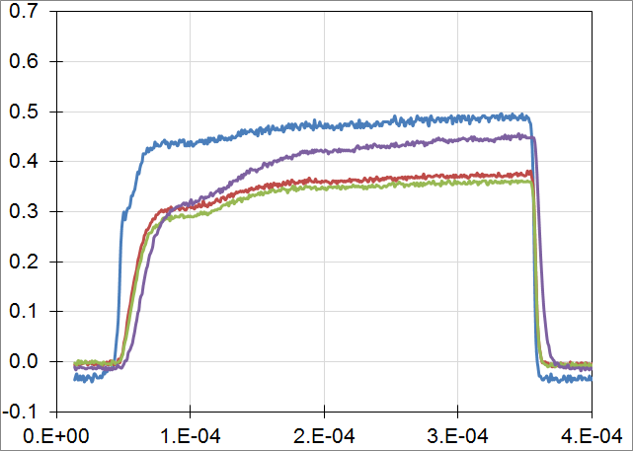
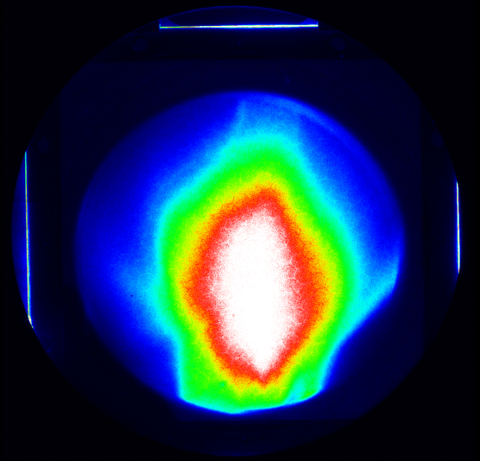
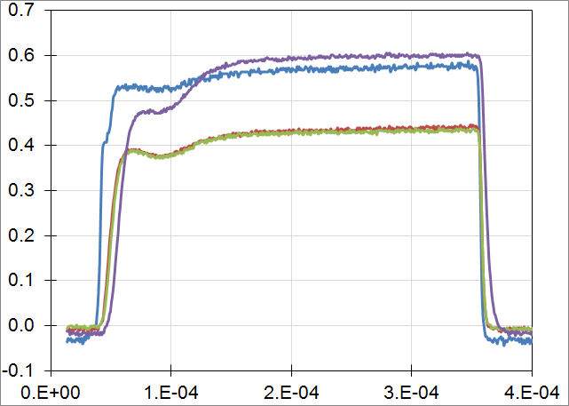
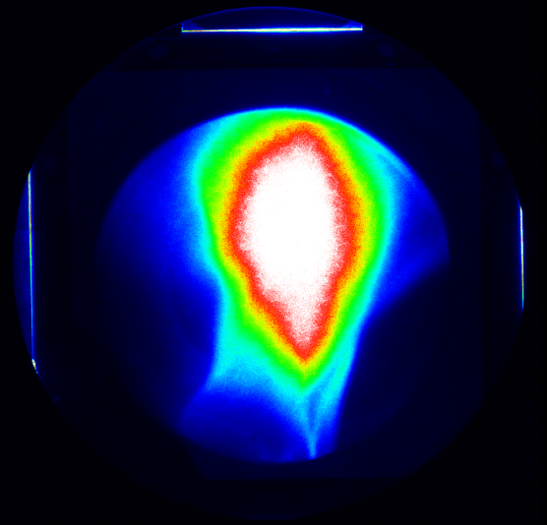
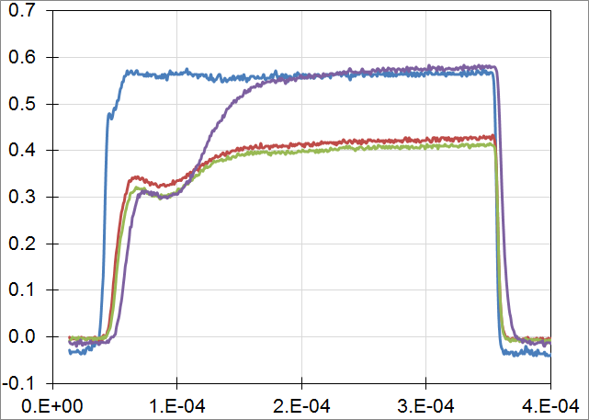
All data taken at 65kV
Sector mag. 11A
U_ext 18kV
(2014-04-25.spe)
Sector mag. 13A
U_ext 21kV
(2014-04-39.spe)
Sector mag. 15A
U_ext 22kV
(2014-04-50.spe)

Slide 2
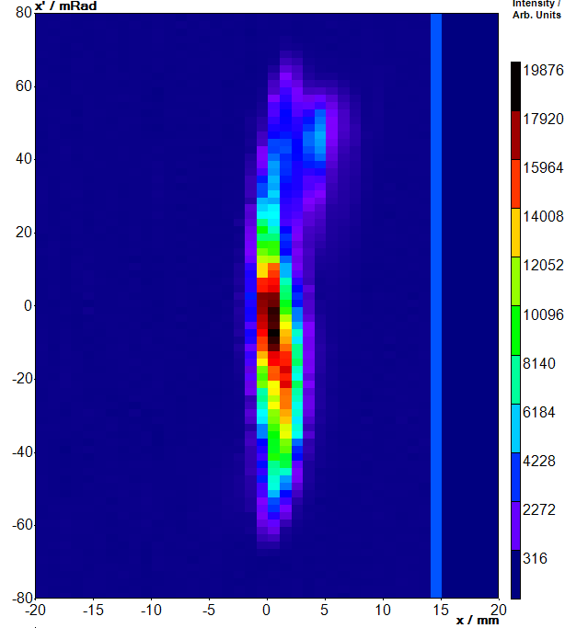
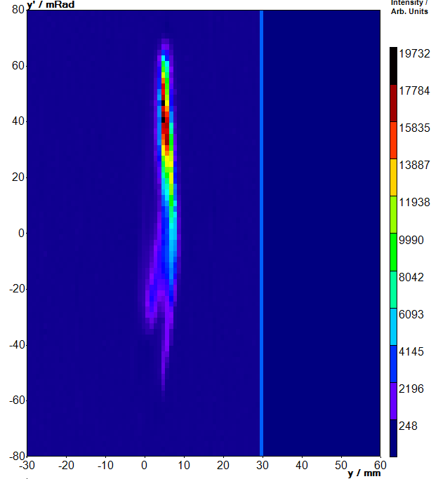
11A, 18kV ext. voltage

Slide 3
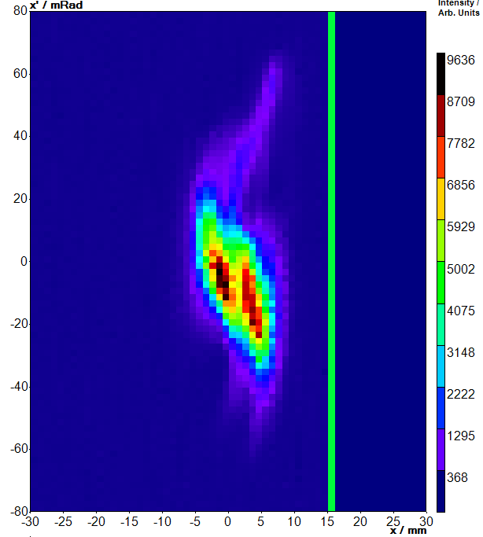
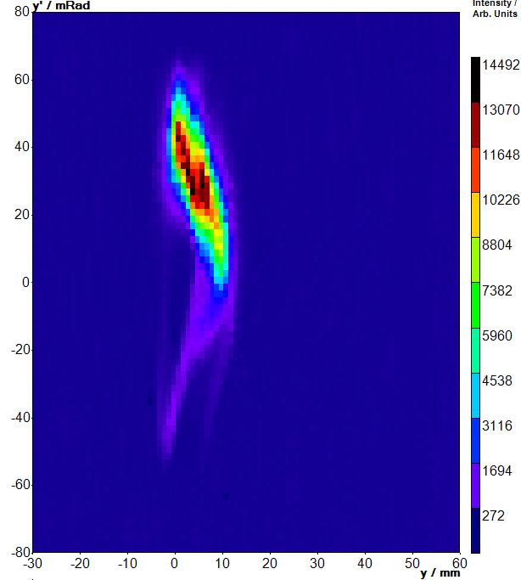
13A, 21kV ext. voltage

Slide 4
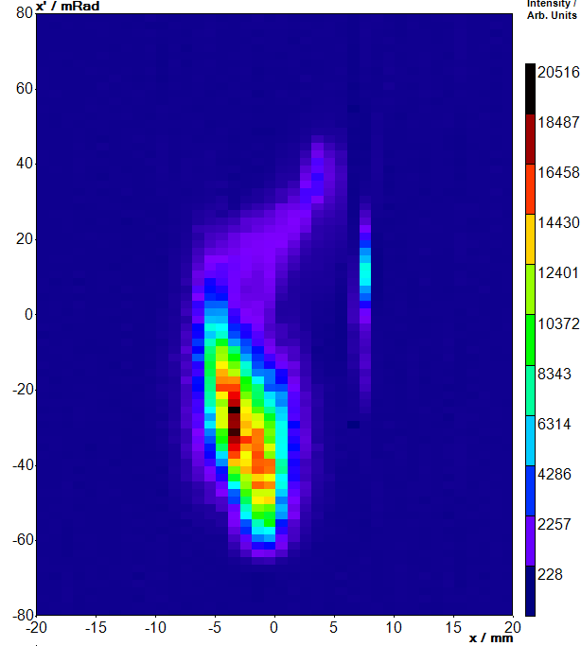
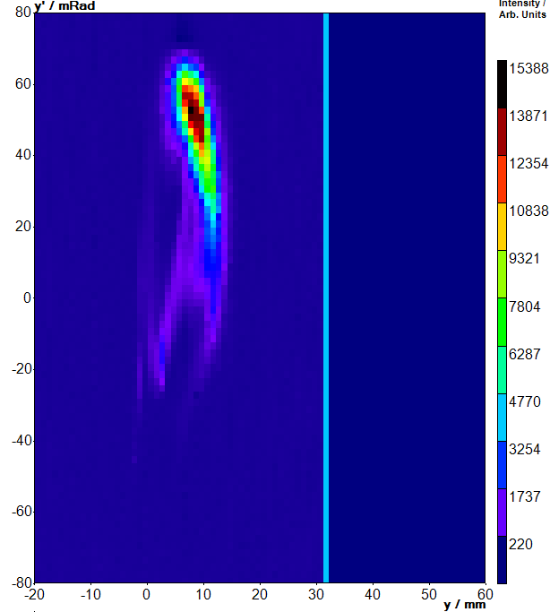
15A, 22kV ext. voltage

Slide 5
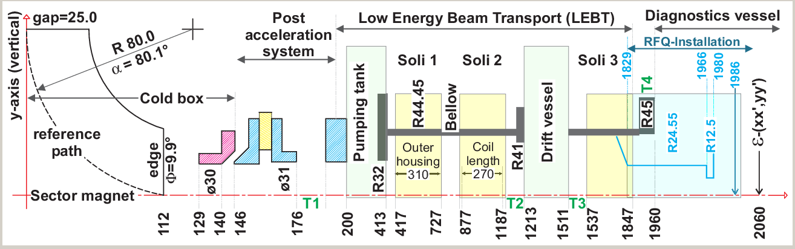
Highest measured current – Narrow extraction (Chinese).

Slide 6
Table of rms-emittance and twiss parameters.
11A, 18kV | V | rms-emi, norm 3.45 | alpha-twiss 0.428 | beta-twiss 0.359
 | H | 1.877 | -0.078 | 0.176
13A, 21kV | V | 0.343 | 1.079 | 0.352
 | H | 1.996 | 0.011 | 0.246
15A, 22kV | V | 3.208 | 0.778 | 0.387
 | H | 0.464 | 0.072 | 0.159

