Slide 1
FETS Meeting
Investigation of Extinction
When both choppers are on

Slide 2
MEBT lattice is now finalized.
Consists of 7 Quads, 3 cavities, 2 choppers and 2 beam dumps in 4.4 meters.
Transmission (above 99%) and Extinction(above 99%) seem satisfactory enough.
Emittance growths seem reasonable.
field maps for the Cavities and Quadrupoles have been prepared.
A document with detailed information is being prepared.
The GPT input file and particle distribution at z=4.4 m were uploaded in the FETS website.

Slide 3
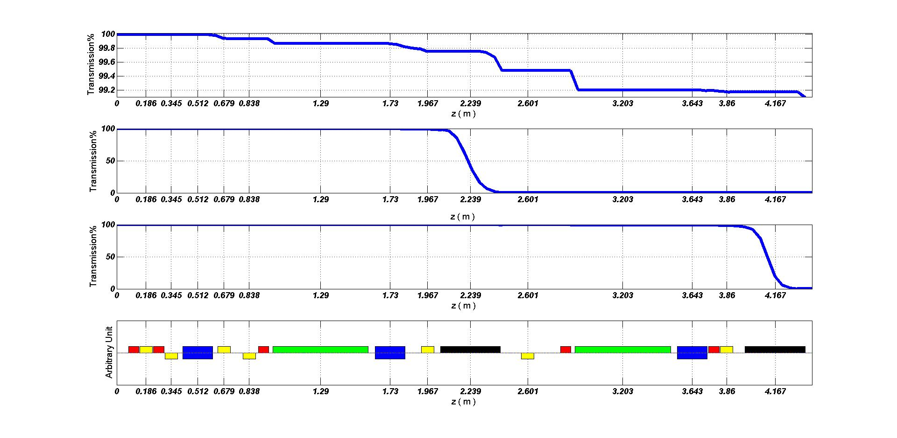
MEBT Status

Slide 4
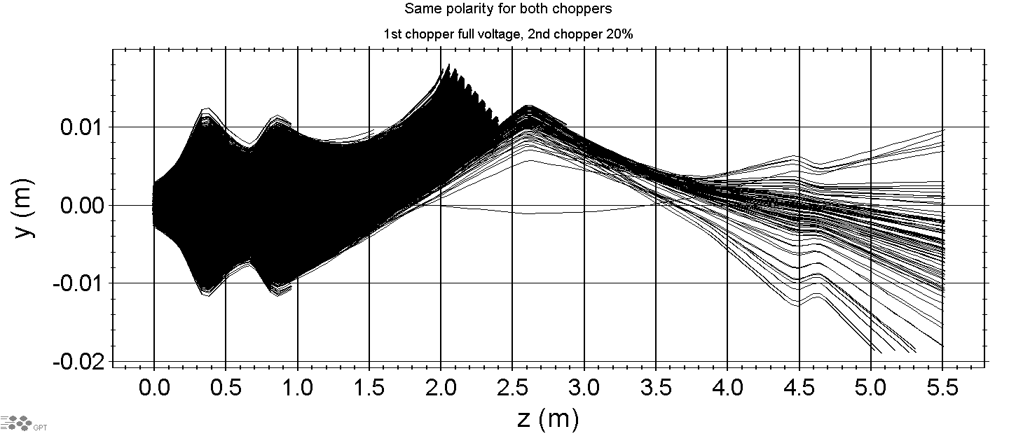
422 particles remain

Slide 5
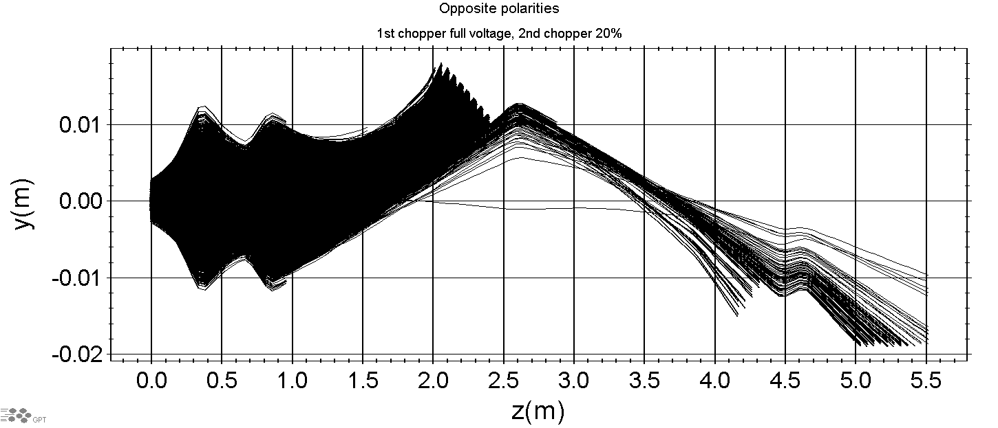
422 particles remain

Slide 6
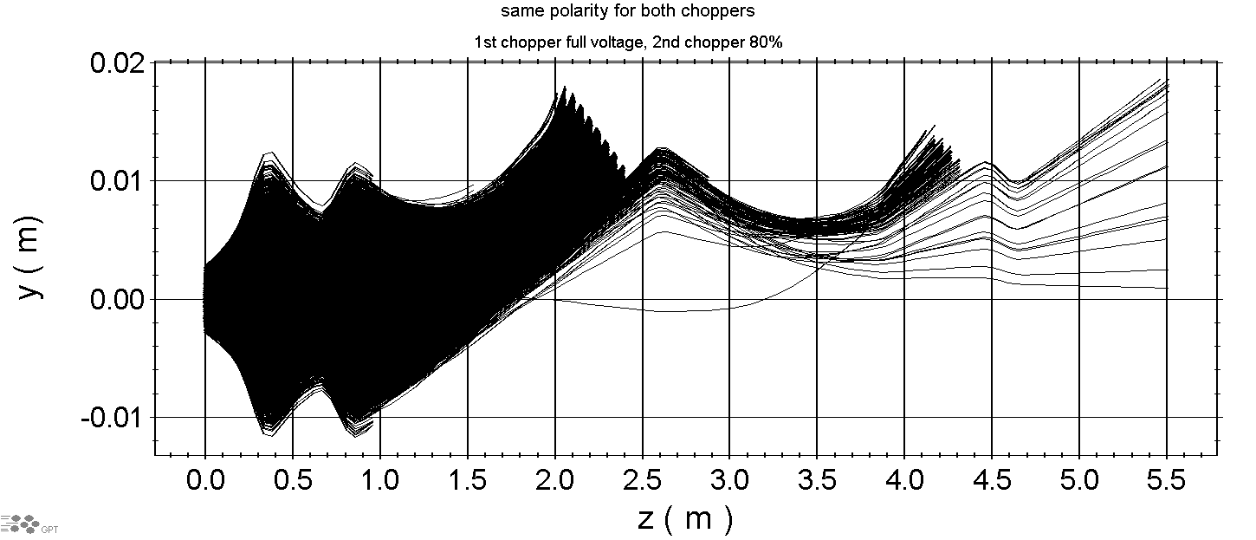
91 particles remain

Slide 7
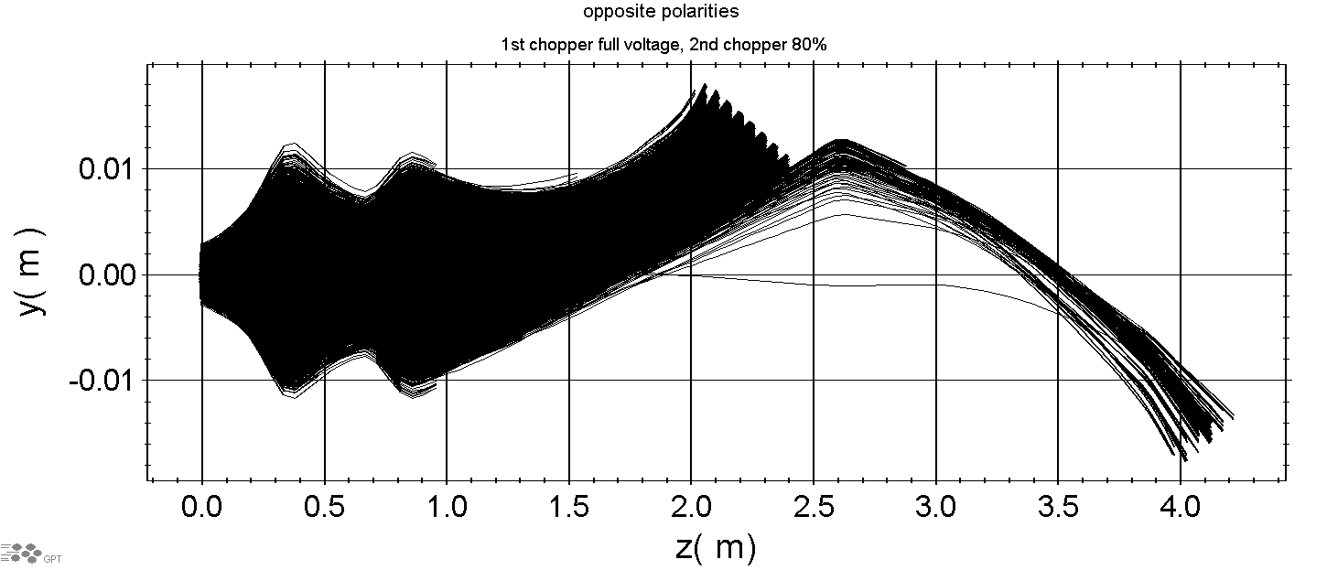
No particles remain

Slide 8
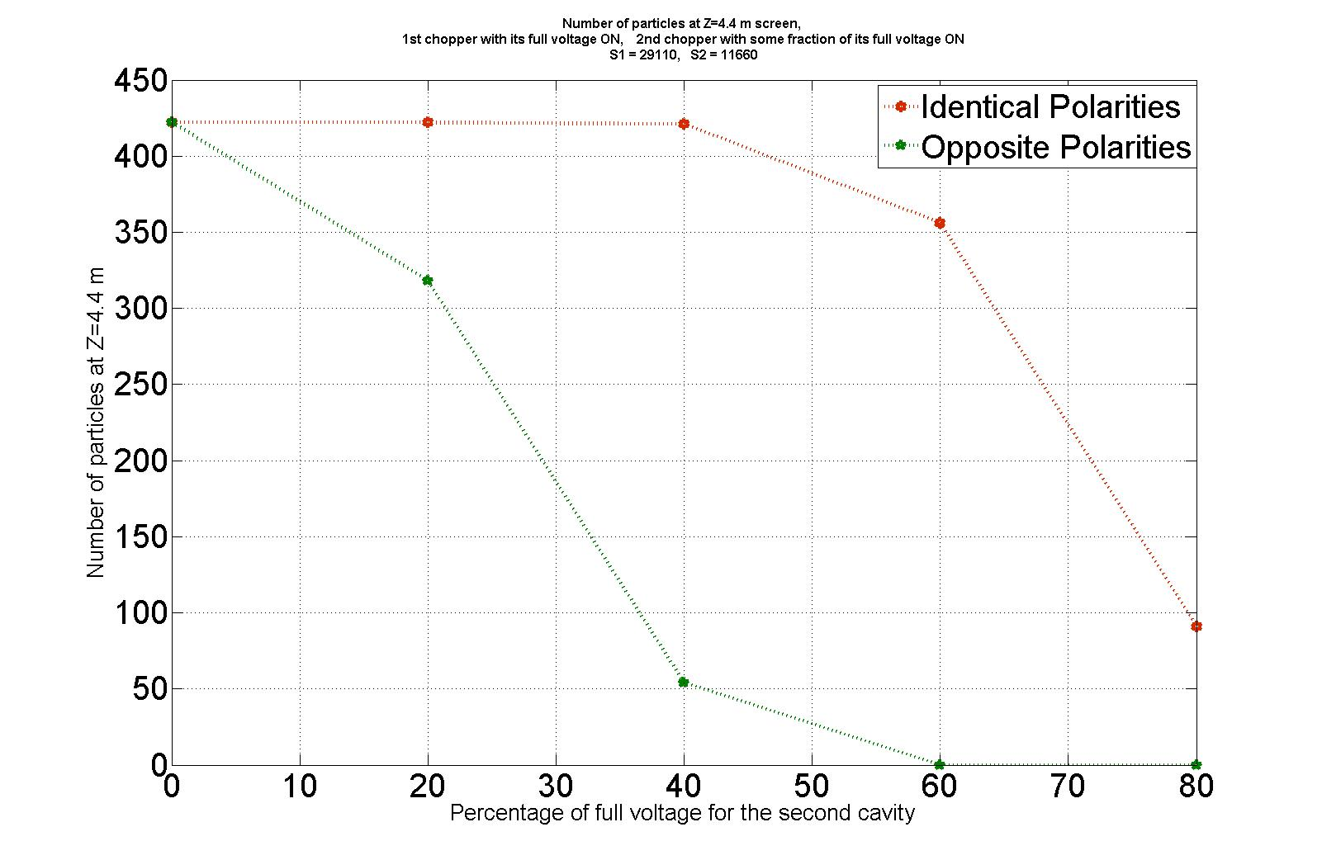

Slide 9
It seems that opposite polarities and a downward shift for the second dump are advantages.
More precise simulation for 10%,30% , 50% and 70% of the 2nd voltage are ongoing.
Thank You

