Slide 1
RF System Updates
By
Saad Alsari
08 May 2013

Slide 2
Circulator 60 Watts Test Plan
The Signal generator and the 60 W amplifier would be collected from Imperial and installed at R8
Circulator test with the 60W power in to be performed testing the circulator performance with similar signal of the FETS RF system
Would need to use Directional couplers in order to investigate the power rates of forwarded and reflected power.
Dump loads been purchased recently as it would be needed in the 60W testing procedures
Testing plan need to be discussed to confirm required outcomes and results
Results of the test should be available in a fairly short time as all the settings and boxes with good transmission and reflection rates are in place

Slide 3
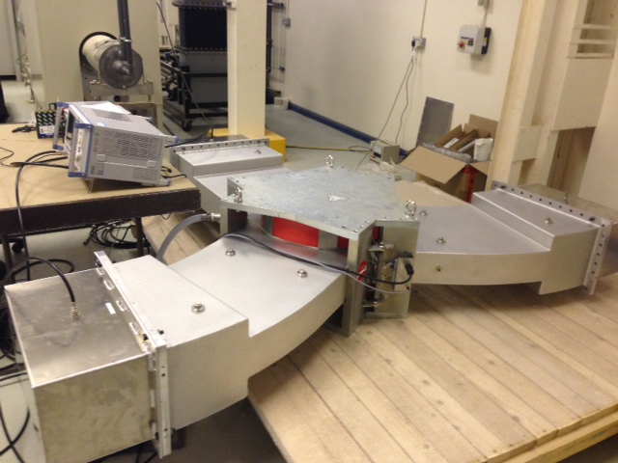

Slide 4
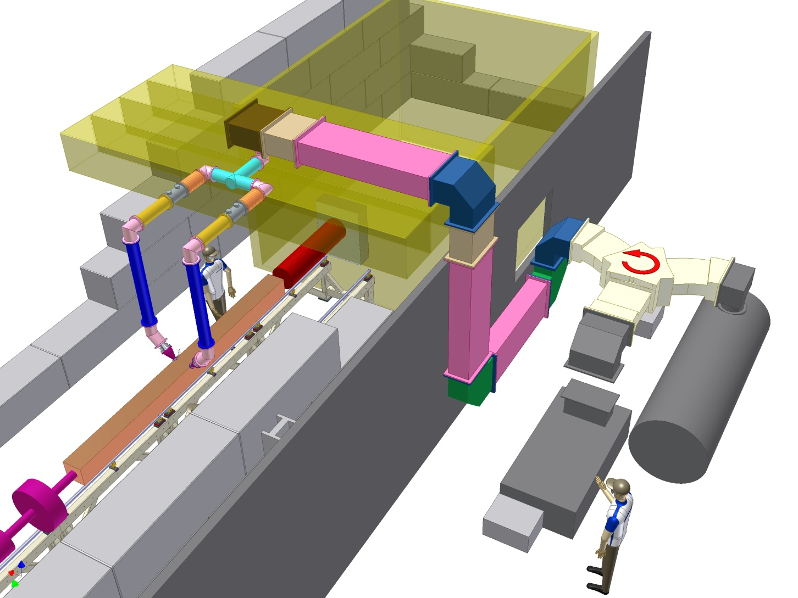
RF System Layout Options

Slide 5
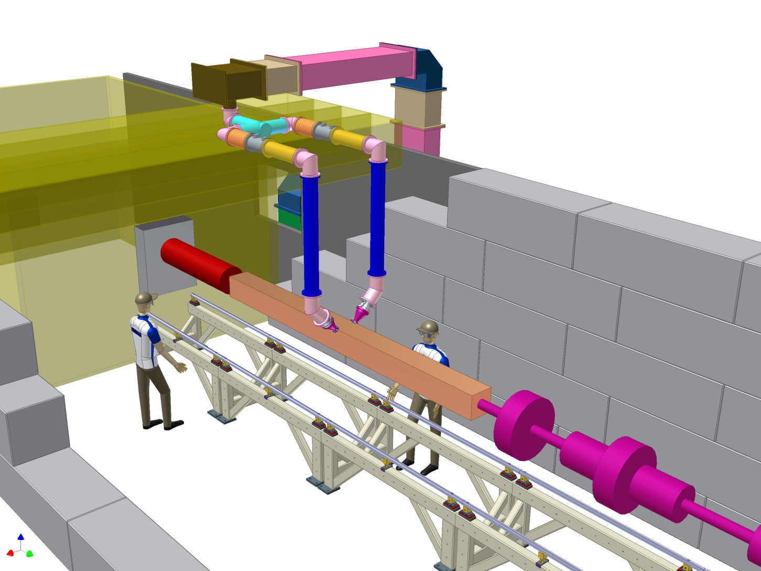
RF System Layout Options

Slide 6
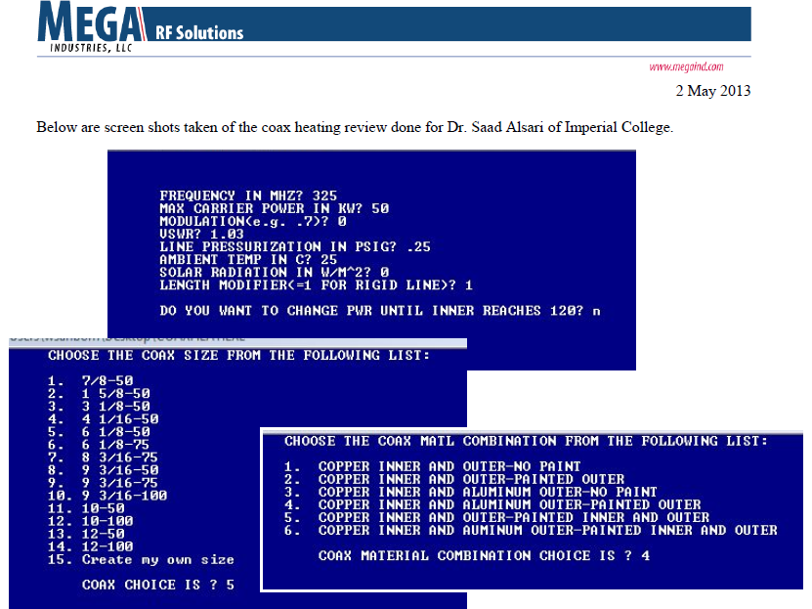
RF System Layout Options

Slide 7
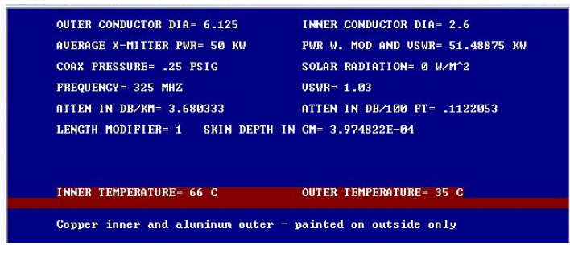
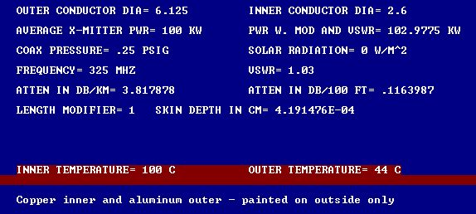
RF System Layout Options

Slide 8
RF System Power Loss Summary
I think that we should stick with what we agreed to have the waveguide running to a closest possible point before splitting the power as:
The coaxial line loss per metre is about 3 times the loss in the WR2300 waveguide.
The loss in the flexible coaxial cable (if we had to use any) would be around 2 times the loss in the rigged coaxial line (6 x waveguide loss).
The loss in the waveguide for our system would be around 1.43 Watts/foot. (4.7 Watts/Metre) (0.03 dB/100 feet) with few degrees temperature increase.
The loss in the coaxial line in our system would be around 3.22 Watts/foot. (10.6 Watts/Metre) (0.112 dB/100 feet) and should equalize at approximately +10C° above the ambient temperature.
I think these are reasonable figures to know what we would expect running the system in different configurations.

Slide 9
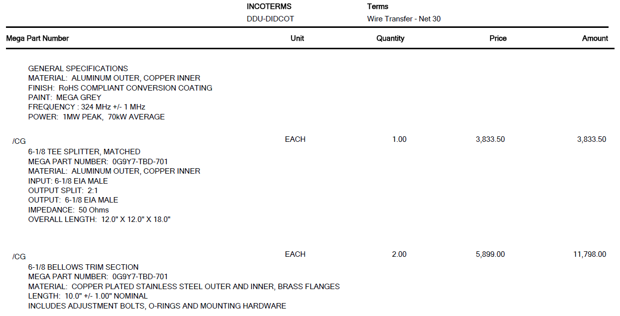
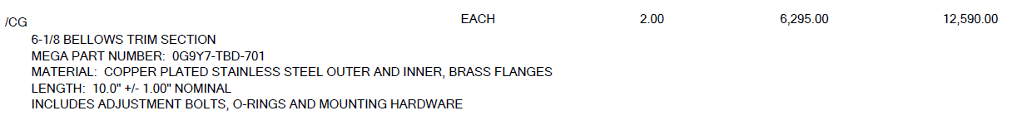
Orders and quotations

Slide 10
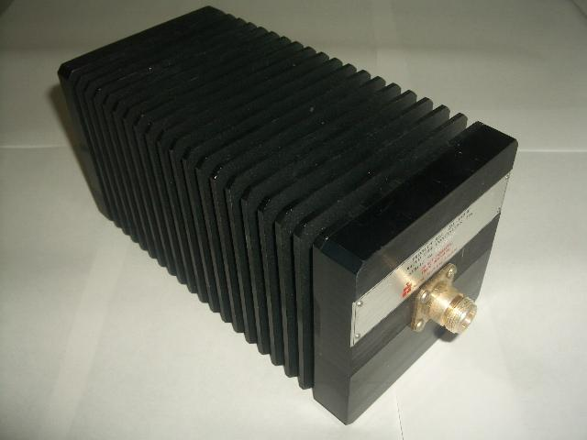
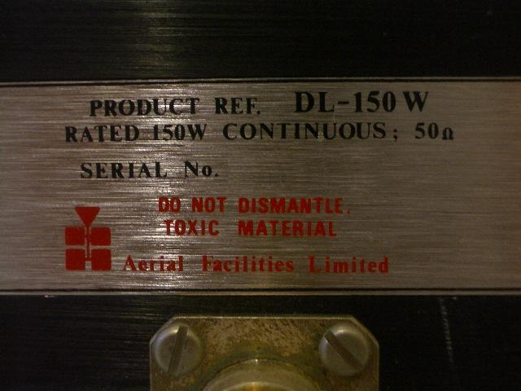
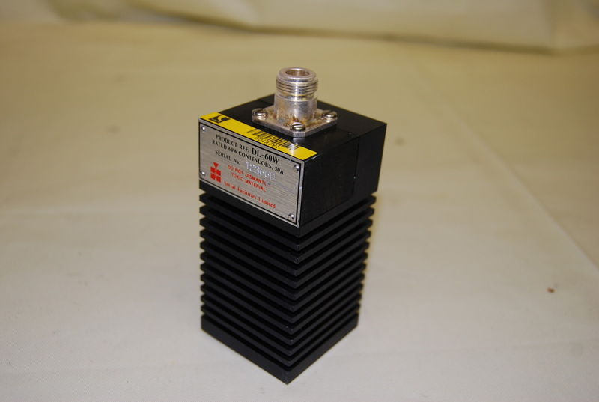
Orders and quotations
150 Watts Load
£53.88
60 Watts Load
£32

