Slide 1
MEBT
Elliptic nose cavities
Closer investigation 2

Slide 2
97651 particles through the MEBT using:
1-Elliptic nose cavity field map form Alan,
Cavity voltages: c1=92kV, c2=55kV, c3=55kV.
2-Quad field map from Scott.
New quad strengths (T/m) found using GPT optimisation routine based on having the highest number of particles at the end of the MEBT:
Bfac1 = -1.303e+001;
Bfac2 = 1.837e+001;
Bfac3 = -1.672e+001;
Bfac4 = 1.217e+001;
Bfac5 = -5.328e+000;
Bfac6 = 6.660e+000;
Bfac7 = -4.139e+000;
Qaud Positions were not changed from the last arrangement.

Slide 3
i) choppers off

Slide 4
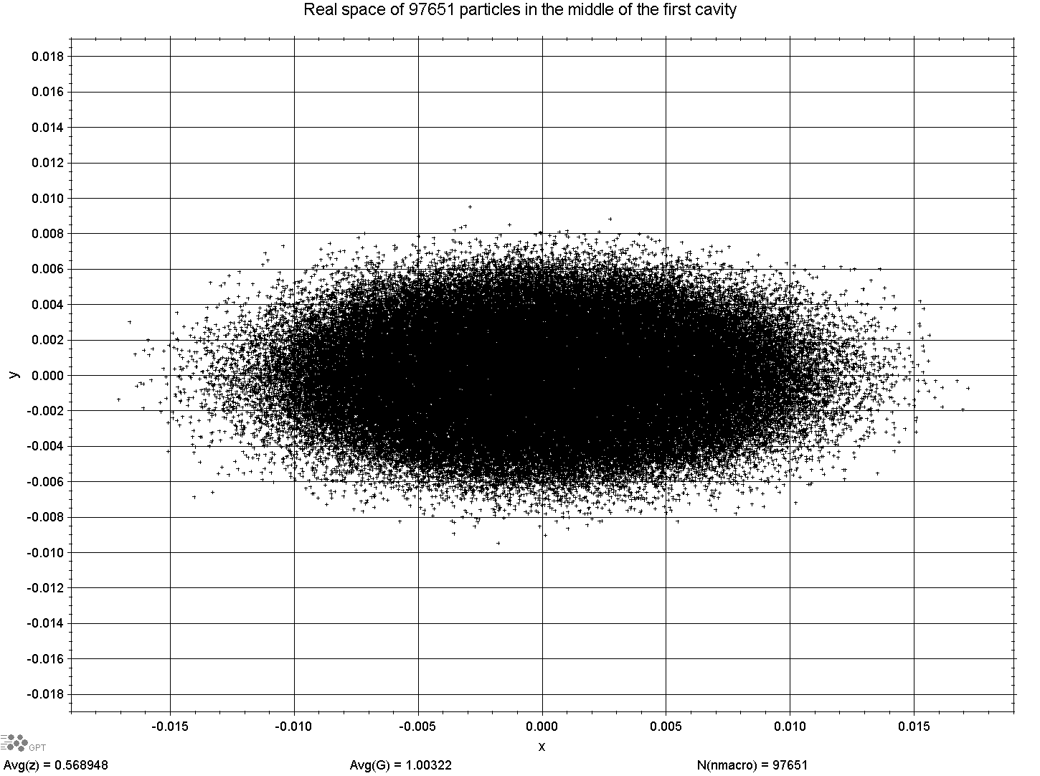

Slide 5
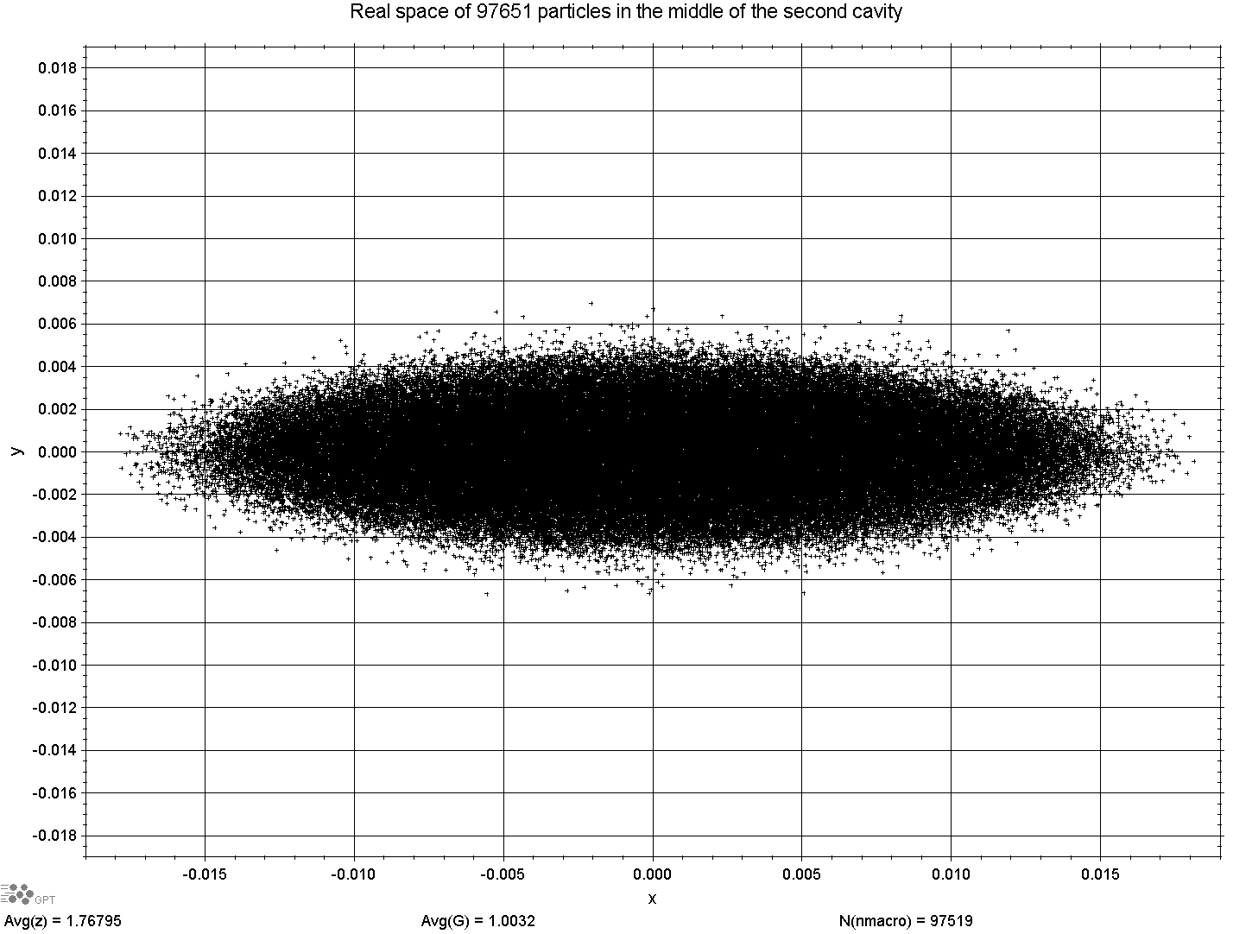

Slide 6
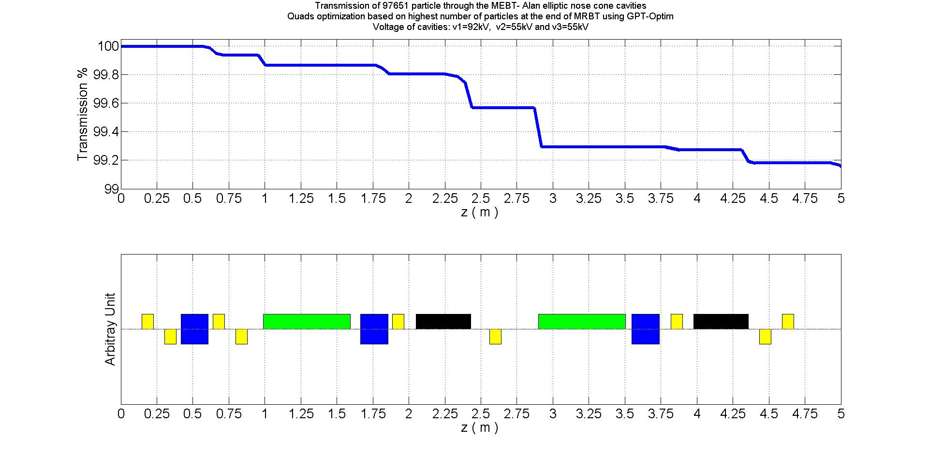

Slide 7
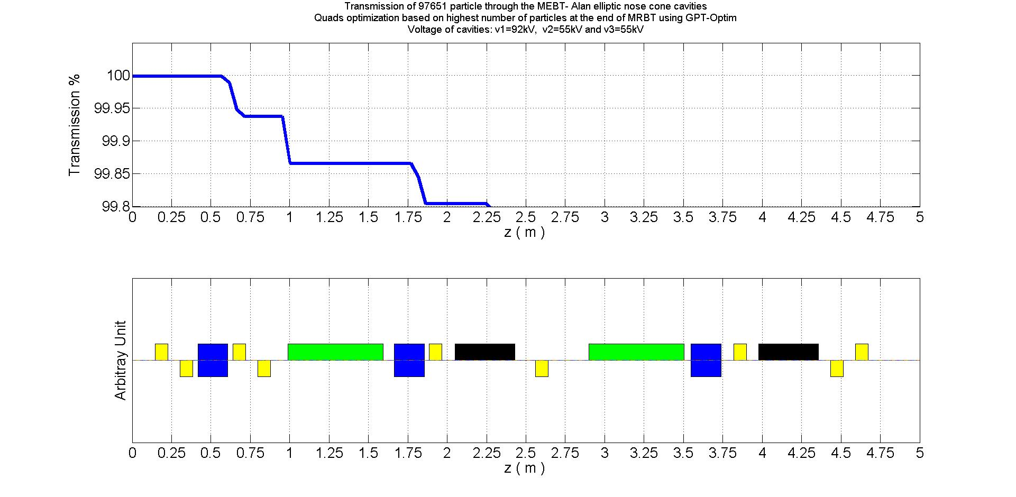

Slide 8
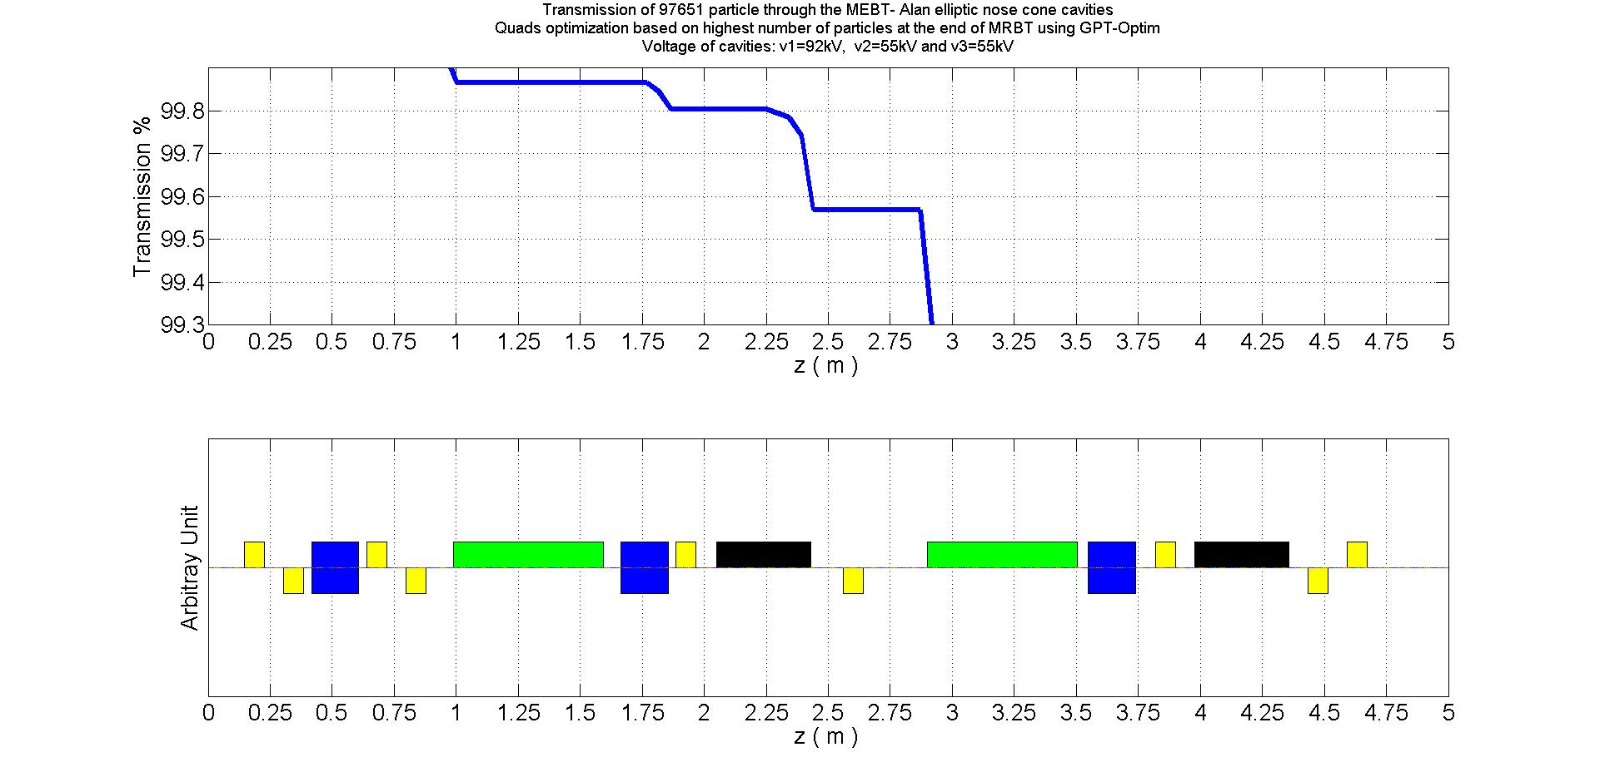

Slide 9
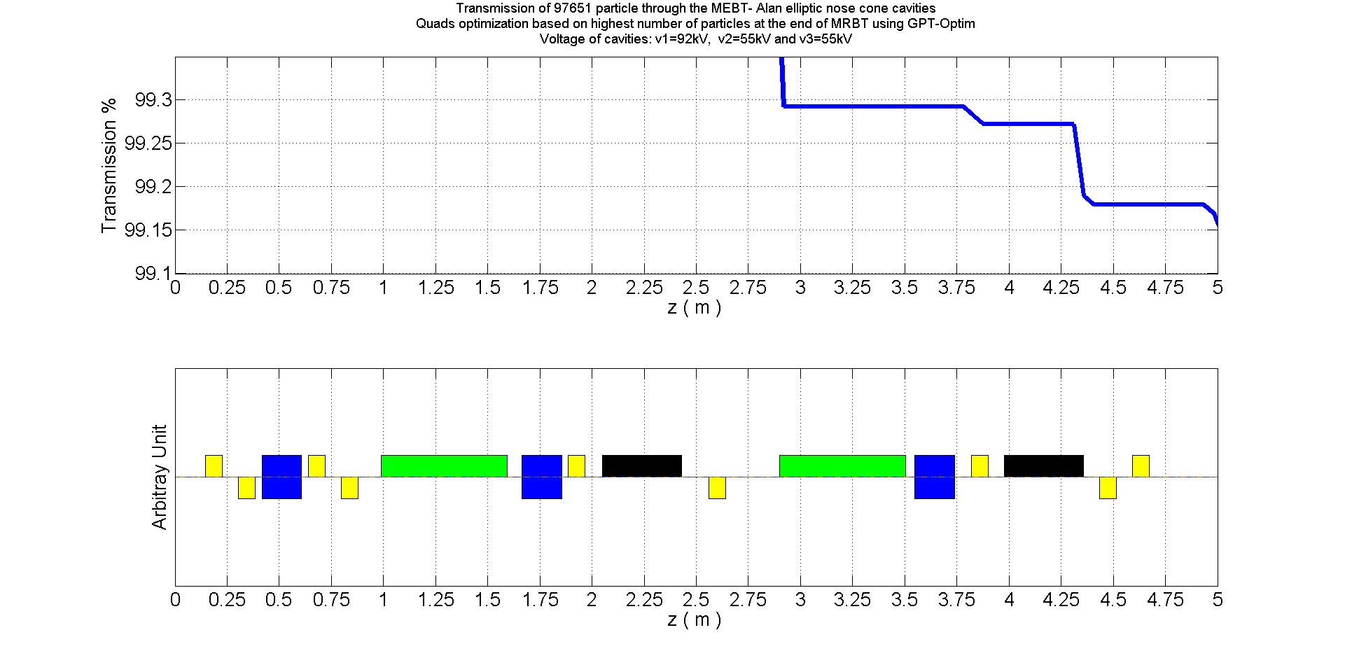

Slide 10
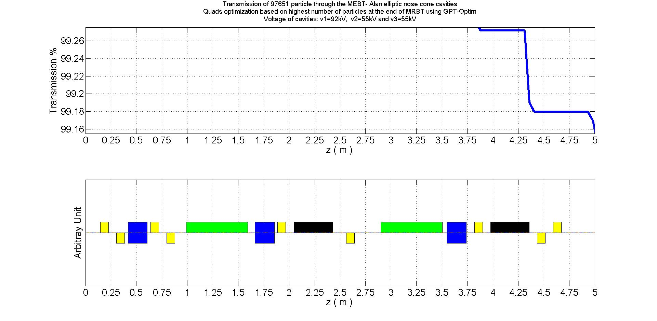

Slide 11
ii) First chopper switched on

Slide 12
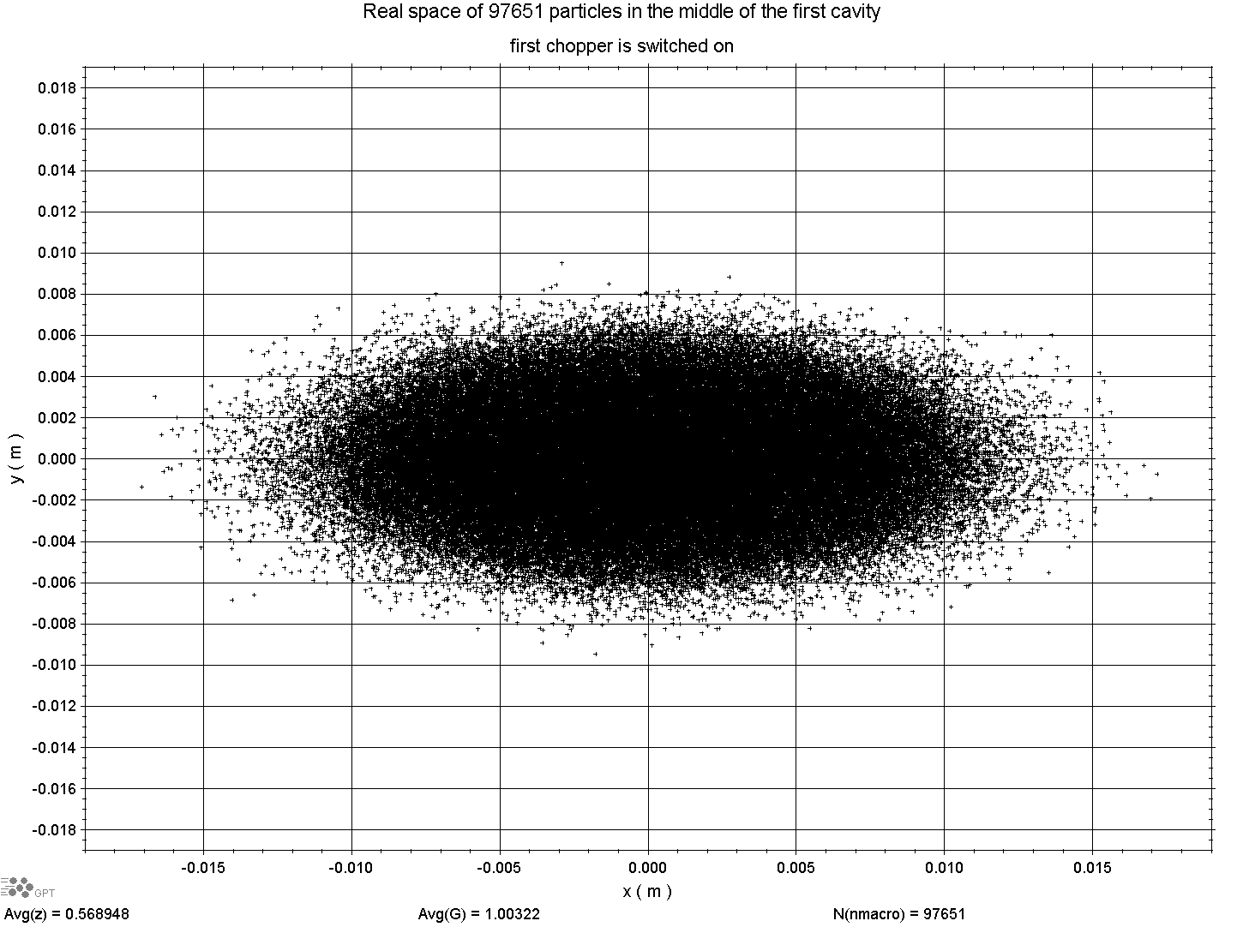

Slide 13
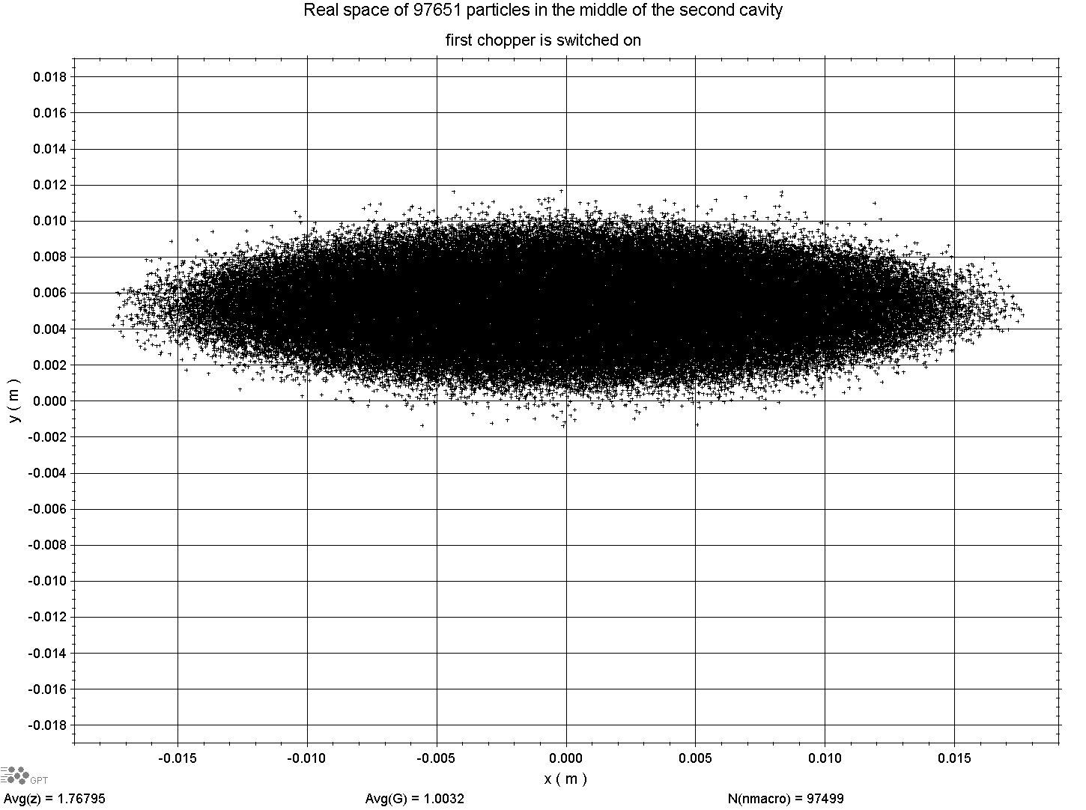

Slide 14
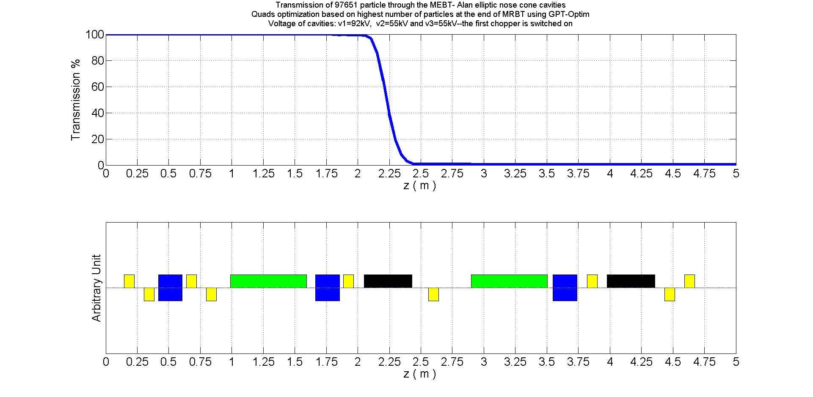

Slide 15
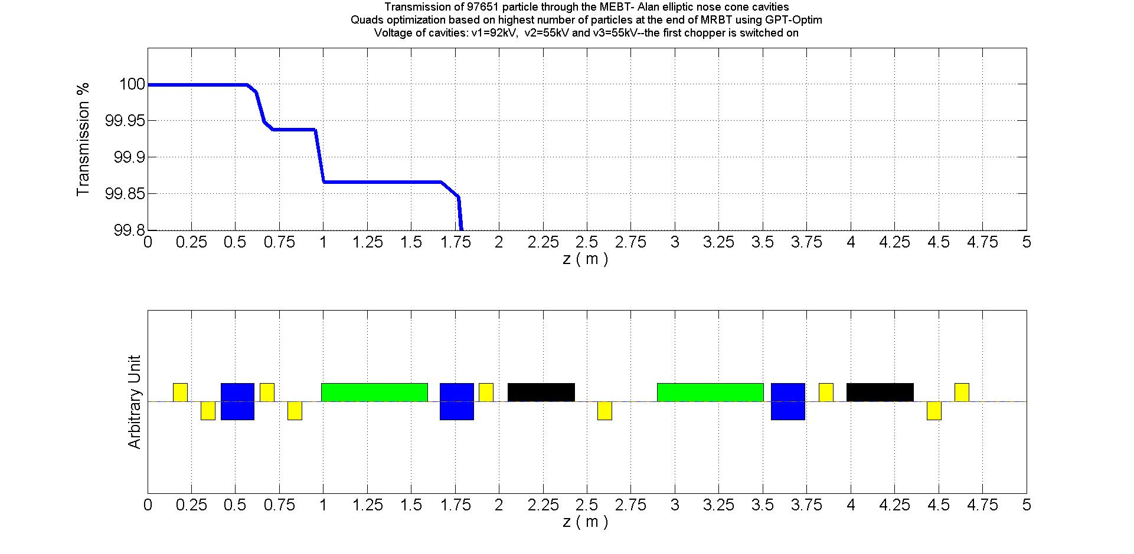

Slide 16
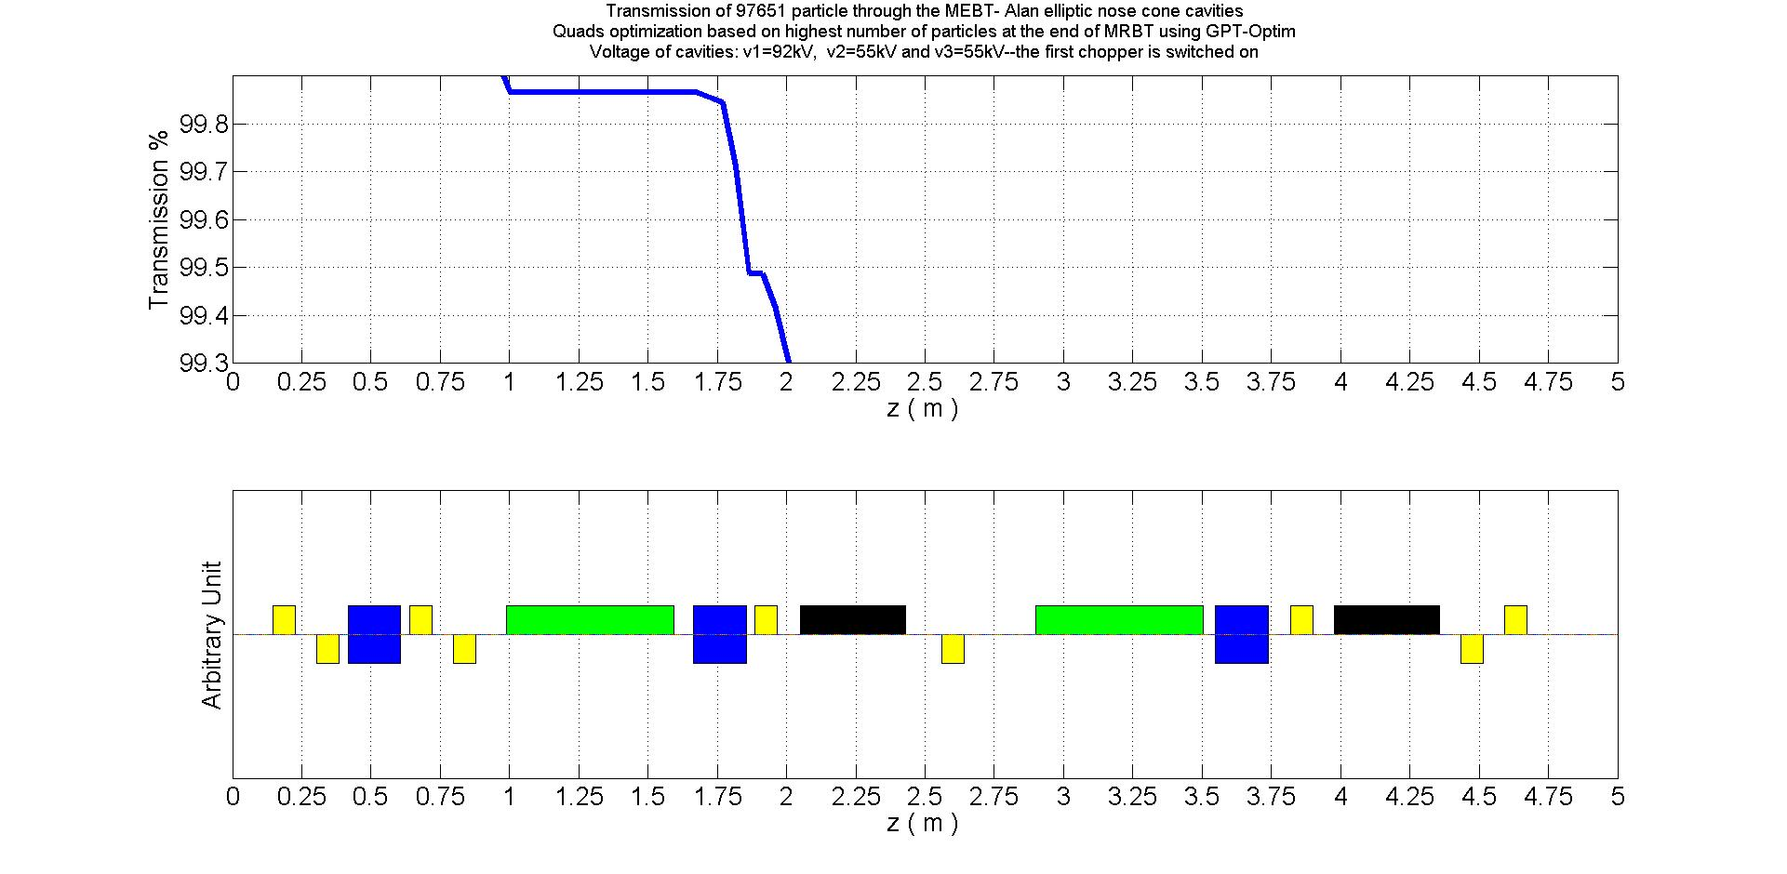

Slide 17
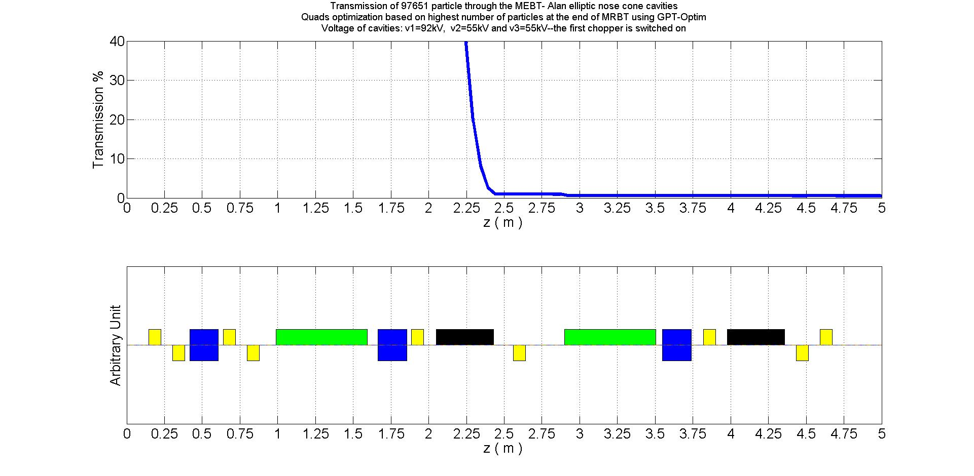

Slide 18
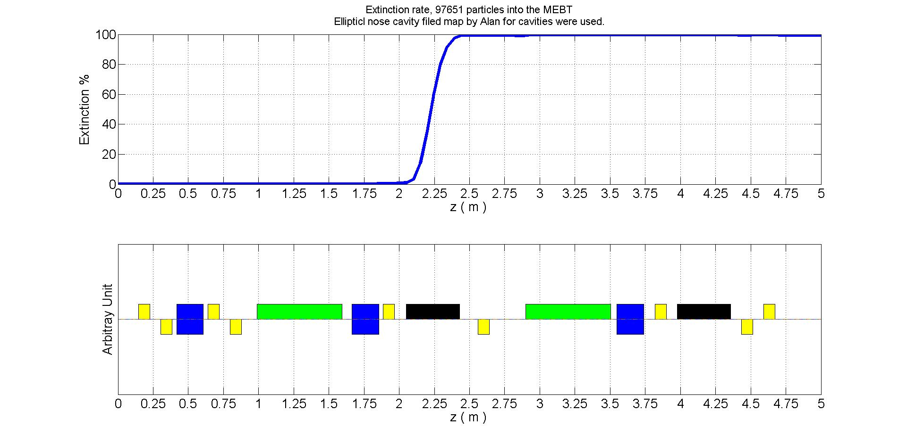

Slide 19
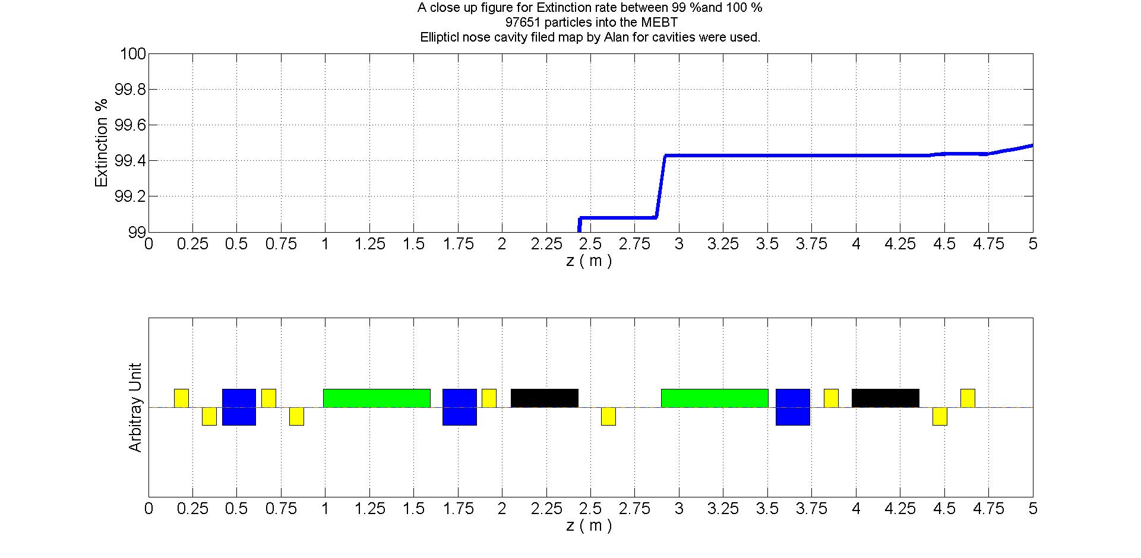

Slide 20
iii)2nd chopper on

Slide 21
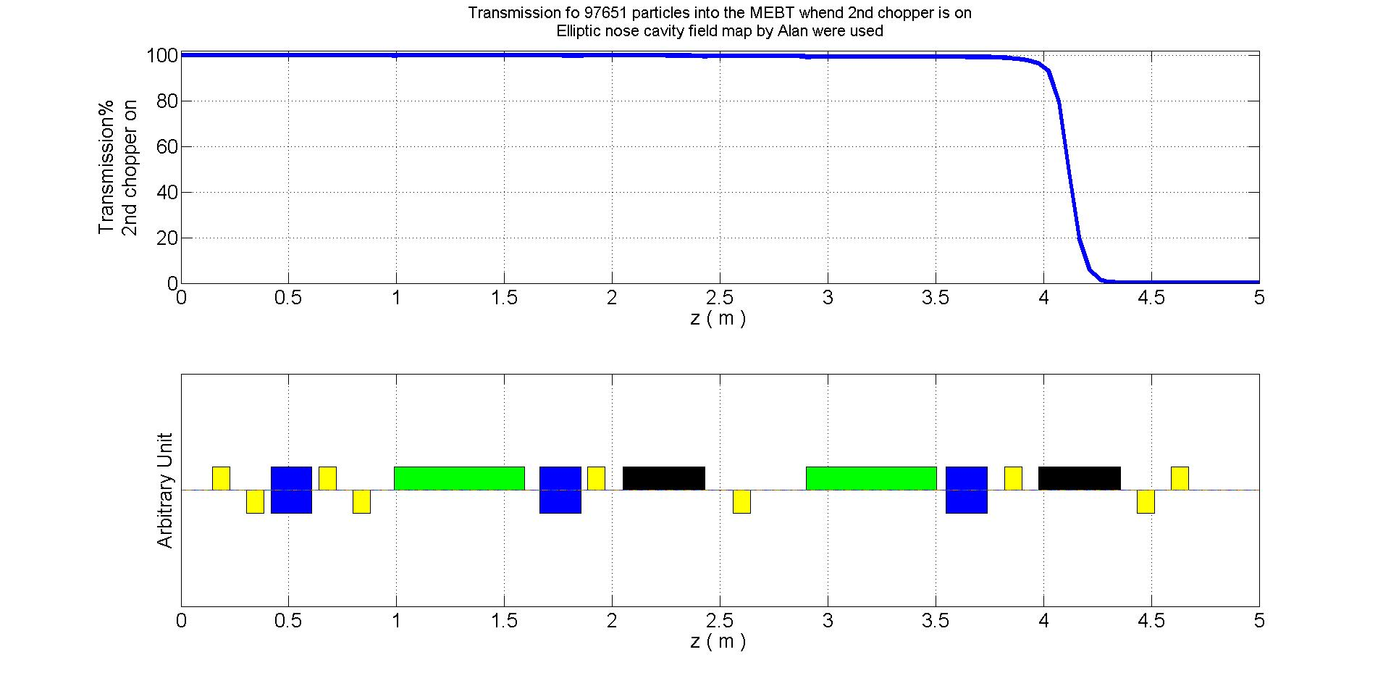

Slide 22
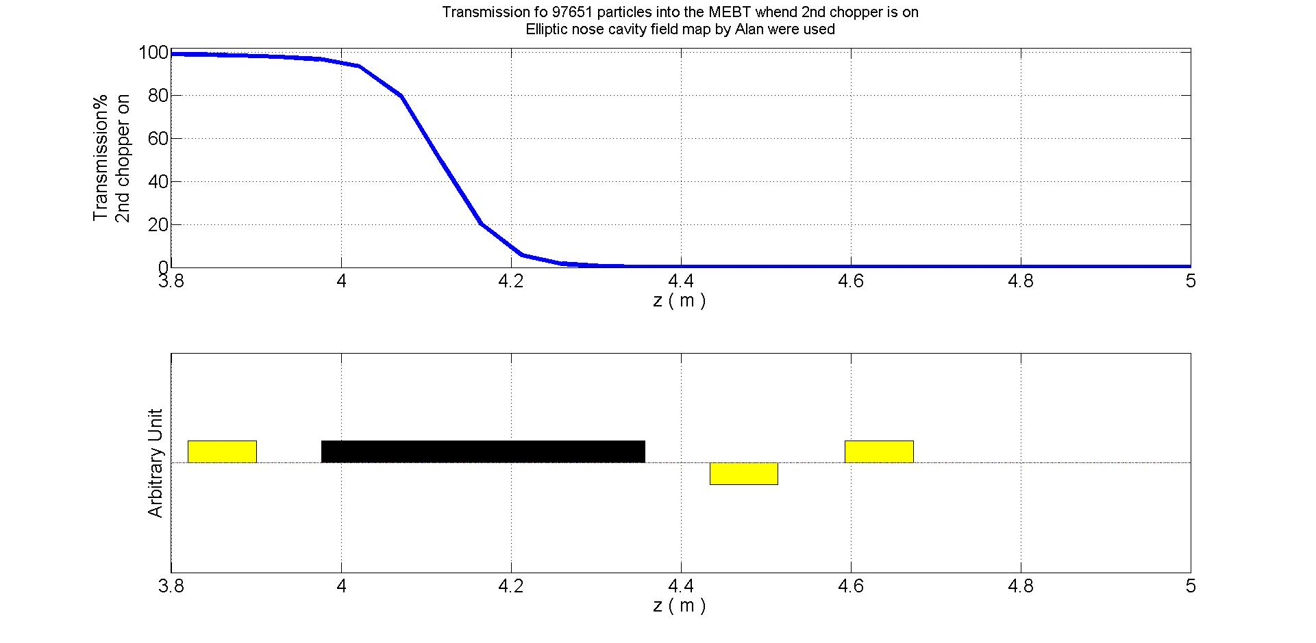

Slide 23
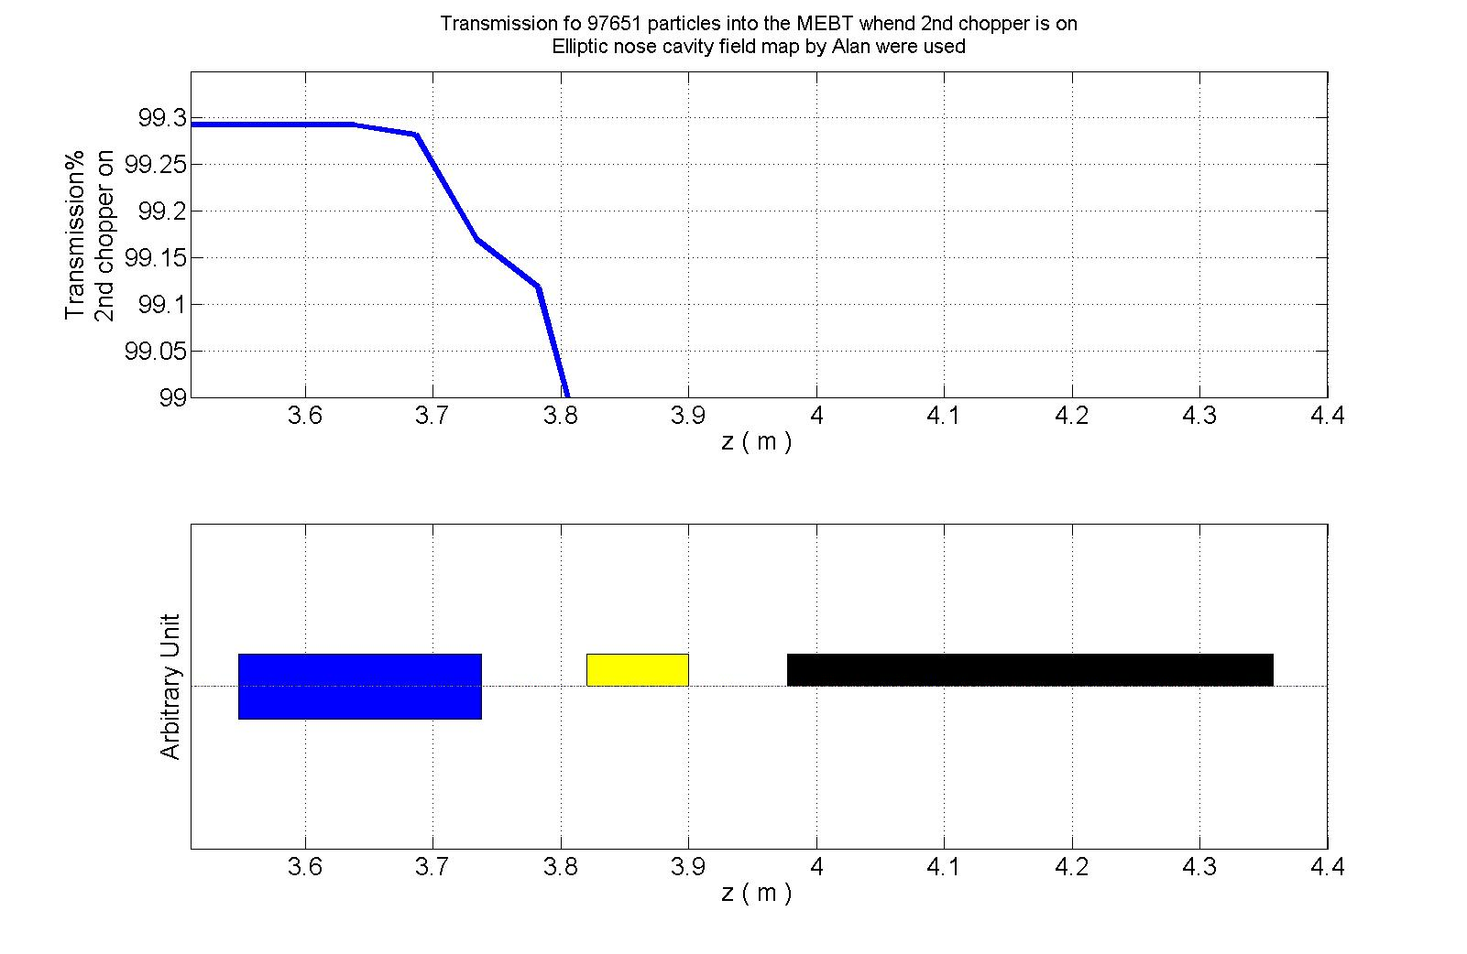

Slide 24
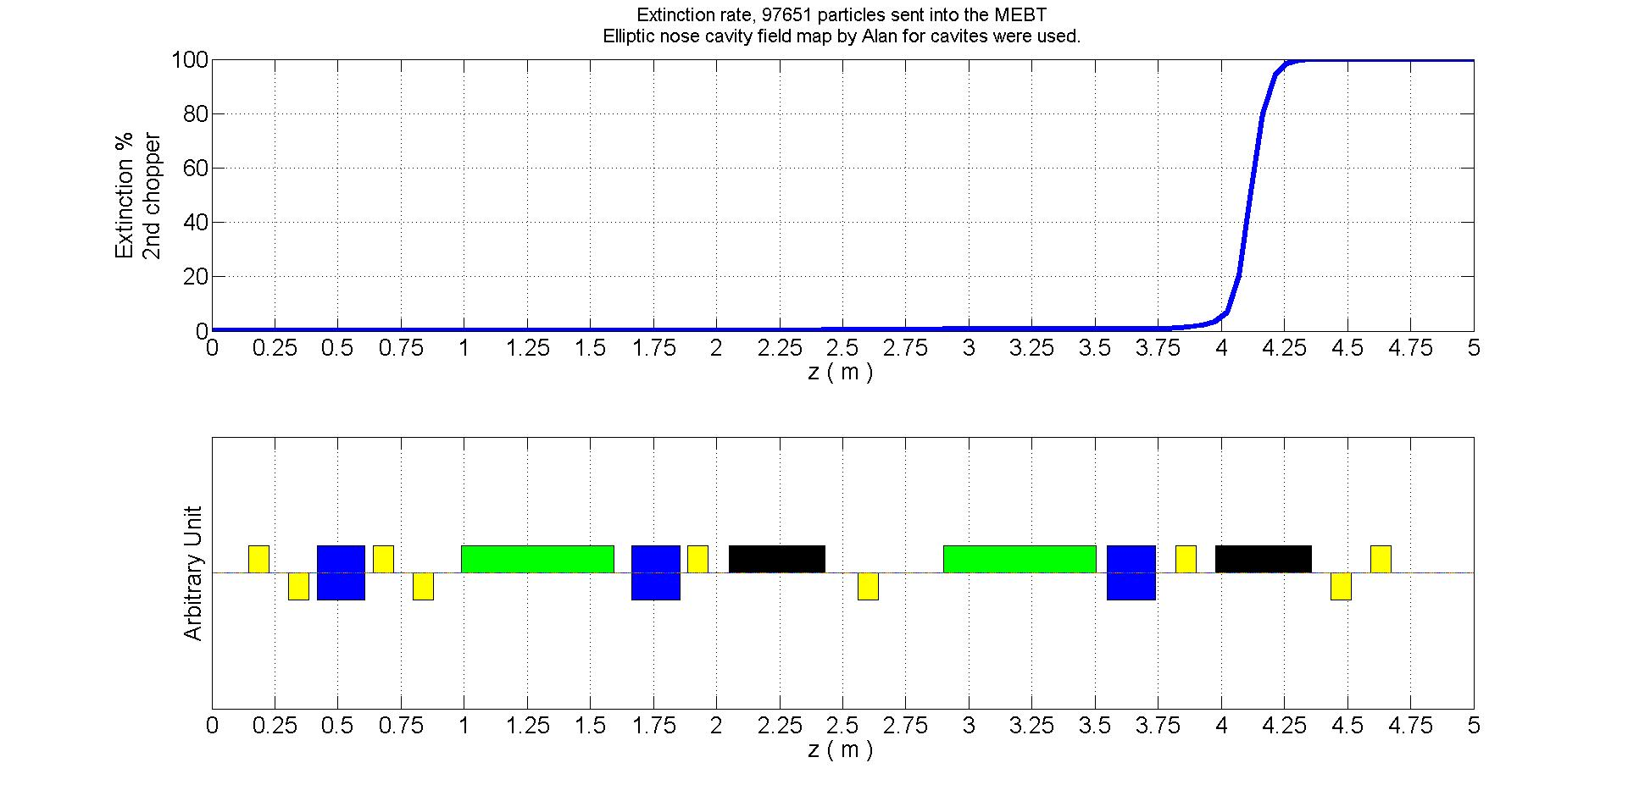

Slide 25
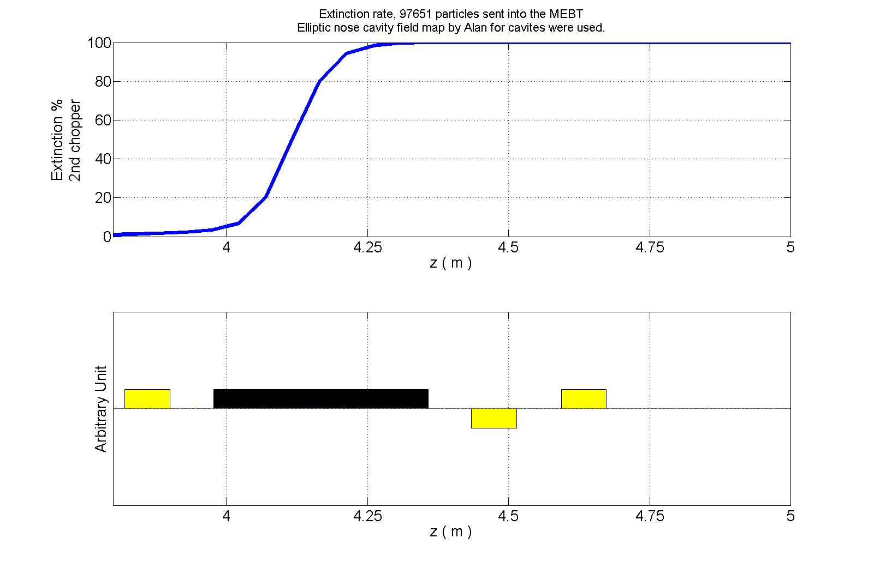

Slide 26
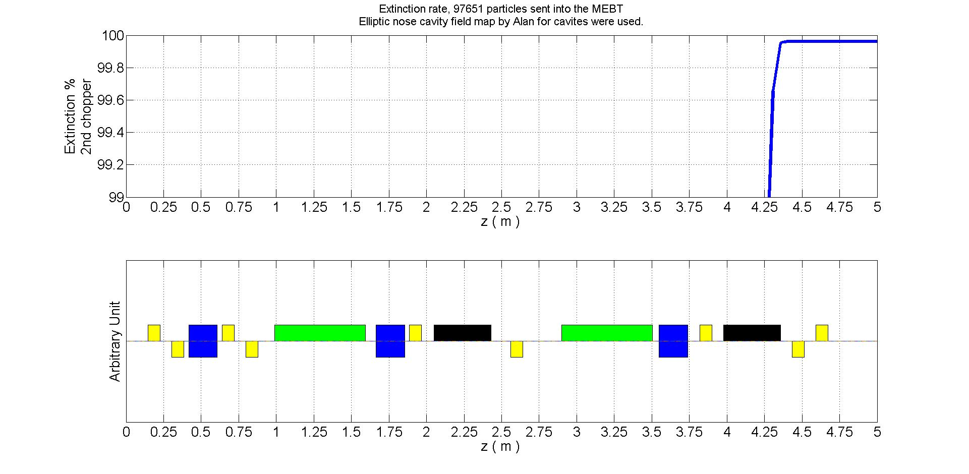

Slide 27
