Slide 1
MEBT Quadrupoles
Scott Lawrie
FETS Meeting
UCL, 8th May 2013

Slide 2
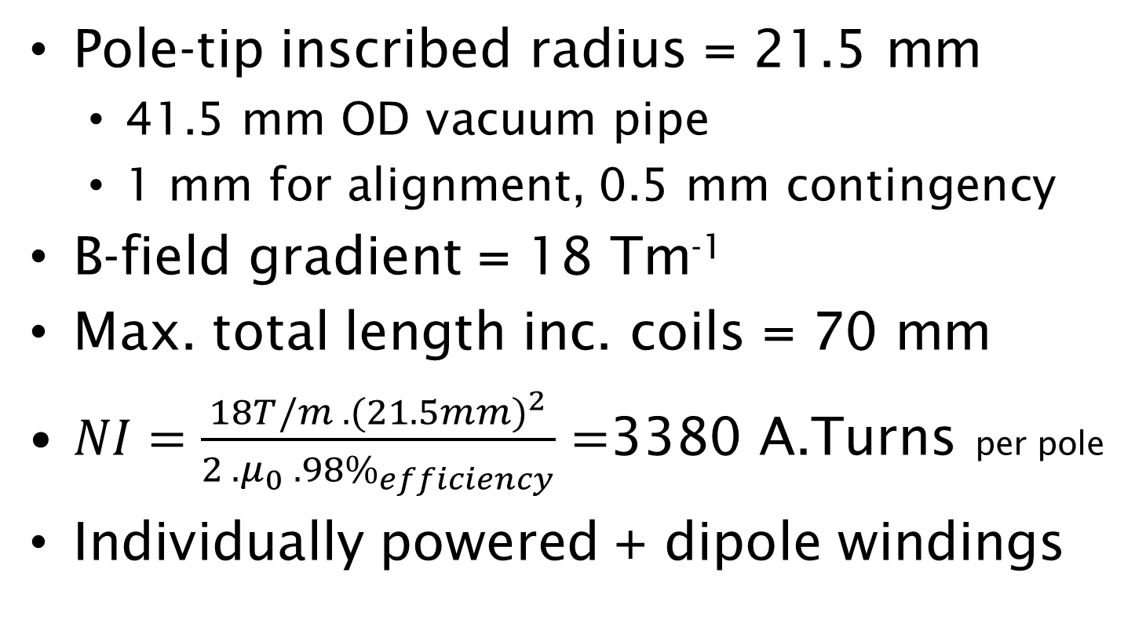
Quadrupole Specifications
Pole-tip inscribed radius = 21.5 mm
  41.5 mm OD vacuum pipe
  1 mm for alignment, 0.5 mm contingency
B-field gradient = 18 Tm⁻¹
Max. total length inc. coils = 70 mm
$NI=\frac{18T/m . {(21.5mm)}^{2}}{2 . μ_{0} . {98\%}_{efficiency}}=$3380 A.Turns per pole
Individually powered + dipole windings

Slide 3
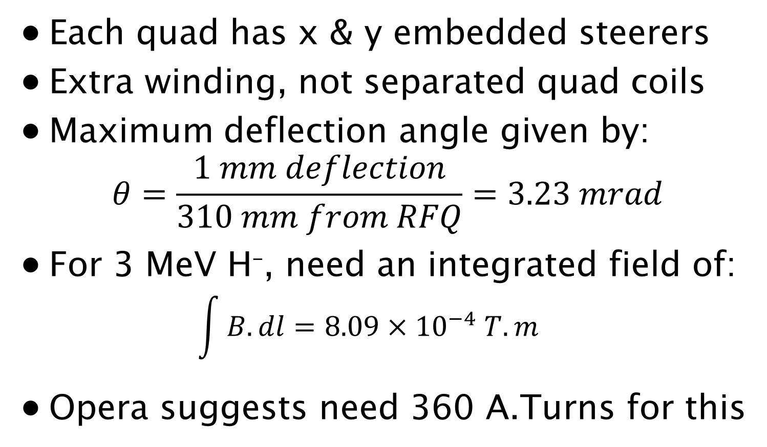
Dipole Winding Specs
Each quad has x & y embedded steerers
Extra winding, not separated quad coils
Maximum deflection angle given by:
$$θ=\frac{1 mm deflection}{310 mm from RFQ}=3.23 mrad$$
For 3 MeV H–, need an integrated field of:
  $$\int{B.dl}=8.09{×10}^{−4}T.m$$
Opera suggests need 360 A.Turns for this

Slide 4
Difficulties with Specs
Bore > 1/2 total length
  Fringe fields very important (2D insufficient)
  Difficult to ensure good field quality
70 mm total length includes coils
  Very little space for coils: Need few # turns
Individually powered + dipole windings
  Possibly £££ on power supplies alone
  Power ∝ Current Density
  Allow space for dipole windings

Slide 5
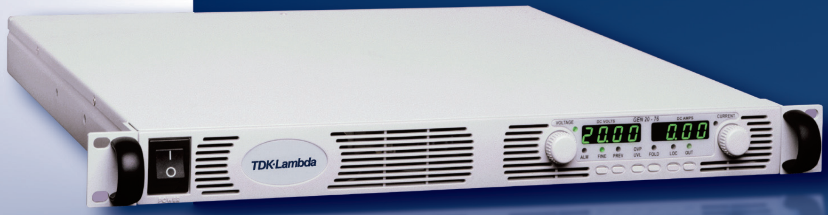
Power Supplies
TDK-Lambda Genesys 6-200
200 A, 6 V → 1200 W in 1U chassis
Same family as used on ISIS linac quads
£1,405 base price + multi-buy discount
→ 18 turns of (5x5)mm² hollow conductor

Slide 6
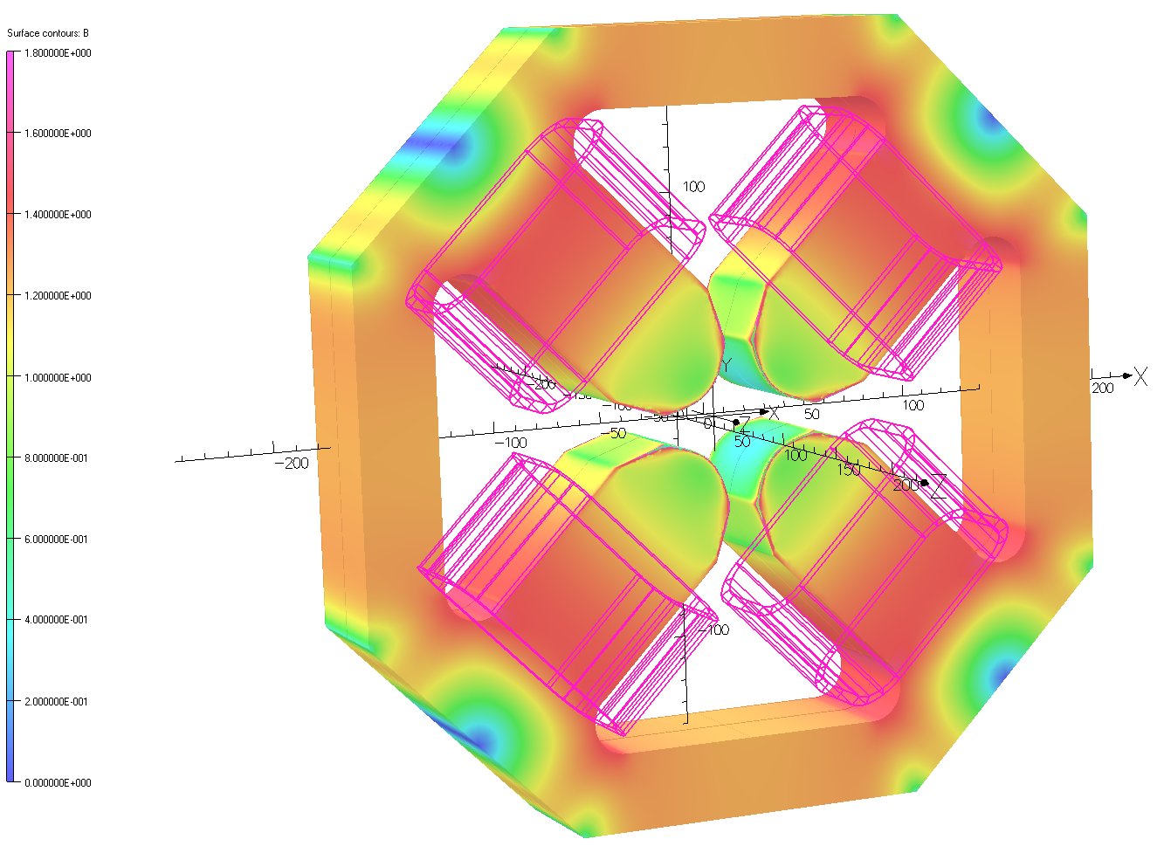
High Gradient → Straight Poles
Straight poles saturate badly at high gradients, reducing homogeneity and increasing magnetic length

Slide 7
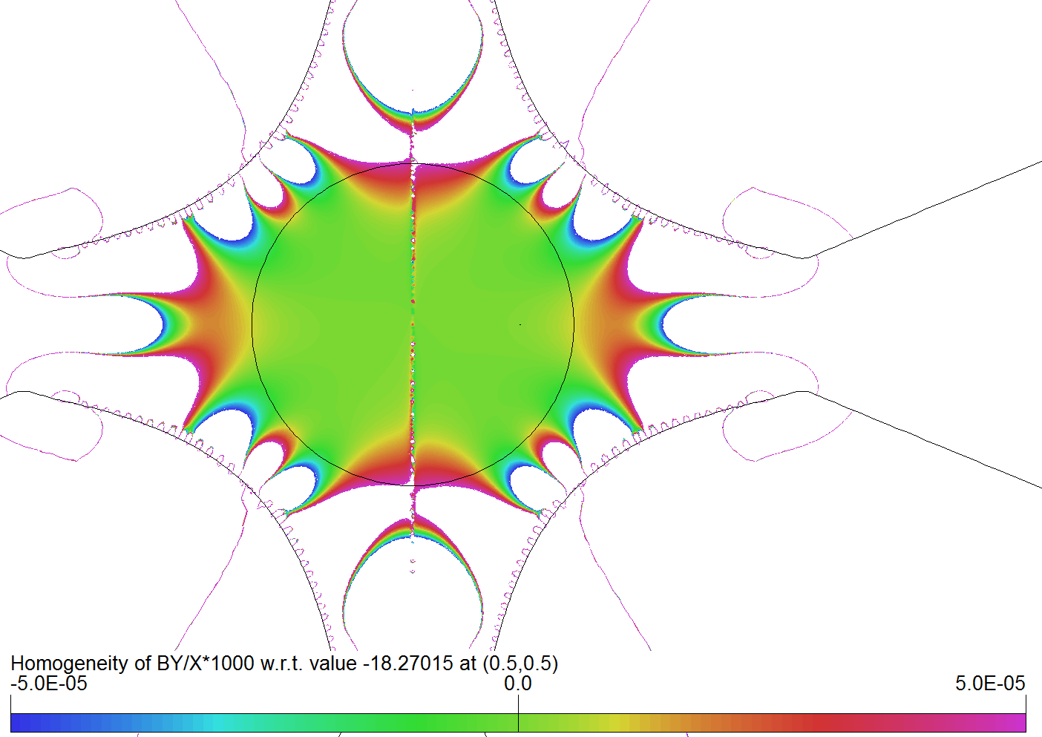
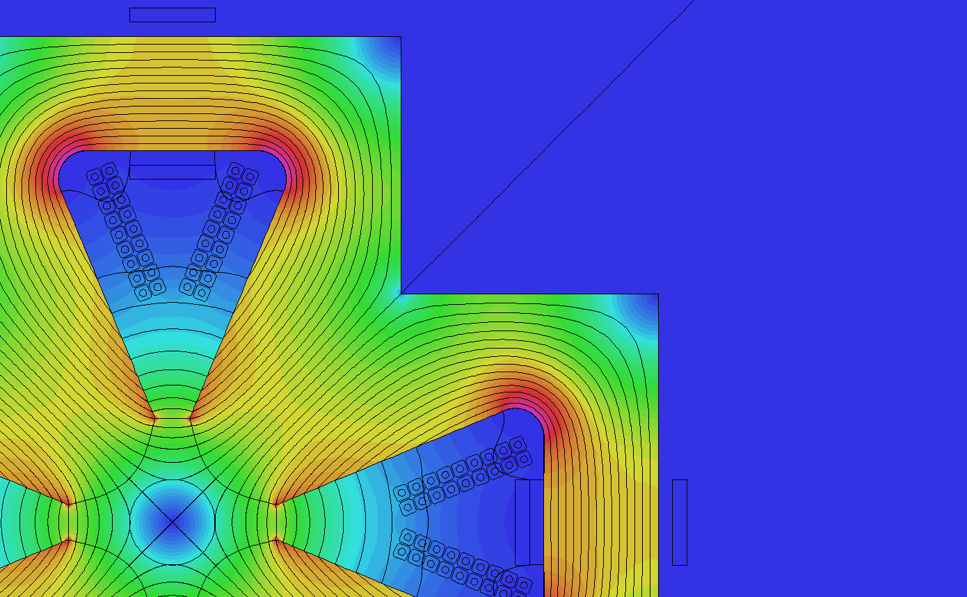
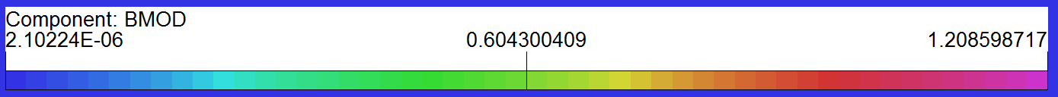
Tapered Pole

Slide 8
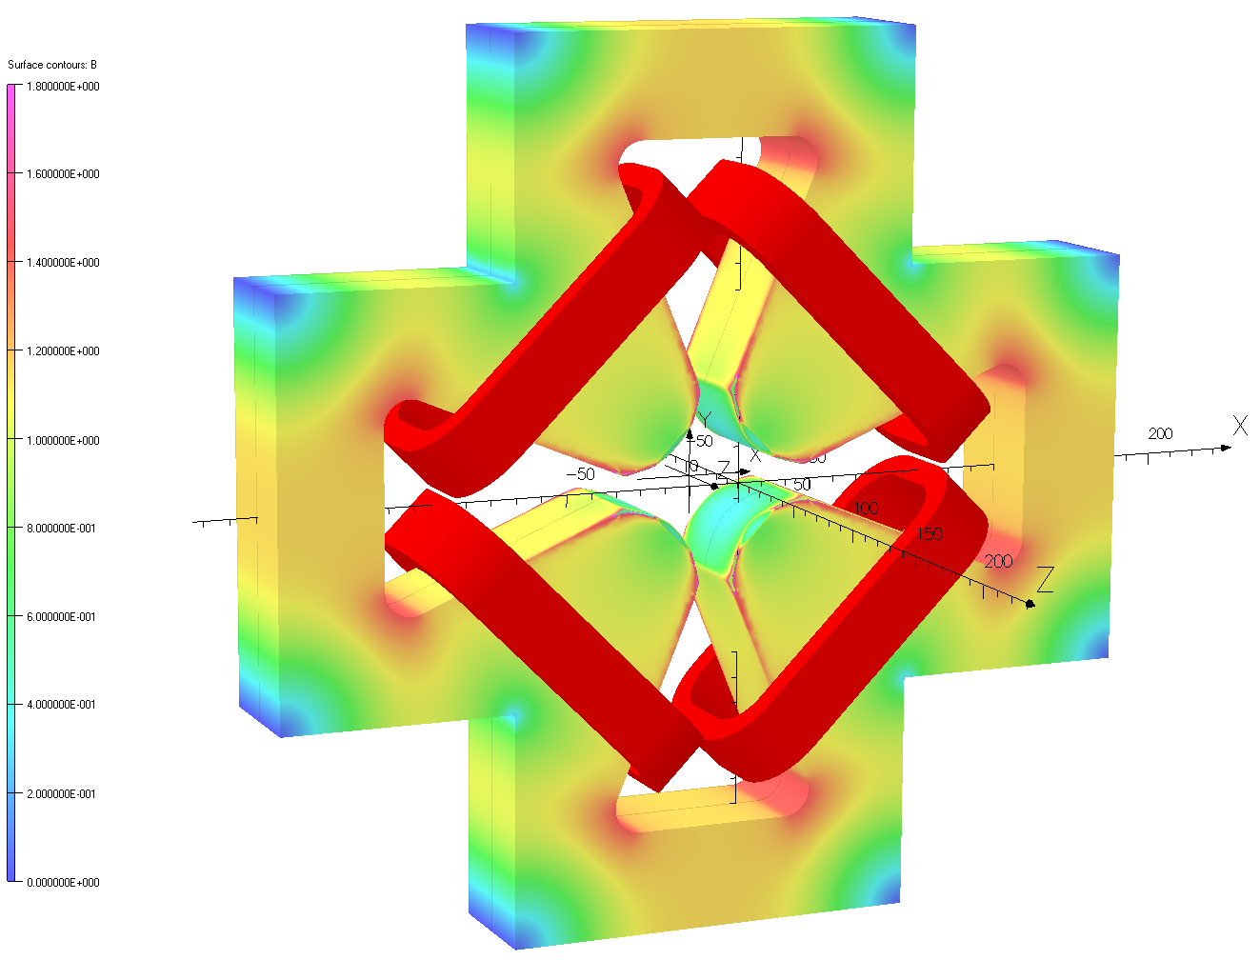
3D Tapered Pole Not Saturating
Note: Coils shown are simple racetracks. Give same results as realistic tapered coils but much faster to solve!

Slide 9
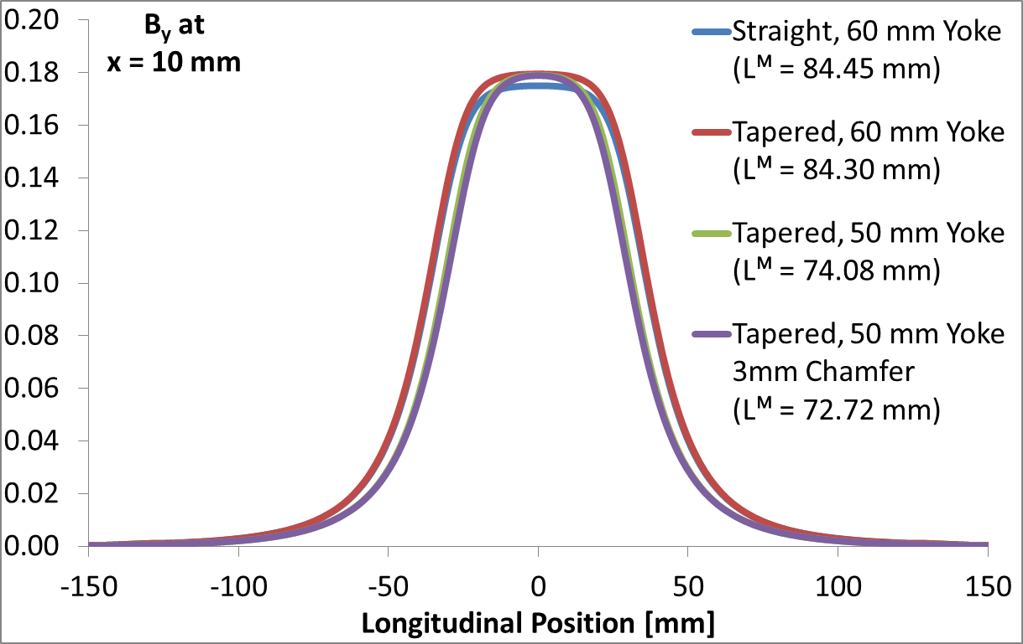
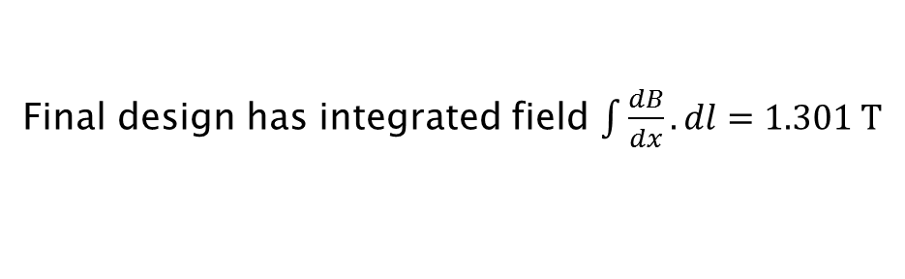
Magnetic Length
Final design has integrated field $\int{\frac{dB}{dx}.dl}=1.301 T$

Slide 10
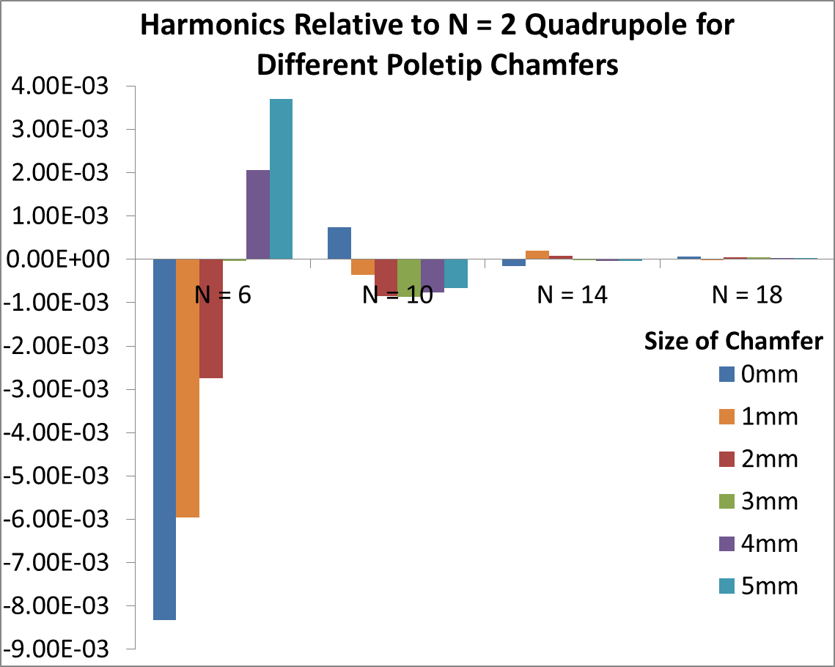
Higher Order Harmonics

Slide 11
Integrated Field Homogeneity

Slide 12
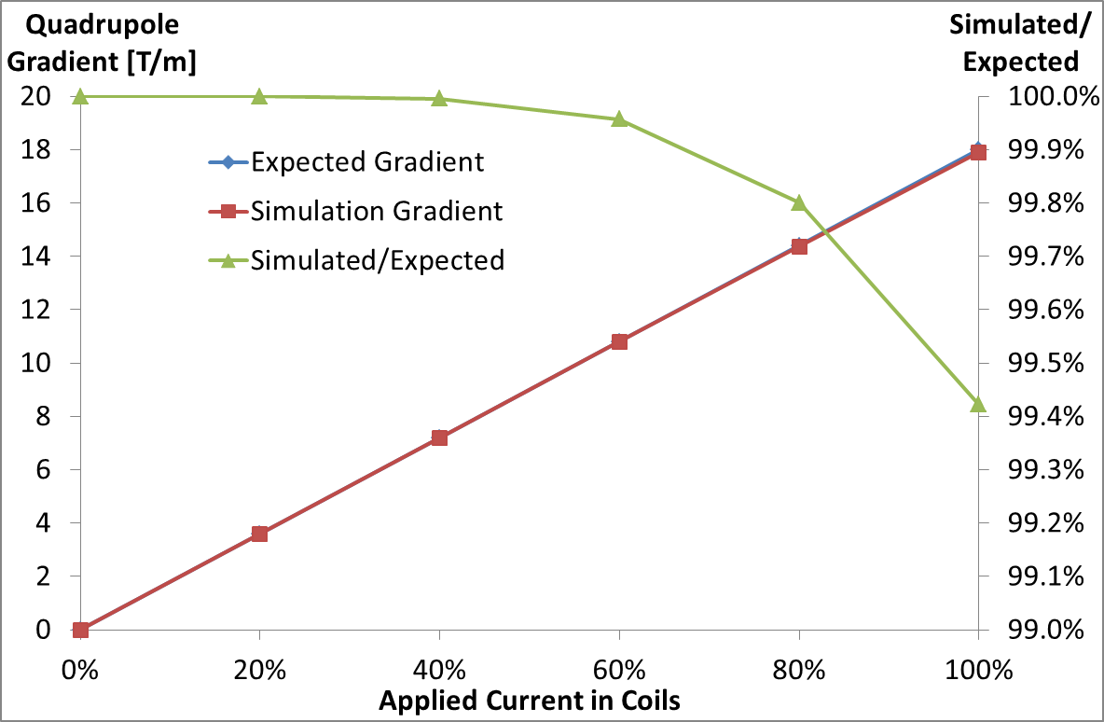
Linearity with Applied Current

Slide 13
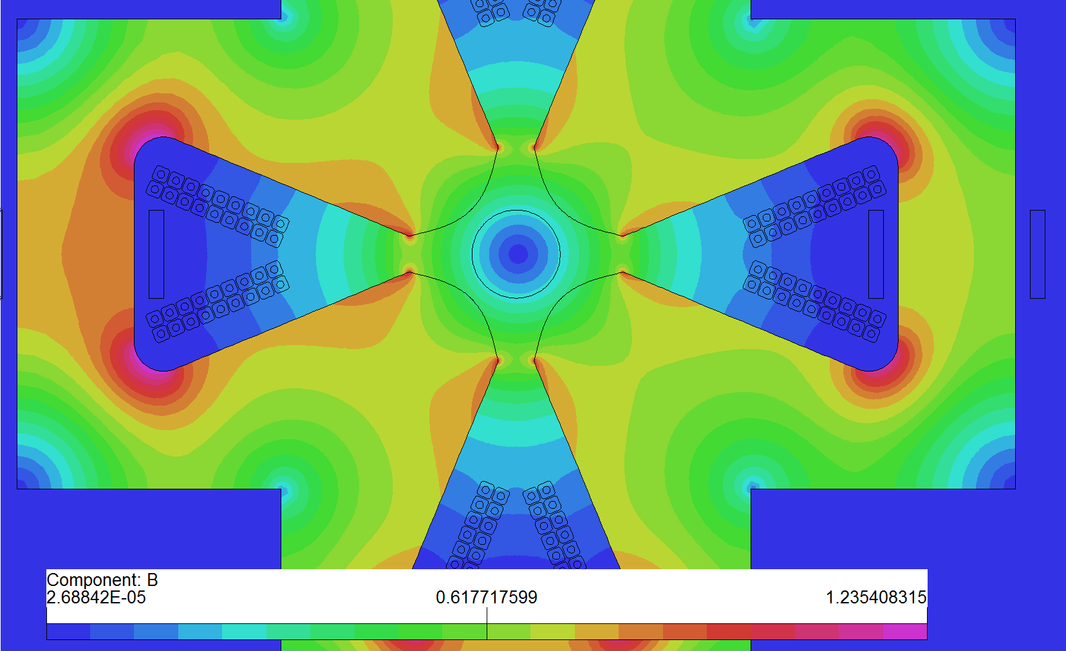
Quad & Dipole Coils Energised

Slide 14
Mechanical Considerations
Machine from solid steel (not laminations)
How to bolt together (Re: dipole windings)
Datums/mounting
Placement of connections/manifold
Thorough quotation request document
  → Danfysik, SigmaPhi, Scanditronix, Tesla

Slide 15
Summary
Each magnet fits within 70 mm space
18 Turns, up to 200 A (water cooled)
Up to 19.2 Tm⁻¹ quad, 12 mT dipole
72.7 mm magnetic length
Nice linear performance
Reasonable homogeneity & harmonics
1200 W power supplies sourced
Aim for quotes ready by June

