Slide 1
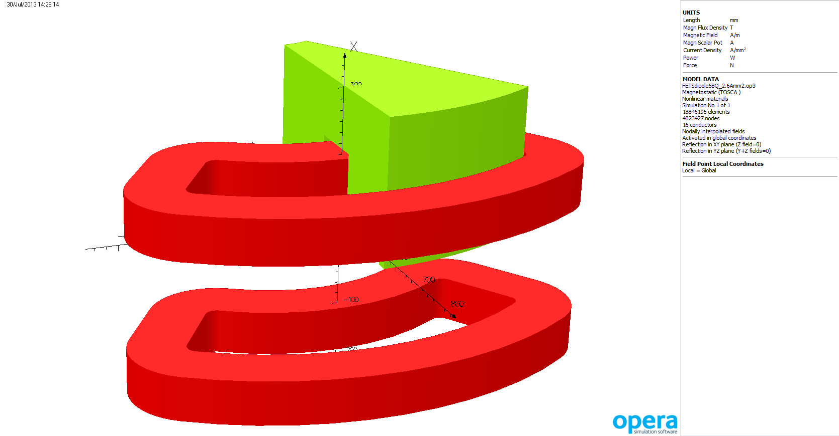

Slide 2
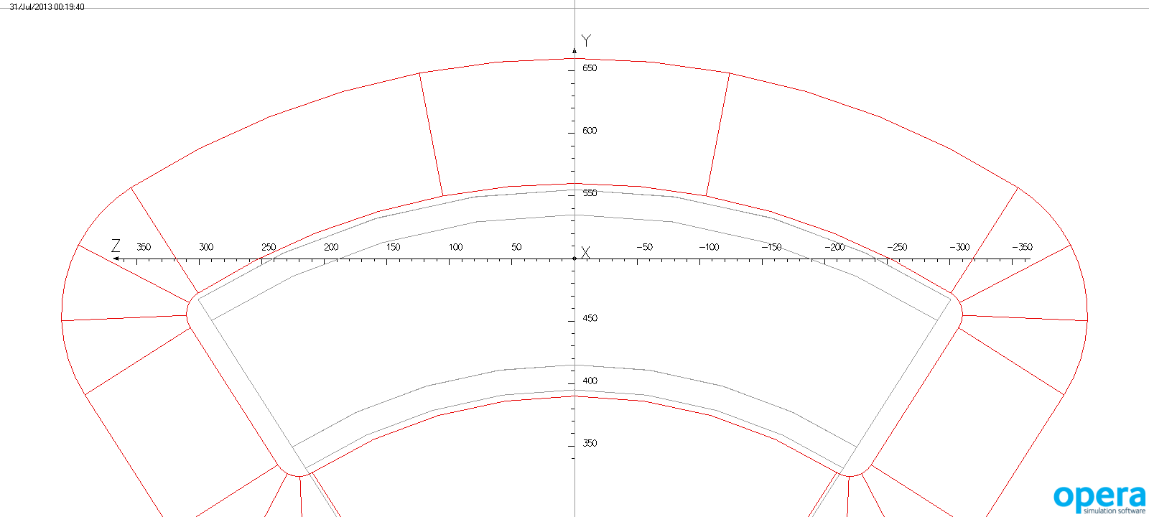

Slide 3
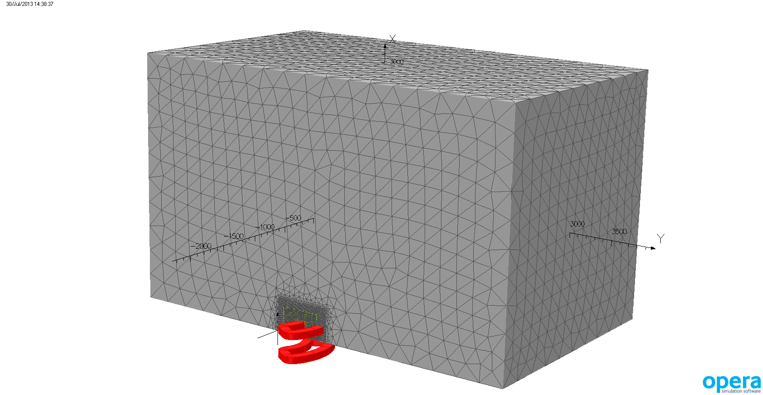

Slide 4
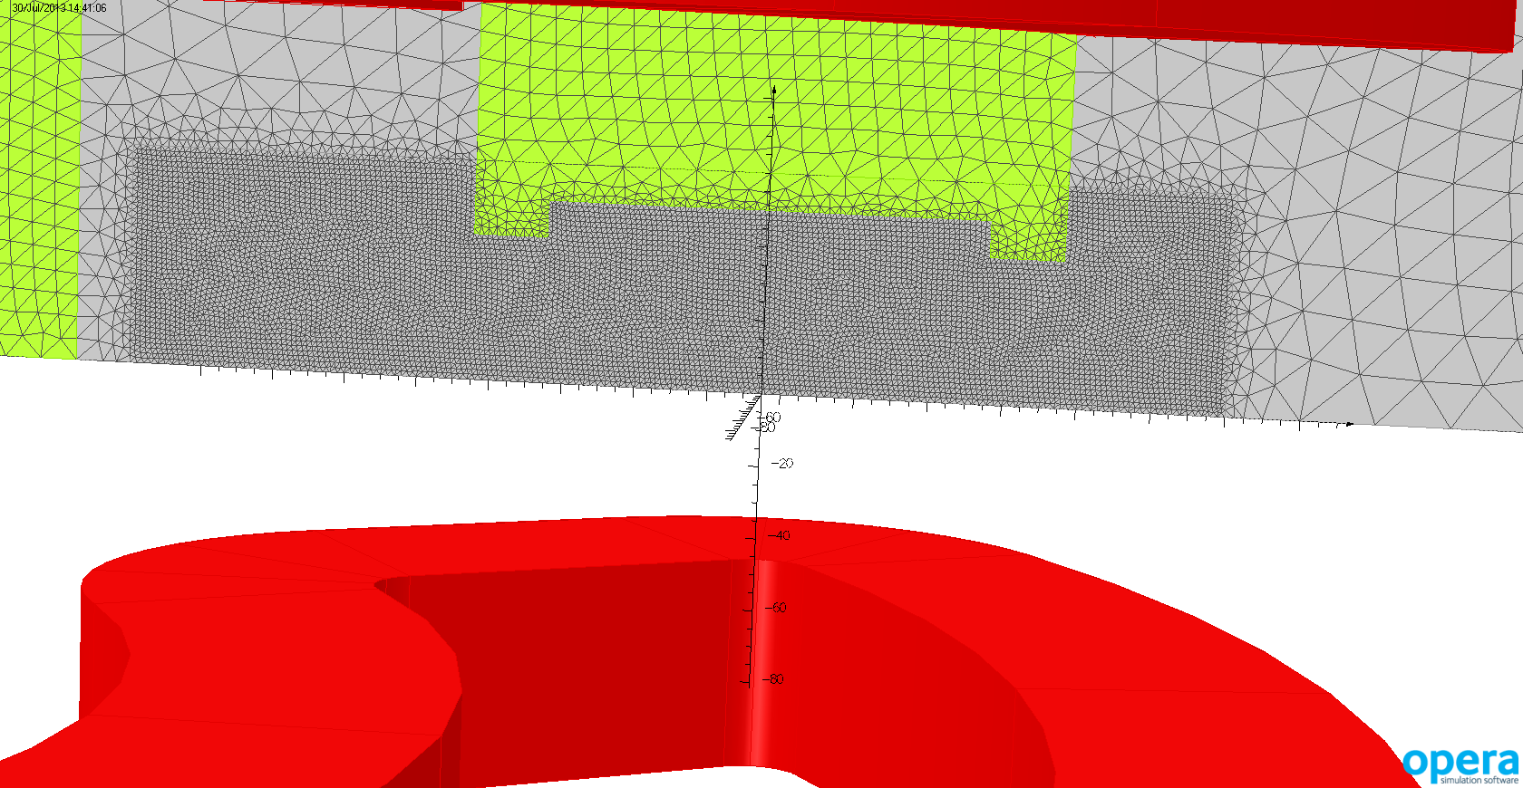
2 mm mesh in beam region

Slide 5
3 MeV beam 475 mm radius = 0.52 T

Slide 6
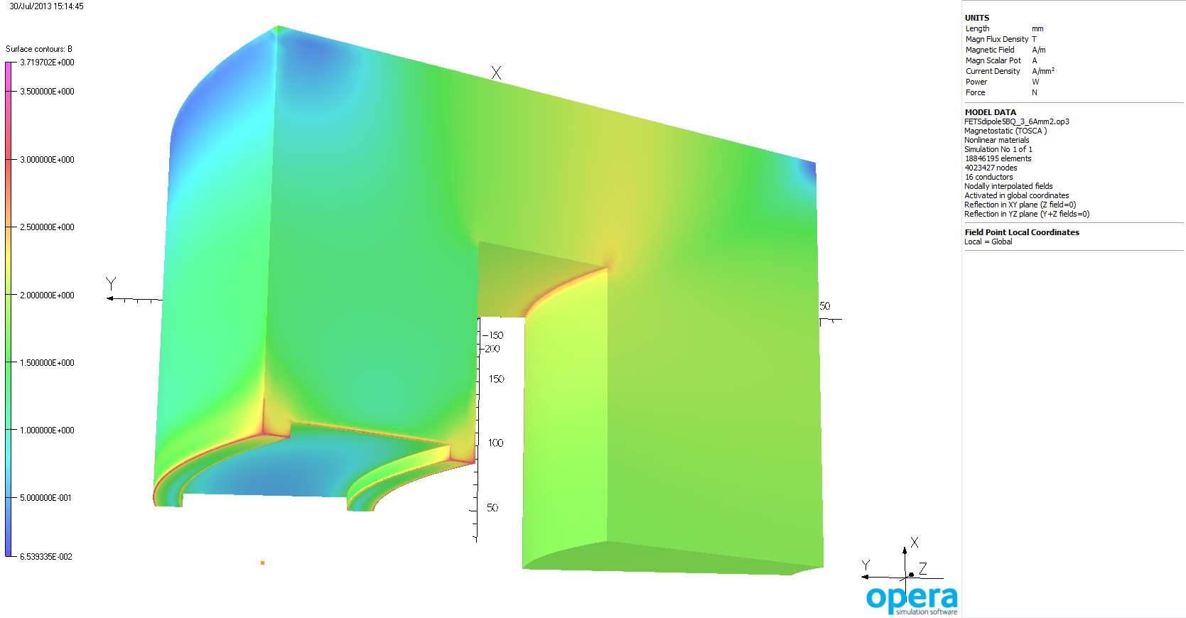
0.52 T
3.6 Amm⁻²

Slide 7
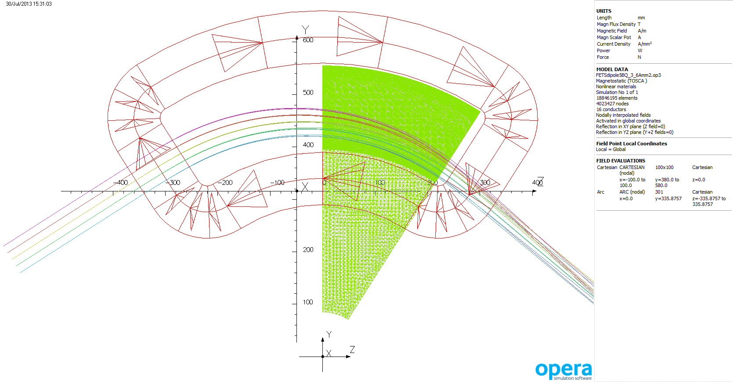

Slide 8
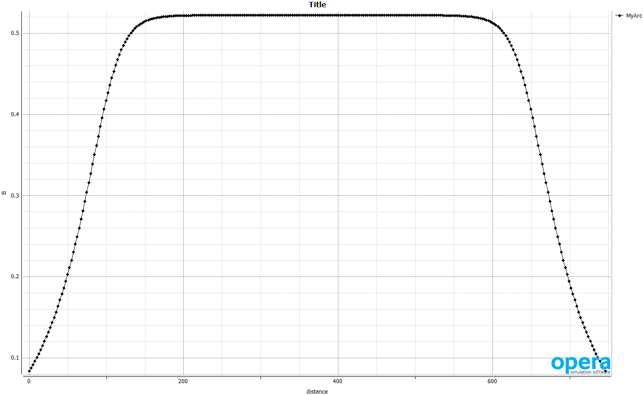

Slide 9
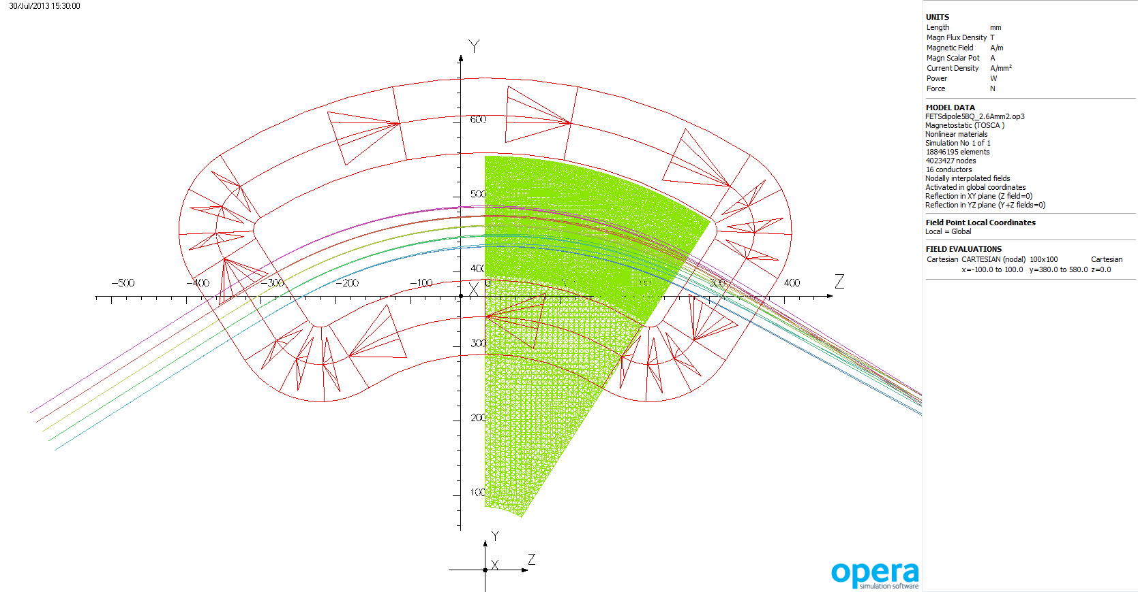

Slide 10
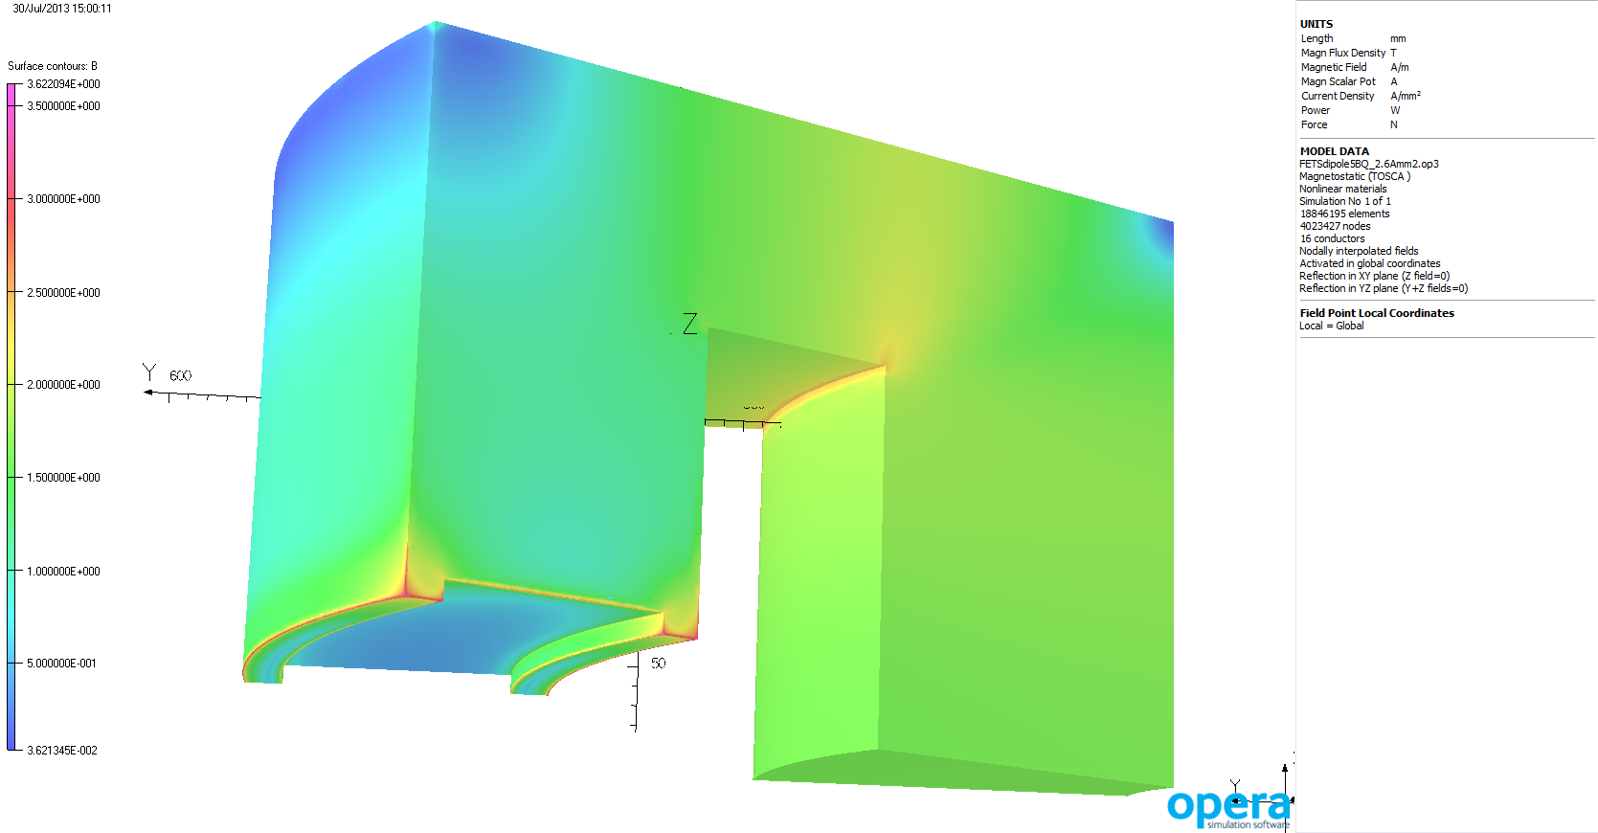
0.4318 T
2.6 Amm⁻²

Slide 11
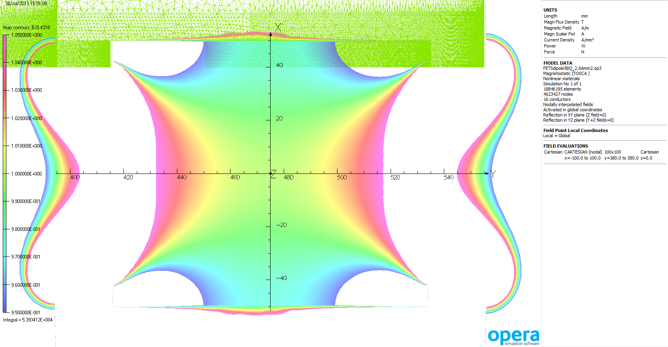
+/- 5%

Slide 12
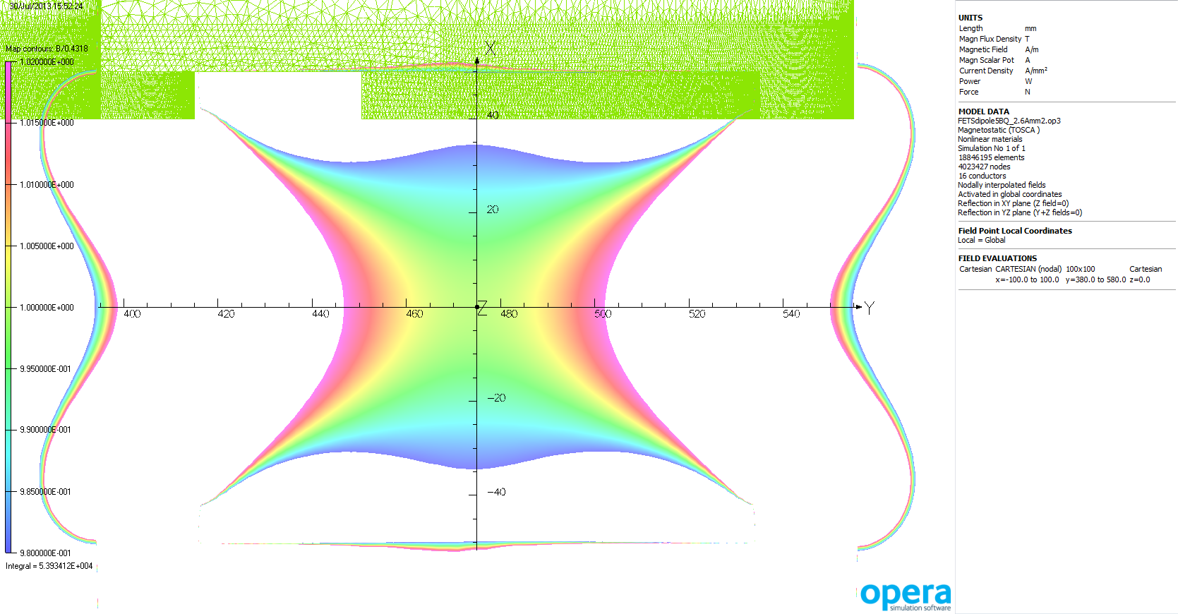
+/- 2%

Slide 13
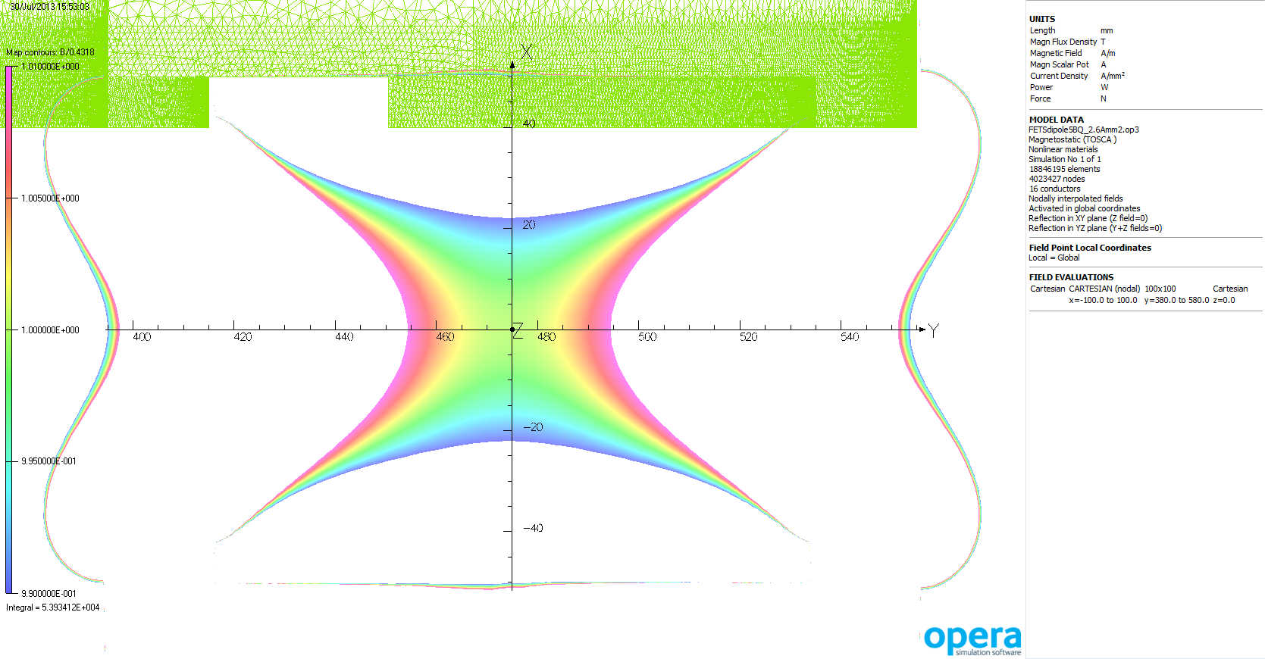
+/- 1%

Slide 14
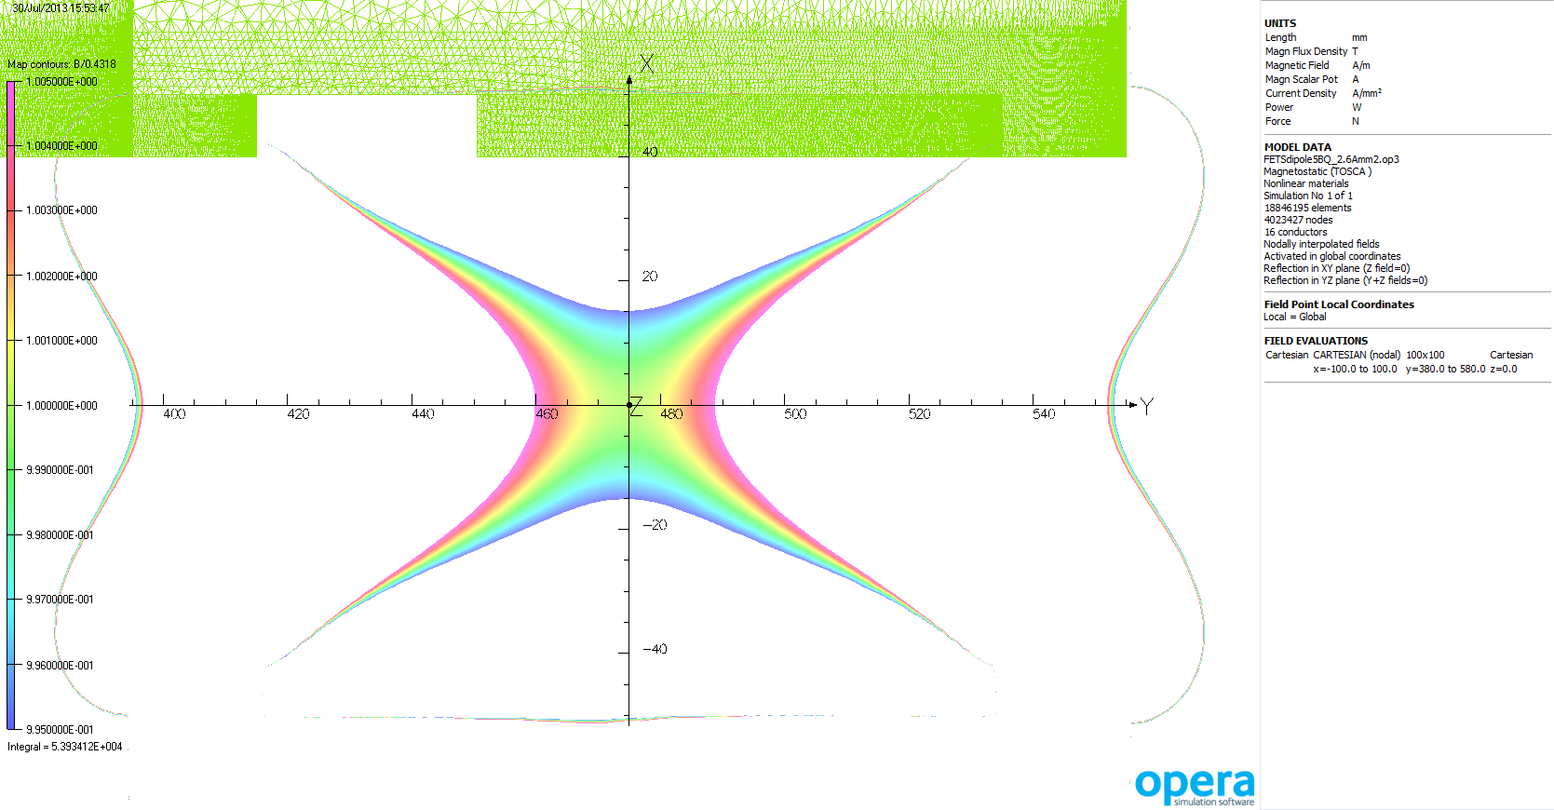
+/- 0.5%

Slide 15
2.6 Amm⁻²
OPERA default magnetic steel 0.4318 T
M800 Steel 0.4280 T
BINP Q13 0.4304 T
Armco 0.4333 T
Minor variation in good field region

Slide 16
