Slide 1
FETS MEBT
Simulations
RAL
Morteza Aslaninejad

Slide 2
MEBT Re-bunching Cavities
map25D-TM (field map)
map1D-TM(field map)
Trwcell (GPT command)
Beam behaviour and Transmission using any of the above.
The first cavity in the 3cavity lattice is located at 0.7 meters from the MEBT starting point.

Slide 3
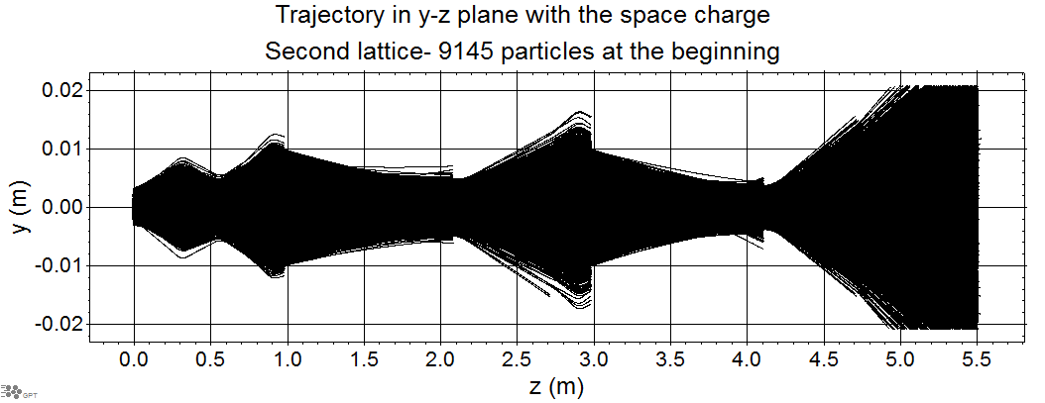
Q7
Q3
Q5
Q1
Q4
Q6
Q2
Chopper1
Dump1
Chopper2
Dump2
C1
C2
C3

Slide 4
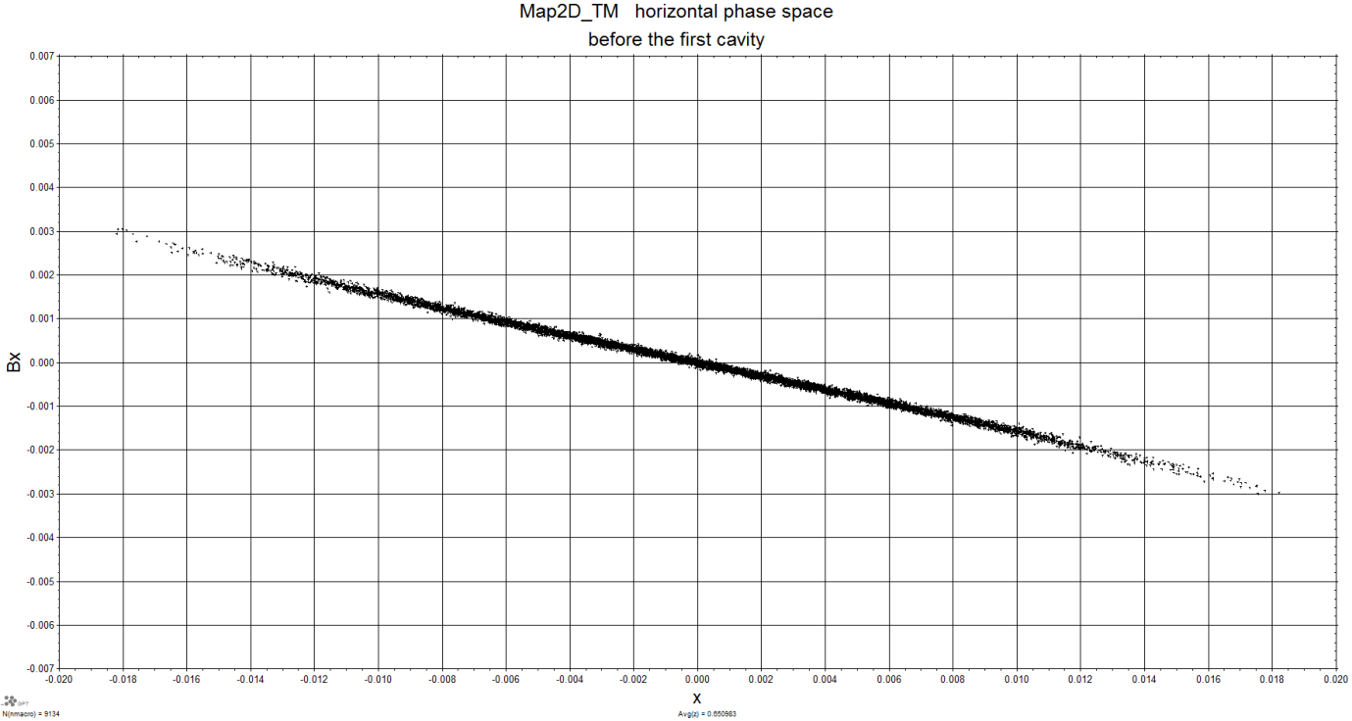
Fig. 1. Horizontal Phase space plot at z=0.650983. The beam size = 0.018 and the slope, B_{x}=-0.003 using Map25D_TM.

Slide 5
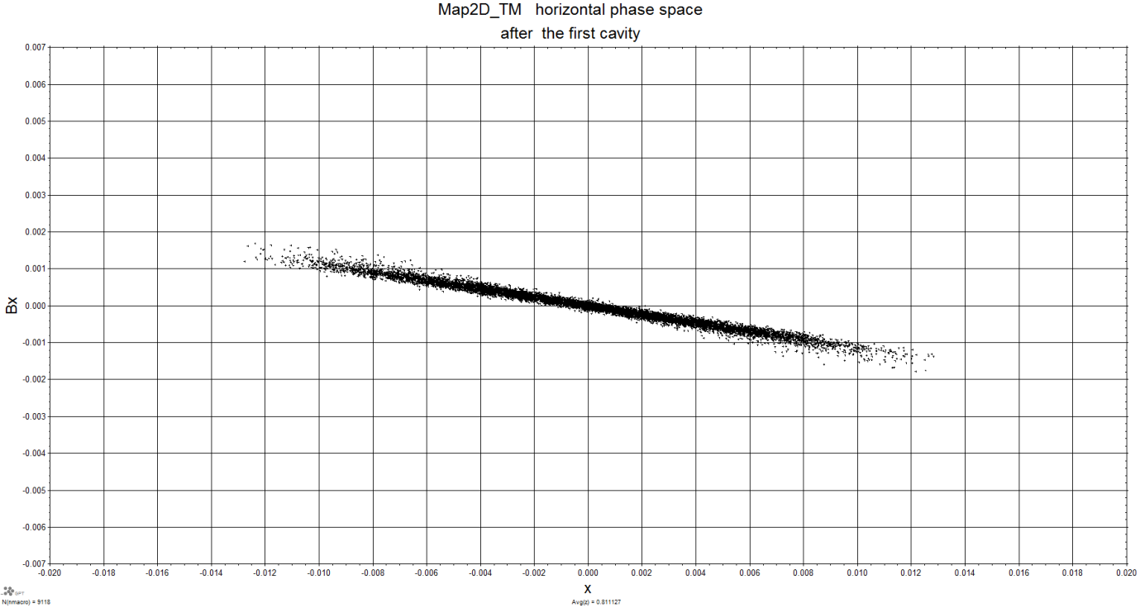
Fig. 2. Horizontal Phase space plot at z=0.811127. The beam size = 0.013 and the slope, B_{x}=-0.0017 using Map25D_TM.

Slide 6
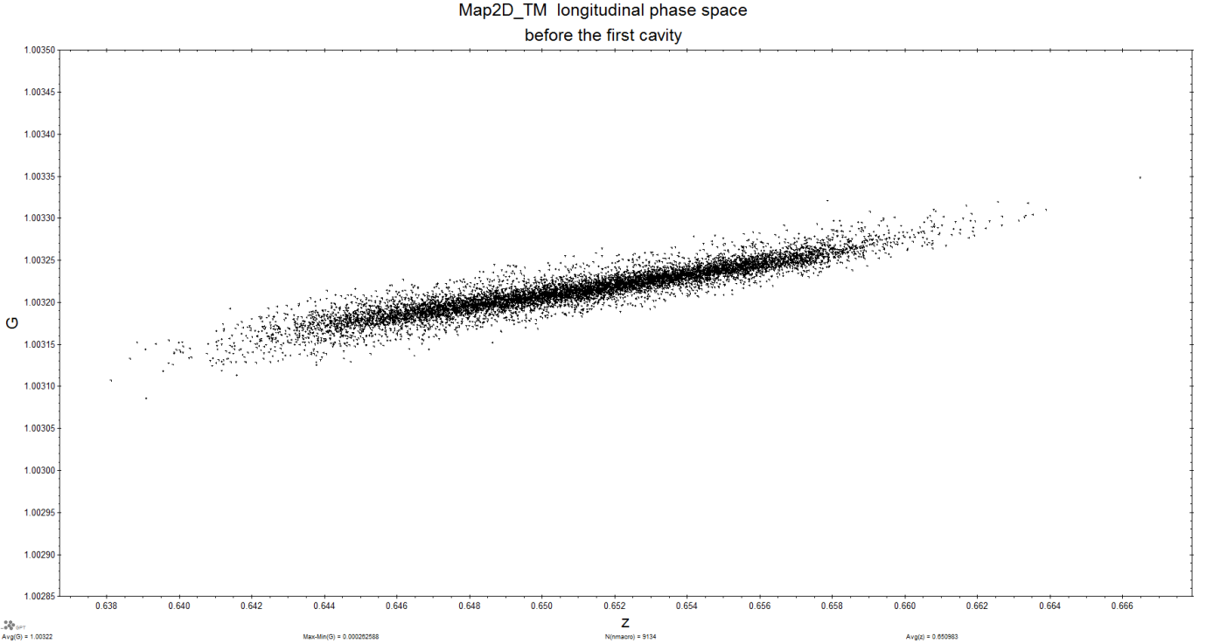
Fig. 3. Longitudinal Phase space before the first cavity using the Map25D_TM field map using Map25D_TM.

Slide 7
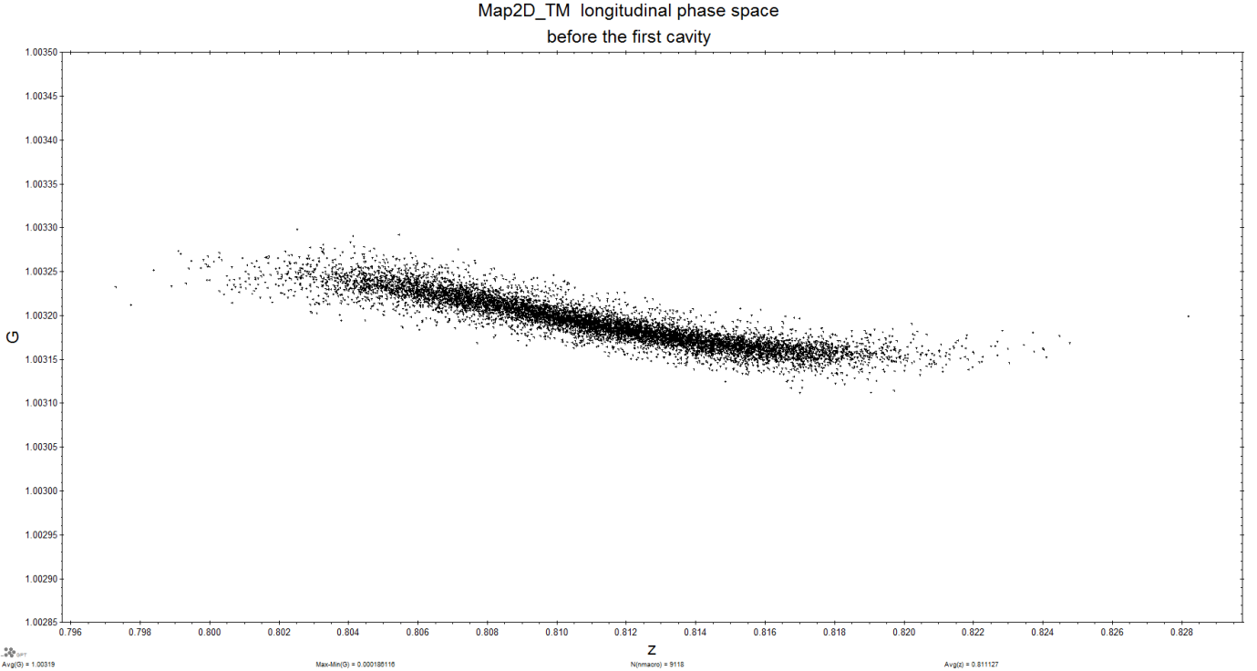
Fig. 4. Longitudinal Phase space after the first cavity using the Map25D_TM field map using Map25D_TM.

Slide 8
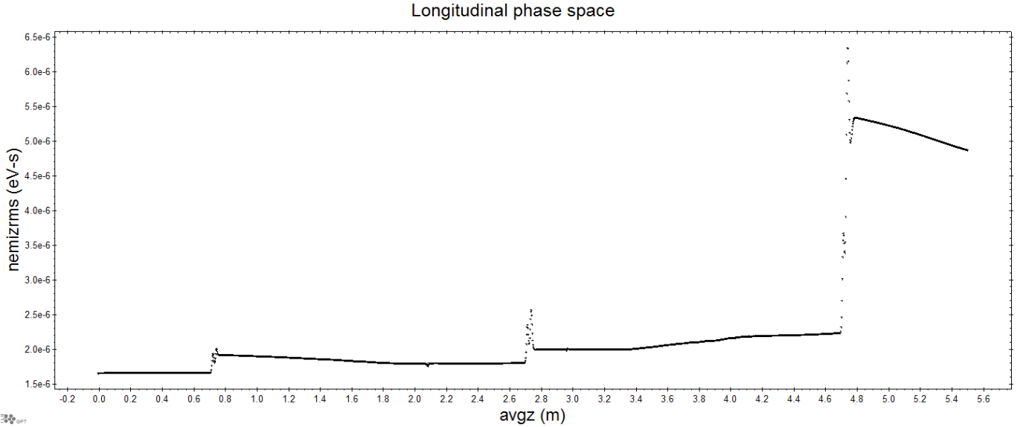
Fig. 5. Longitudinal rms emittance development using Map25D_TM.

Slide 9
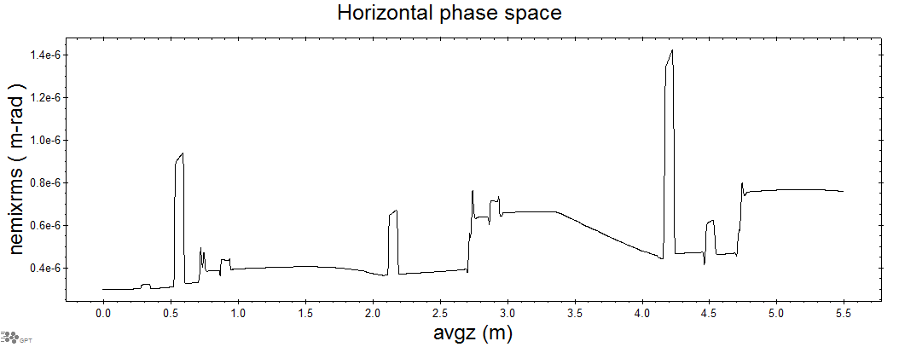
Fig. 6. Horizontal rms emittance development 2Dmap.

Slide 10
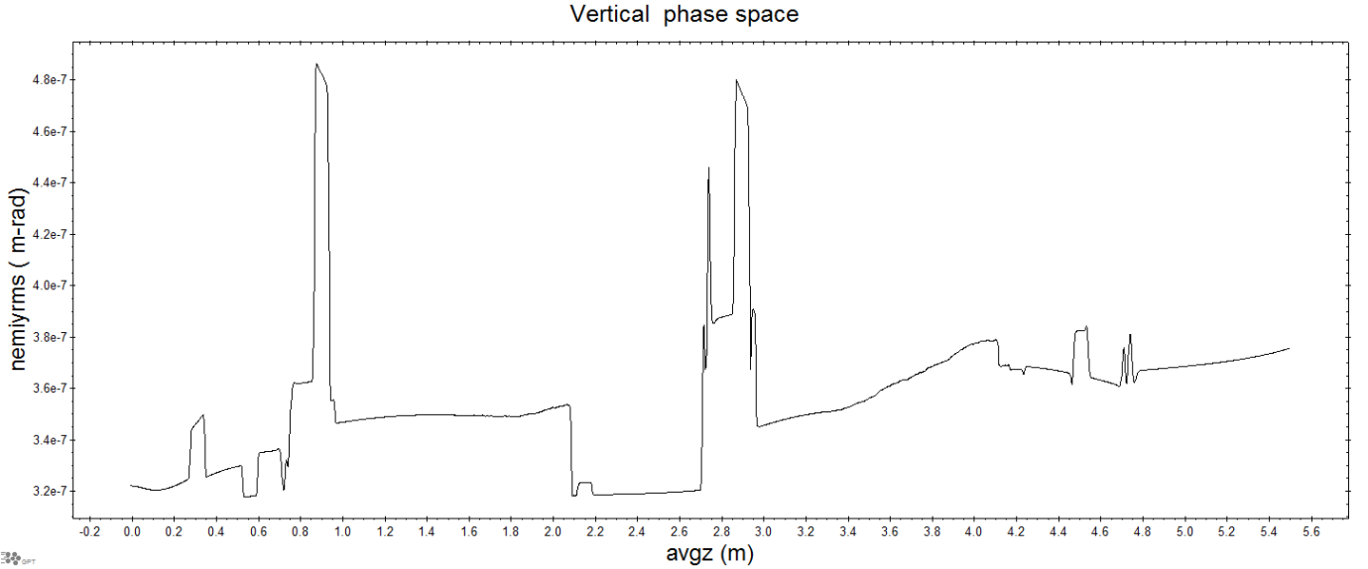
Fig. 7. Vertical rms emittance development using Map25D_TM.

Slide 11
Table. 1. summary of results using Map25D_TM simulations.
Horizontal phase space | size | slope
Before the 1st cavity | X=0.018 m | Bx= -0.003
After the 1st cavity | X=0.013 m | Bx=-0.0017
Horizontal phase space | size | slope
Before the 1st cavity | X=0.018 m | Bx= -0.003
After the 1st cavity | X=0.013 m | Bx=-0.0017
Horizontal phase space | size | slope
Before the 1st cavity | X=0.018 m | Bx= -0.003
After the 1st cavity | X=0.013 m | Bx=-0.0017

Slide 12
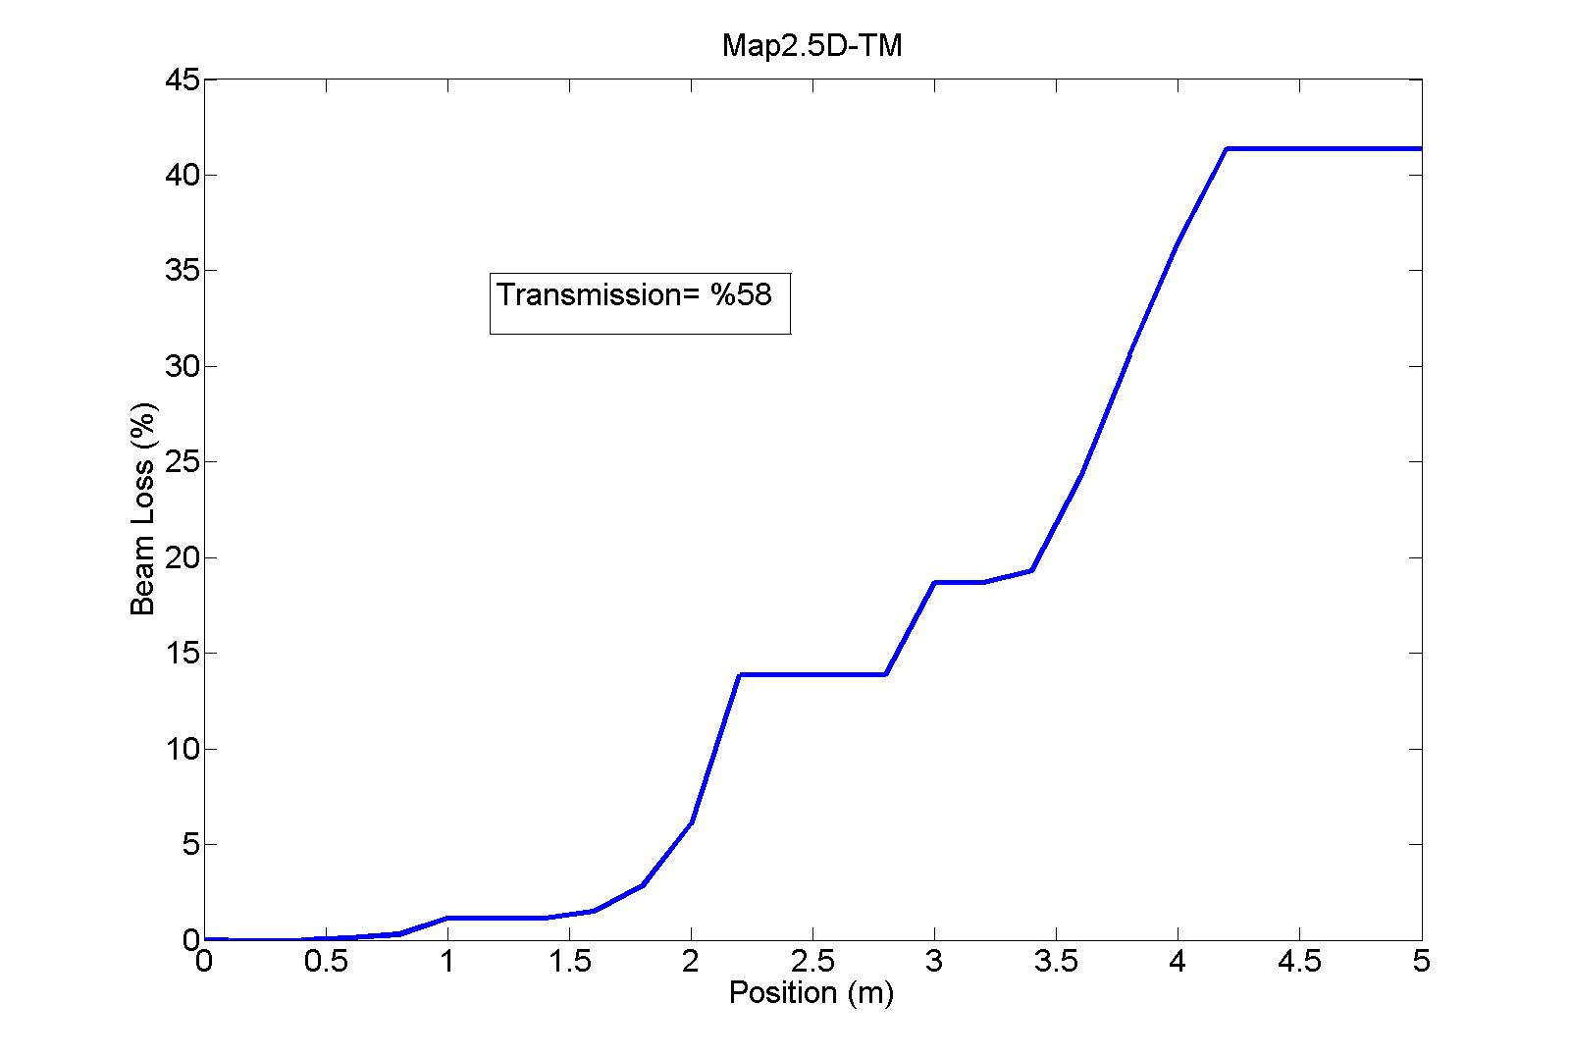
Fig. 8. Beam Loss for the 3 cavity lattice using Map25D-TM field map.

Slide 13
Now the same simulation using Map1D-TM:

Slide 14
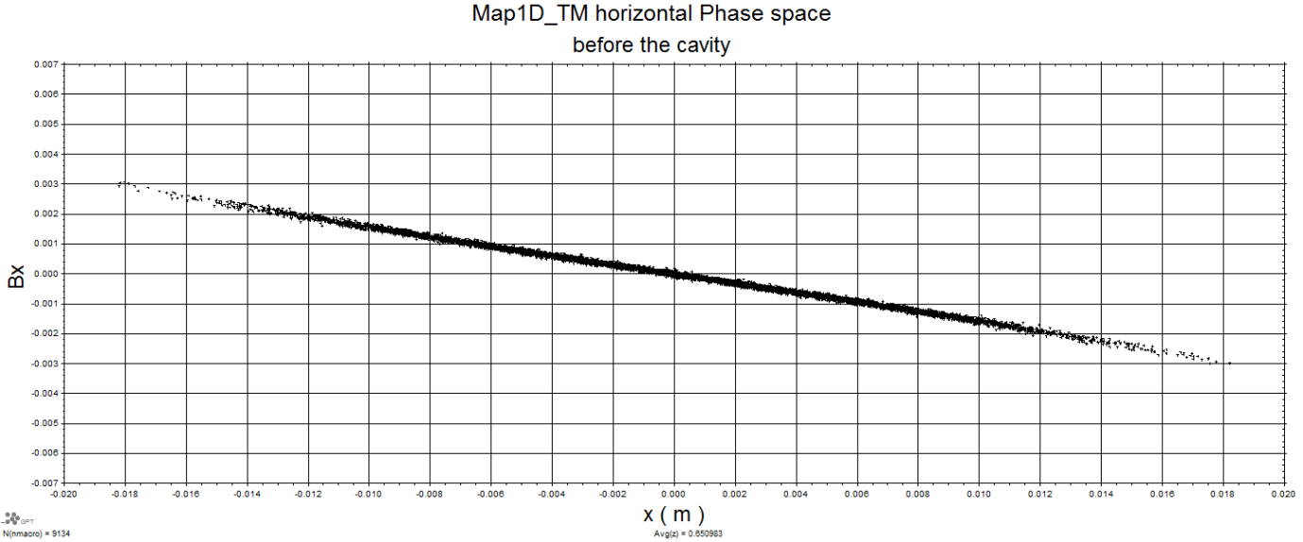
Fig. 9. Horizontal Phase Space before the 1st cavity

Slide 15
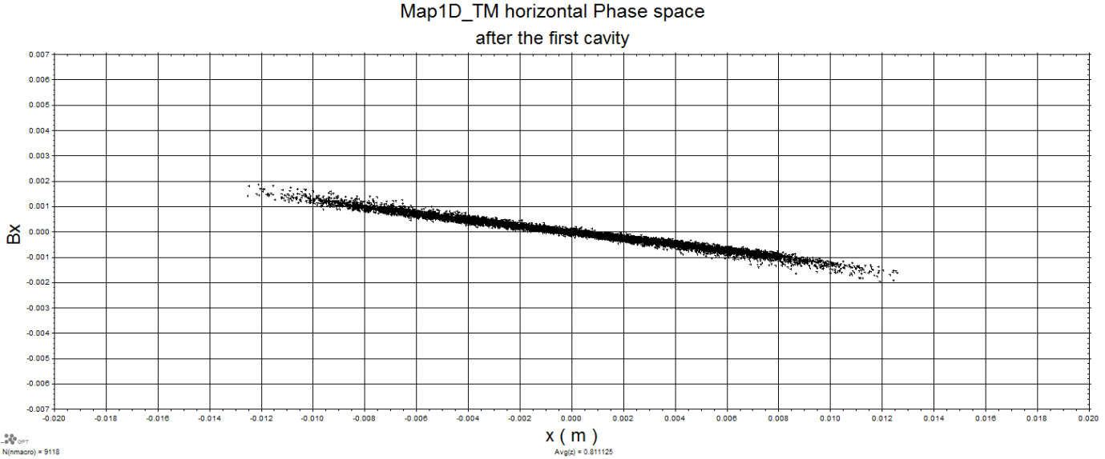
Fig. 10. Horizontal Phase space after the 1st cavity

Slide 16
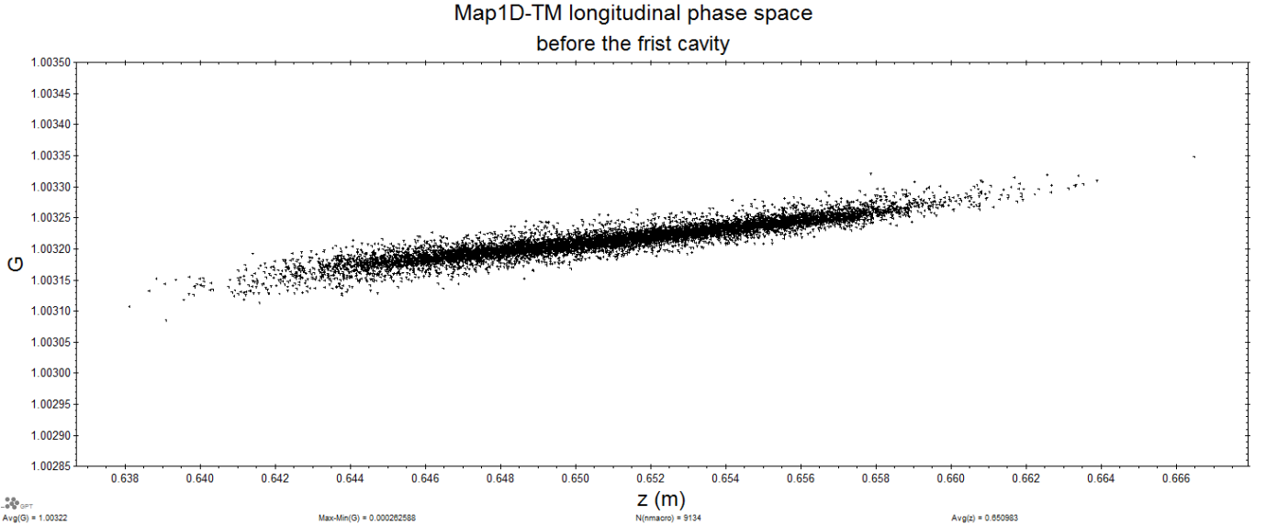
Fig. 11. Longitudinal Phase space before the first cavity using the Map1D_TM field map.

Slide 17
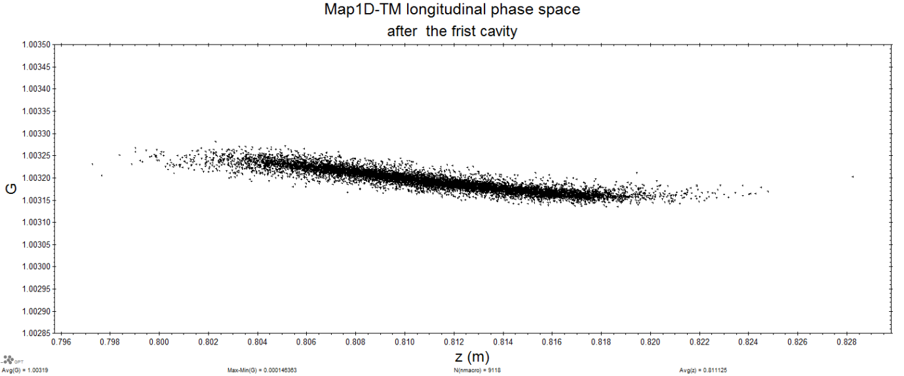
Fig. 12. Longitudinal Phase space after the first cavity using the Map1D_TM field map.

Slide 18
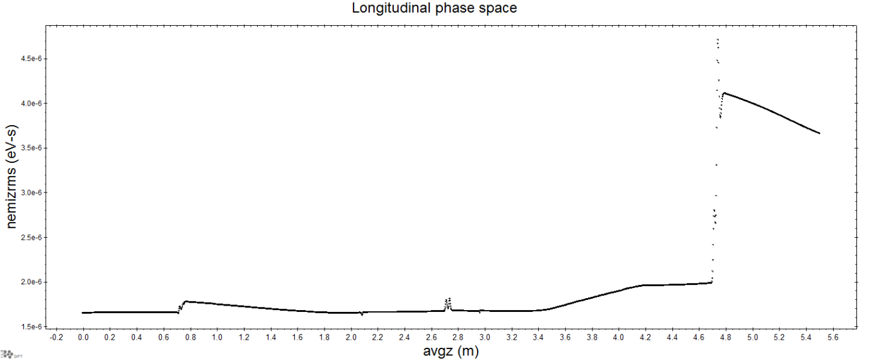
Fig. 13. Longitudinal rms emittance development 1Dmap

Slide 19
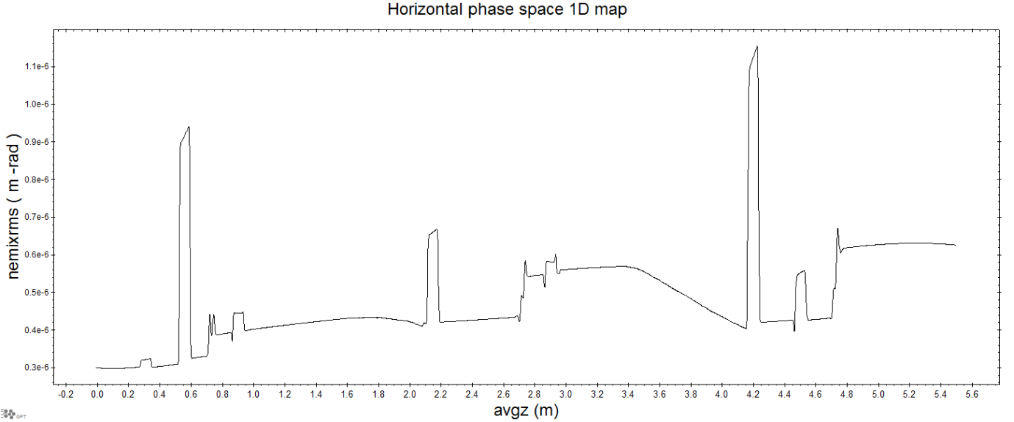
Fig. 14. Horizontal rms emittance development 1Dmap.

Slide 20
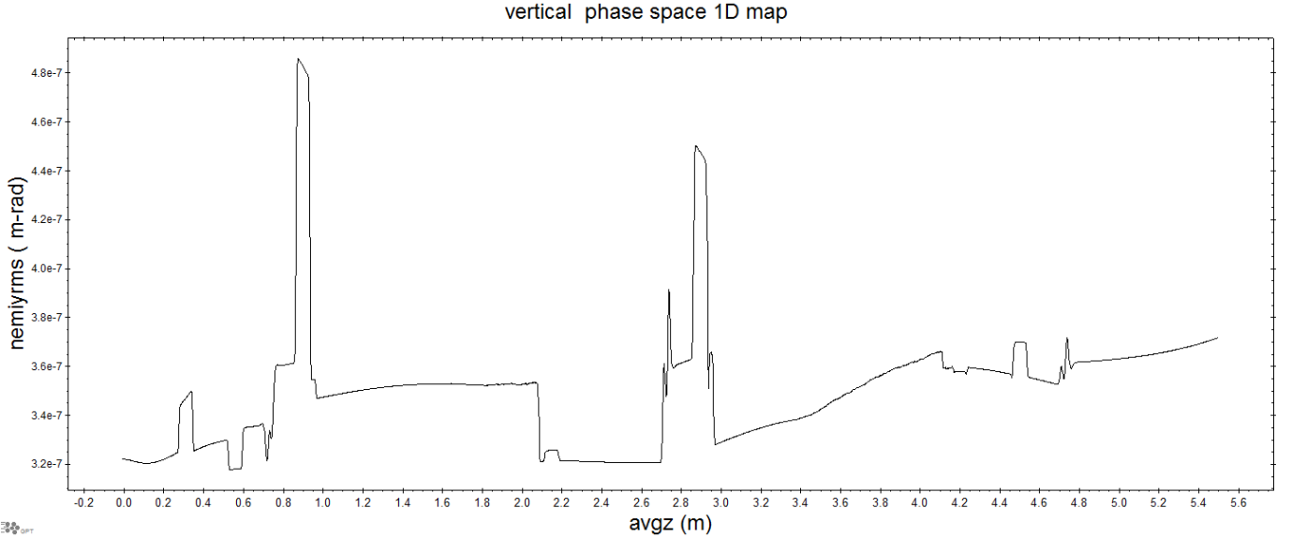
Fig. 15. Vertical rms emittance development 1Dmap.

Slide 21
Table 2. summary of results of 1D map simulations.
Horizontal phase space | size | slope
Before the 1st cavity | X=0.018 m | Bx= -0.003
After the 1st cavity | X=0.013 m | Bx=-0.0017

Slide 22
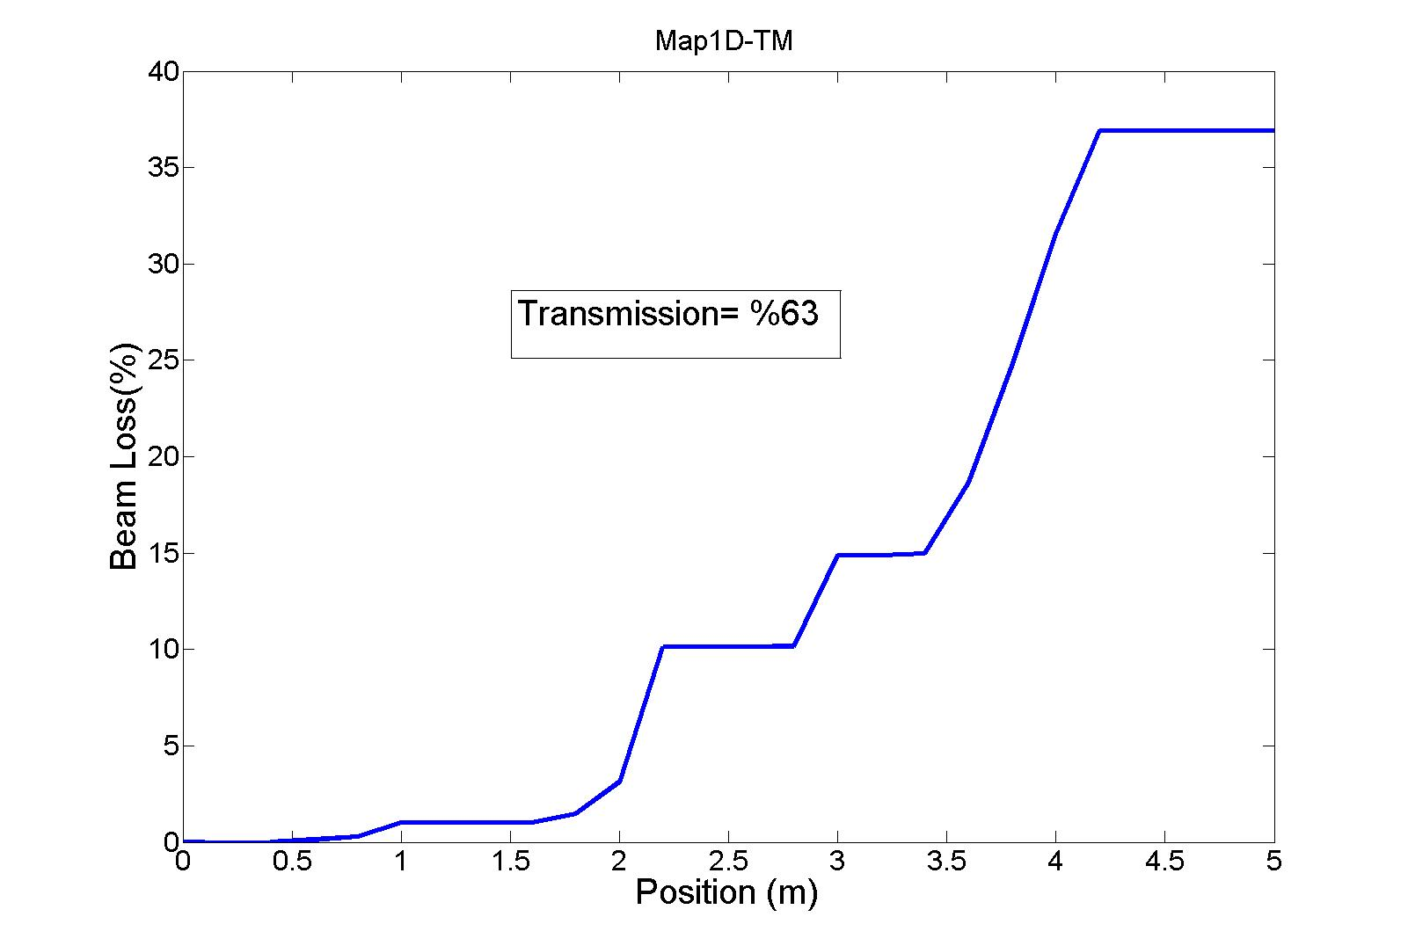
Fig. 16. Beam loss for the 3 cavity lattice using map1D-TM field map.

Slide 24
Trwcell Cavity

Slide 25
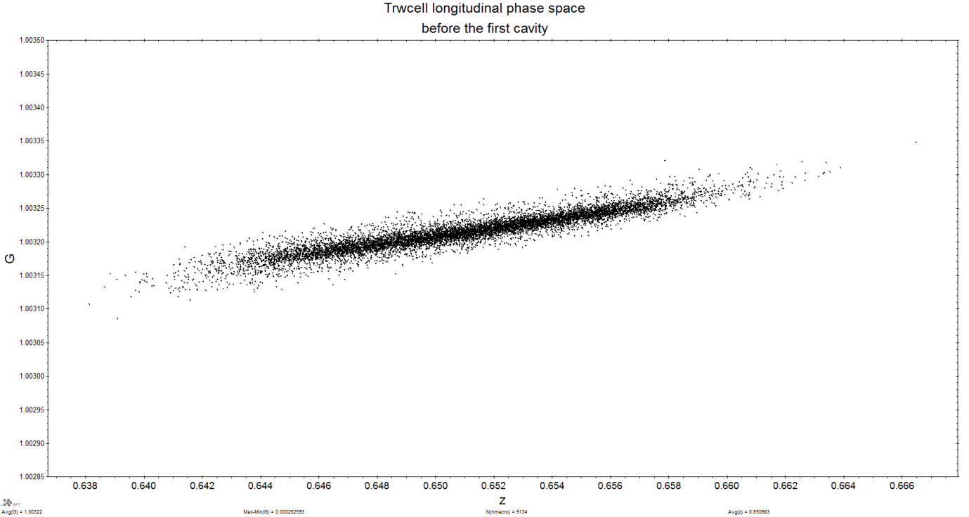
Fig. 17. Longitudinal Phase space before the first cavity using a Trwcell cavity.

Slide 26
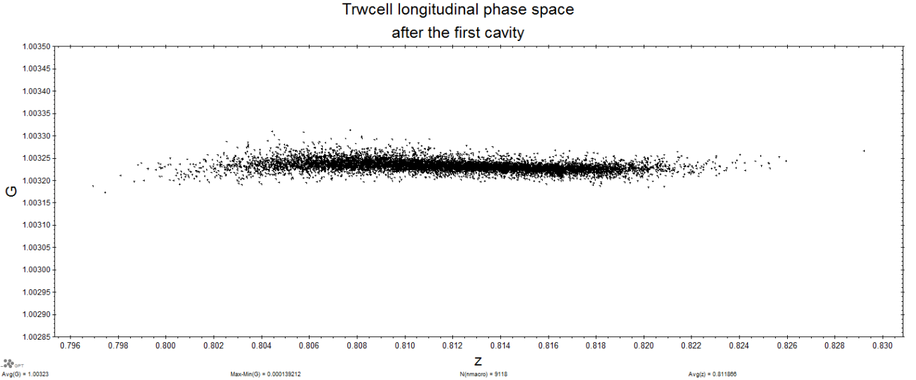
Fig. 18. Longitudinal Phase space after the first cavity using a Trwcell cavity.

Slide 27
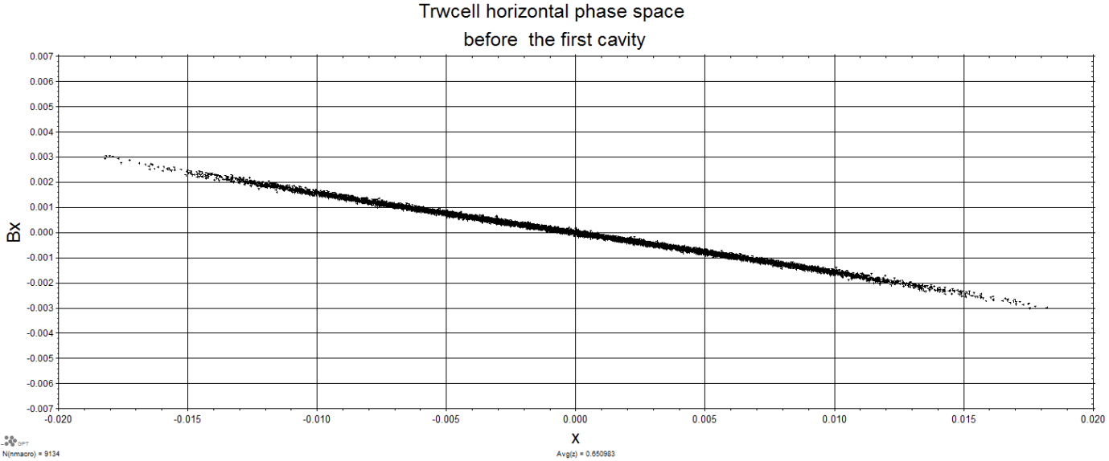
Fig. 19. Horizontal Phase space before the first cavity using a Trwcell cavity.

Slide 28

Fig. 20. Horizontal Phase space after the first cavity using a Trwcell cavity.

Slide 29
Table .3 summary of results for the Trwcell simulations.
Horizontal phase space | size | slope
Before the 1st cavity | X=0.018 m | Bx= -0.003
After the 1st cavity | X=0.0125 m | Bx=-0.0019

Slide 30
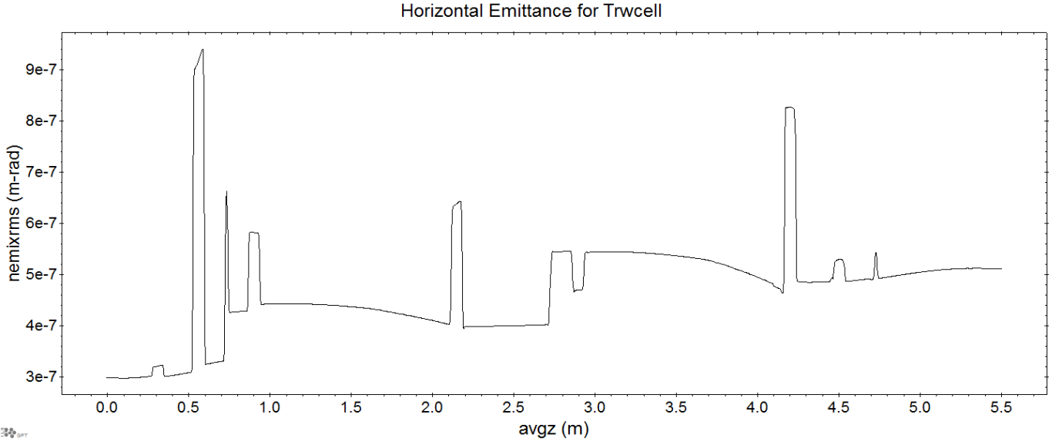
Fig. 21. Horizontal emittance as a function of z for Trwcell.

Slide 31
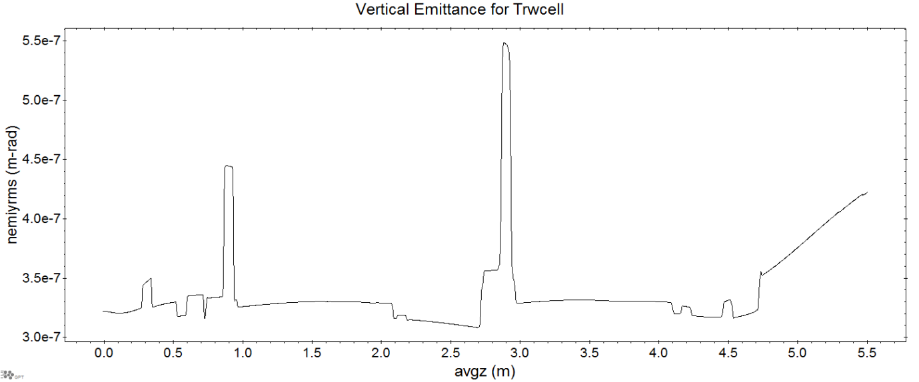
Fig. 22. vertical emittance as a function of z for Trwcell.

Slide 32
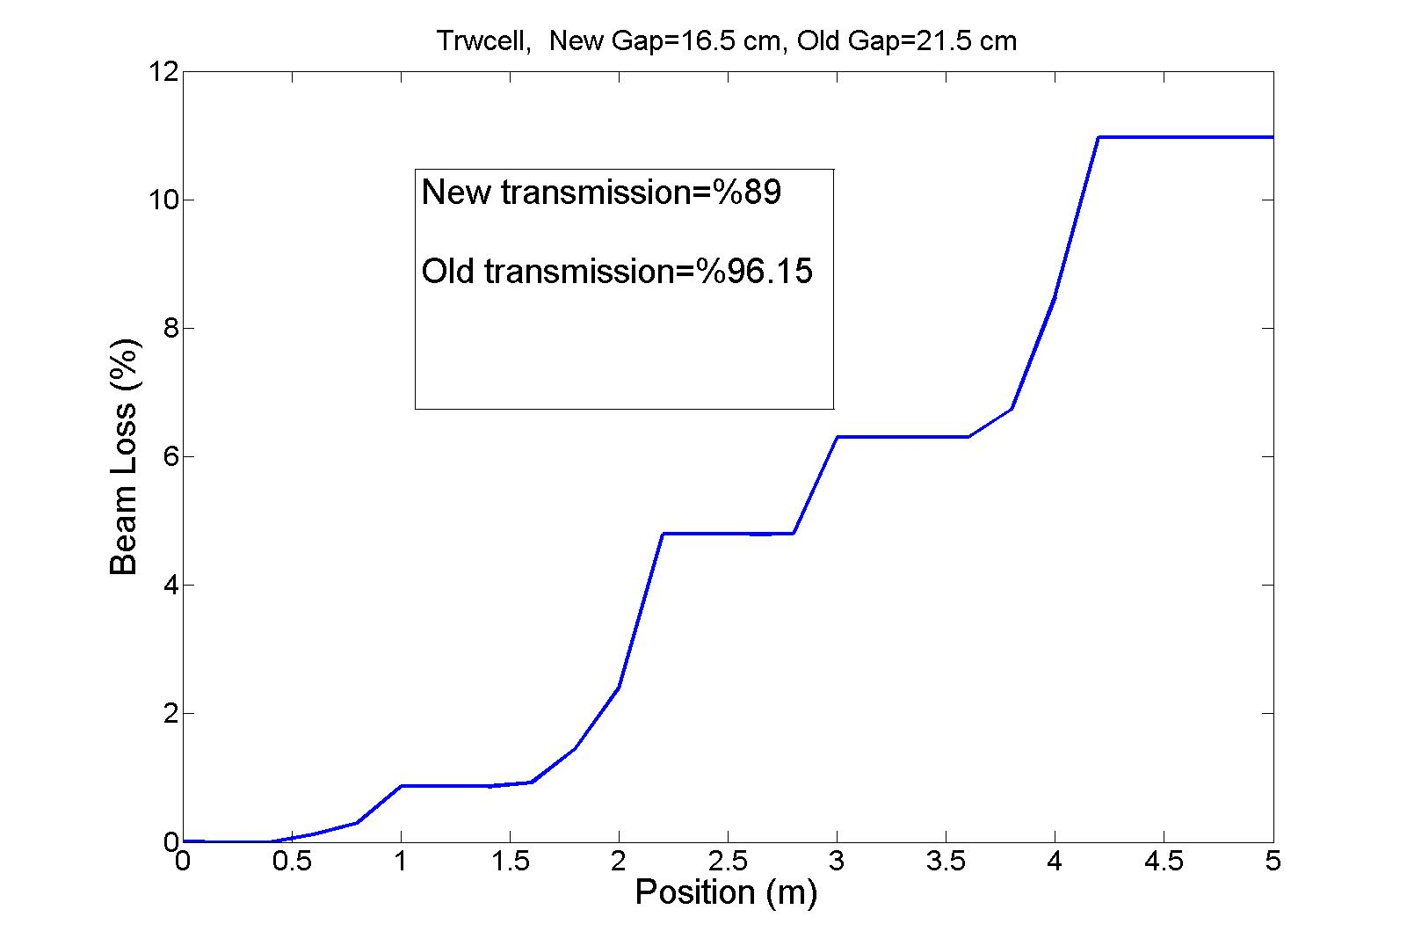
Fig. 24. Beam loss for the 3 cavity lattice using Trwcell. The number of initial particles is 9145. The old value of the cavity gaps was 21.5 cm. The new value of cavity caps is 16.5 cm. The electric fields for the cavities have been accordingly changed. The transmission has dropped.

Slide 33
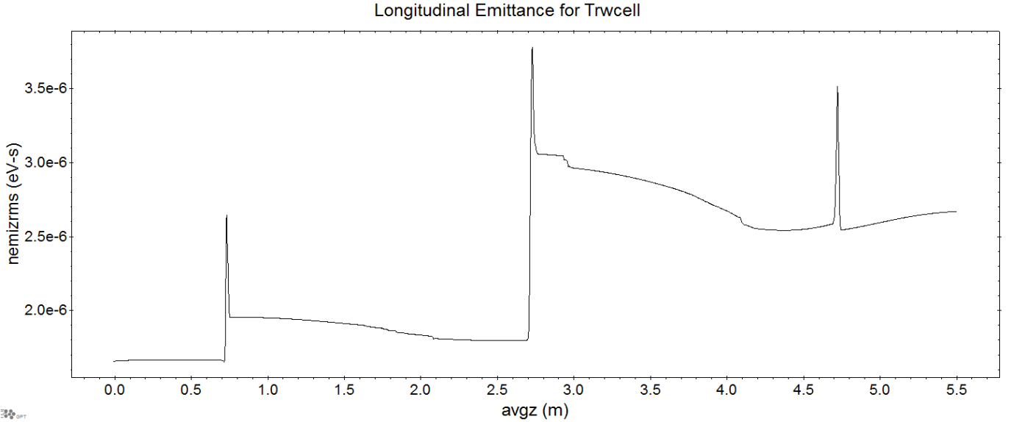
Fig. 23. Longitudinal emittance as a function of z for Trwcell.

Slide 34
Transmission now is one main concern,
Power needed will be subject to changes as we go to higher transmissions.
Confusion between the LINAC and Ring definitions for power.
Juergen suggest a kind of scaling approach for finding power (I am not convinced yet that we need that method; more discussion with Juergen is needed)
Thank you

