Slide 1
FETS Technical Meeting:
Chopper Update
27/04/2016
Chris Wilcox

Slide 2
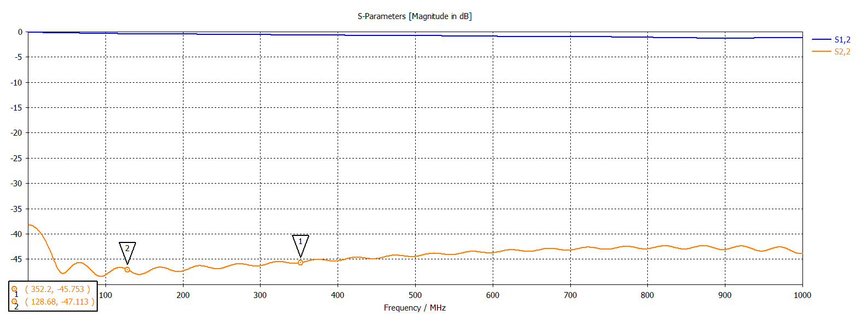
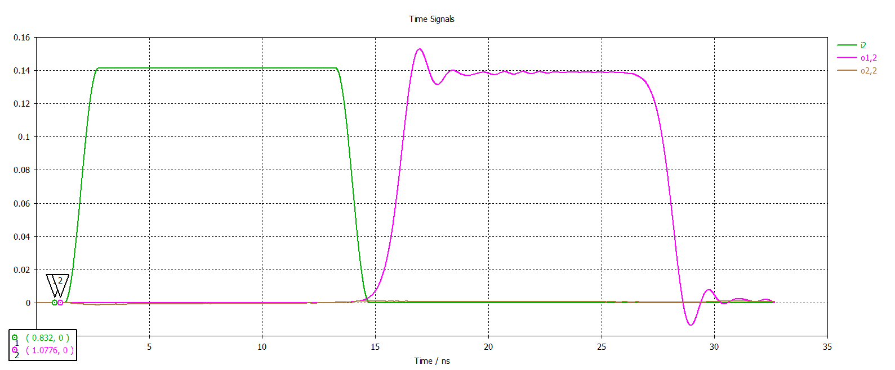
Current Design:
Transmission Properties over 40 cm
Target

Slide 3
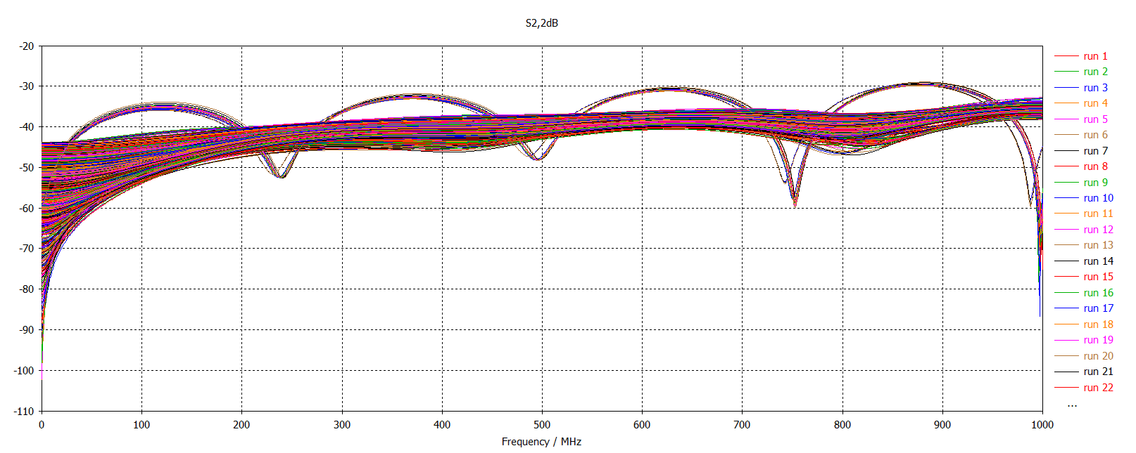
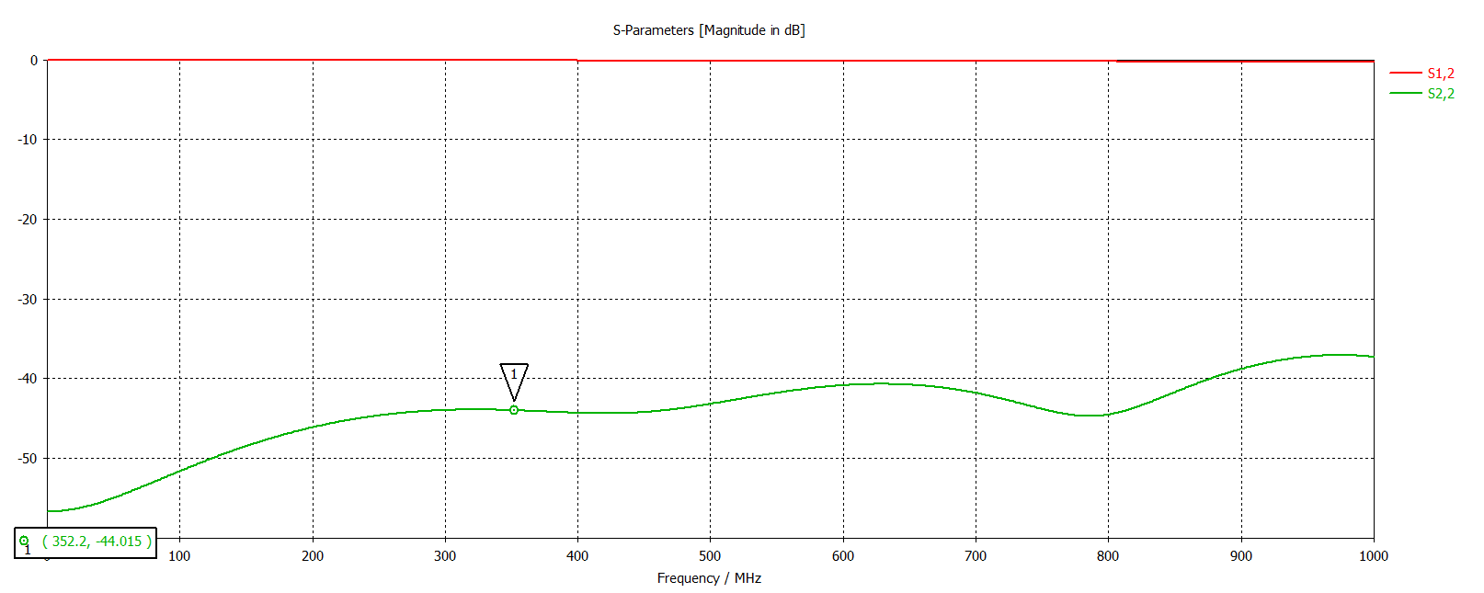
Fine Tuning
There is still some ongoing fine tuning to further improve the transmission properties.
Some improvement has been gained but another large scale (>6cm) simulation has not been performed yet for full results.

Slide 4
What’s next?
Recreation of the chopper in ANSYS HFSS simulation software to verify the results calculated with CST MWS.
Further simulation work, studying:
  Coverage factor of the kicking signal
  Effective velocity of the fast chopping signal
  Current density in the meander line track
Finalising the design will require changes to the transverse width of the ceramic substrate, and the overall length of the structure.
  Dimensions for the chopper vacuum vessel will need to be agreed prior to setting these dimensions
Discussions with the CERN LINAC4 team:
  Feedthrough design – preferably done after seeing how the CERN chopper feedthroughs have been designed, as these should be very similar to our own.
  Discussions with the CERN design team regarding some unexpected differences in dimensions for impedance matching between our and there designs.

Slide 5
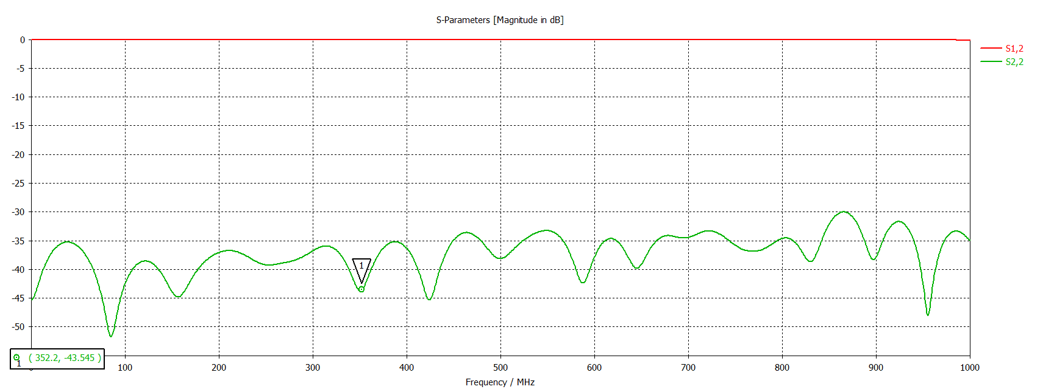
Vacuum Vessel Internal Dimensions
The inner dimensions of the vacuum vessel have been shown to have a significant impact of the transmission properties of the new chopper.
How the chopper will be mounted will affect these dimensions.
Any required cooling for the chopper plate will also need to be considered.
  This is dependant on the amount of beam expected to collide with the chopper (~1% at CERN).
Scattering parameters of the chopper with +10 mm vacuum added to both transverse edges.
Scattering parameters of the chopper with no vacuum.

Slide 6
Vacuum Vessel - Feedthroughs
The feedthroughs of the chopper will need to be designed and impedance matched to the plate to prevent reflected signals.
  Ideally, these can be the same as those used on the CERN chopper, as both use 50 Ω lines at the feedthrough positions.
  However this should be discussed with the CERN team as their 50 Ω and 100 Ω line dimensions differ from ours (a separate point that should also be discussed!) and they also use a different length and power of signal.

Slide 7
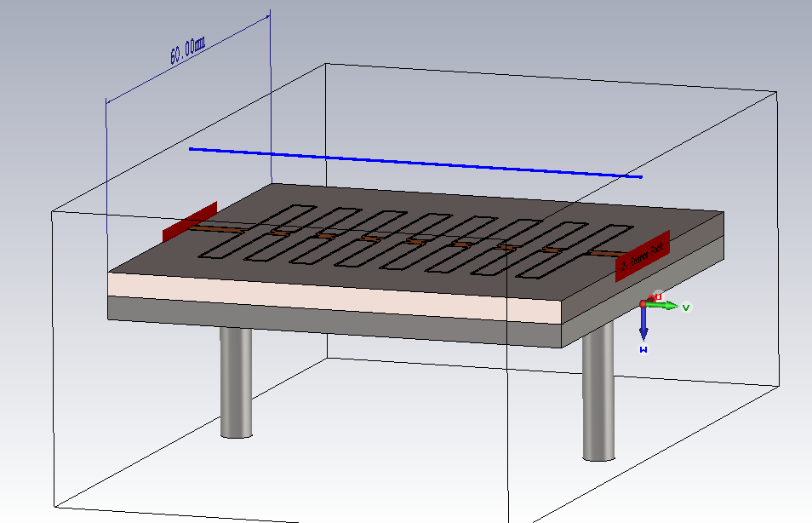
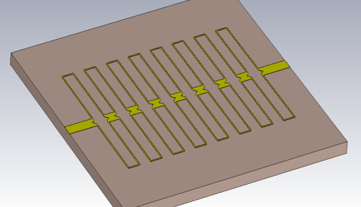
Increasing the Simulation Scale
To both design the RF feedthroughs and to optimise the internal vacuum vessel dimensions, the simulation must now include a much larger area of vacuum around the chopper plate:

Slide 8
Discussions with the CERN team
There are a few things that ideally will be discussed with the CERN chopper team, including:
  Differing track widths when targeting the same impedances as their design.
  Requirement for water cooling on the chopper plate.
  Method of mounting the chopper in the vacuum vessel.
  Details of the feedthroughs used in the CERN design.
  Impact of cooling and mounting on the performance of the chopper.

