Slide 1
MEBT Status
FETS meeting
UCL
8 May 2013

Slide 2
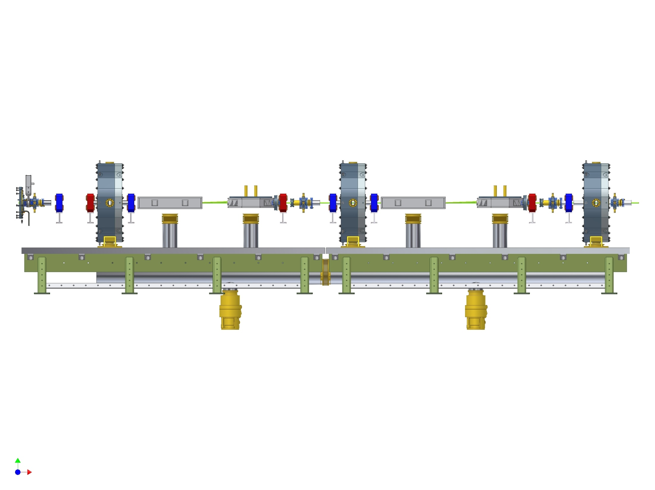

Slide 3
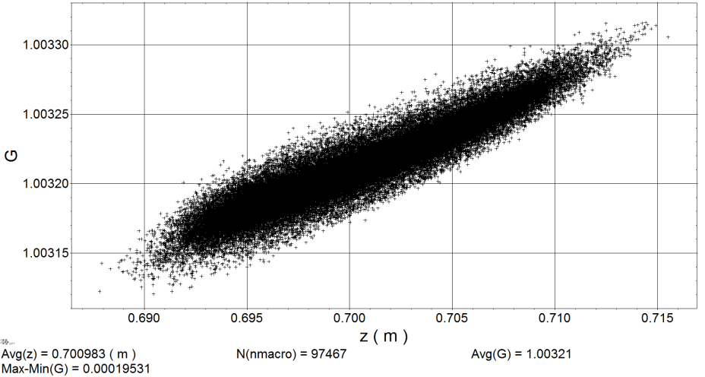
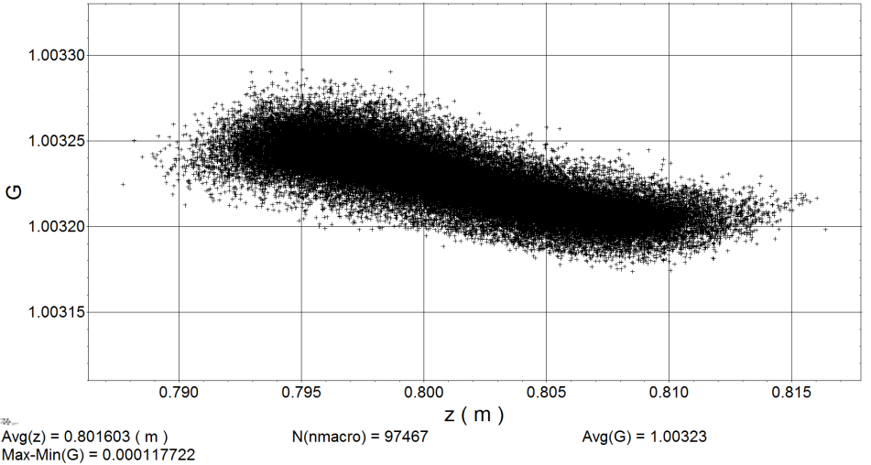
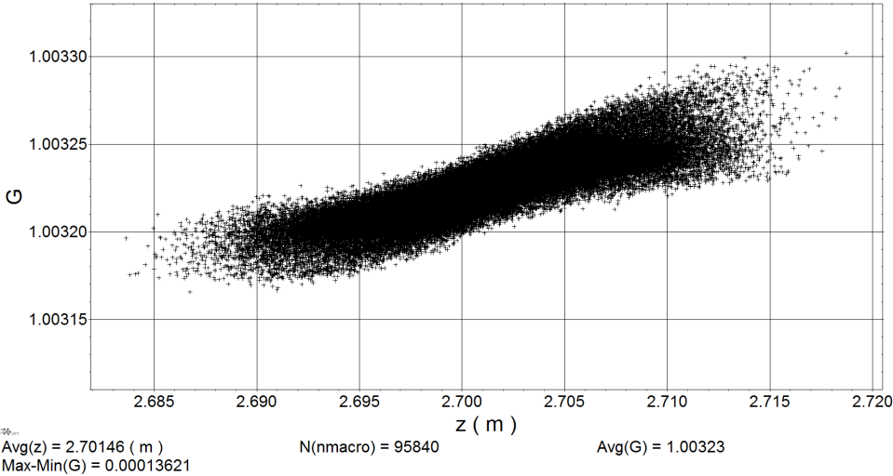
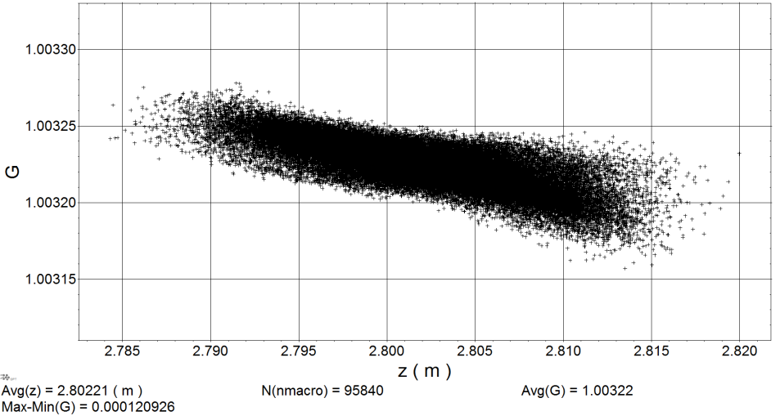
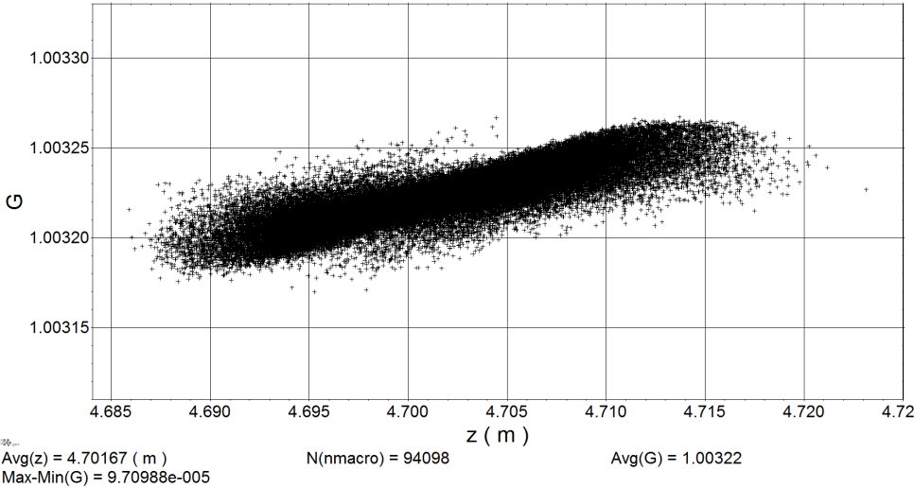
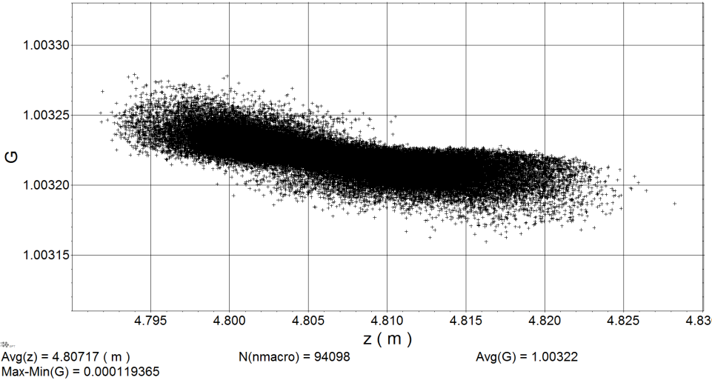

Slide 4
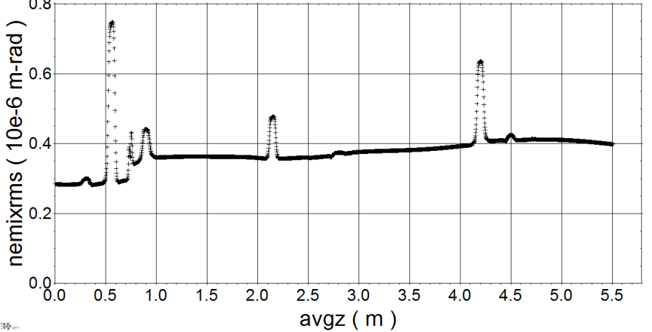
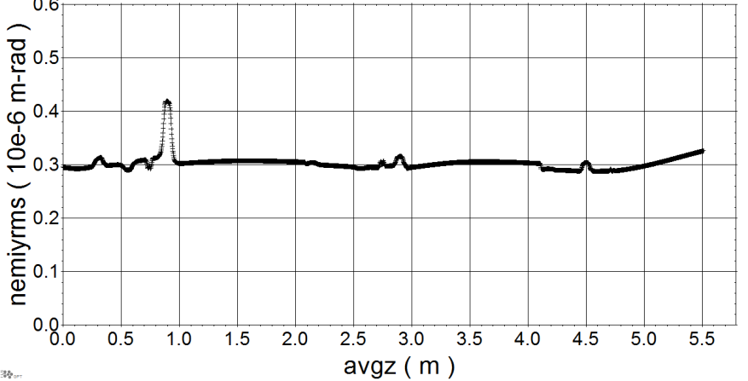
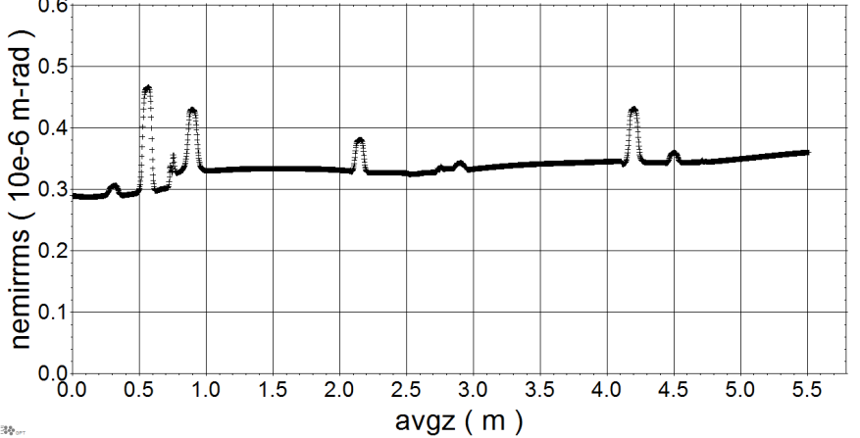
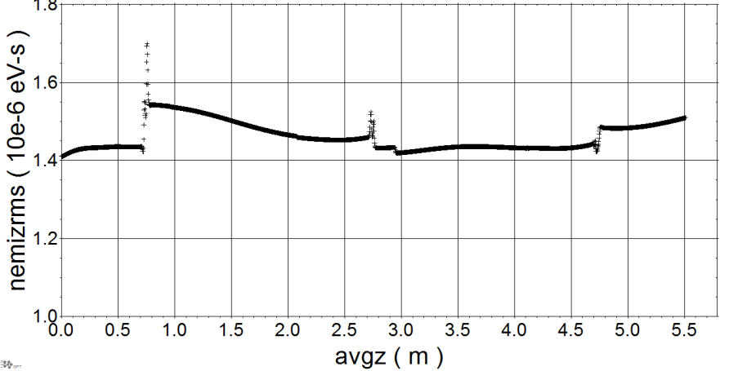
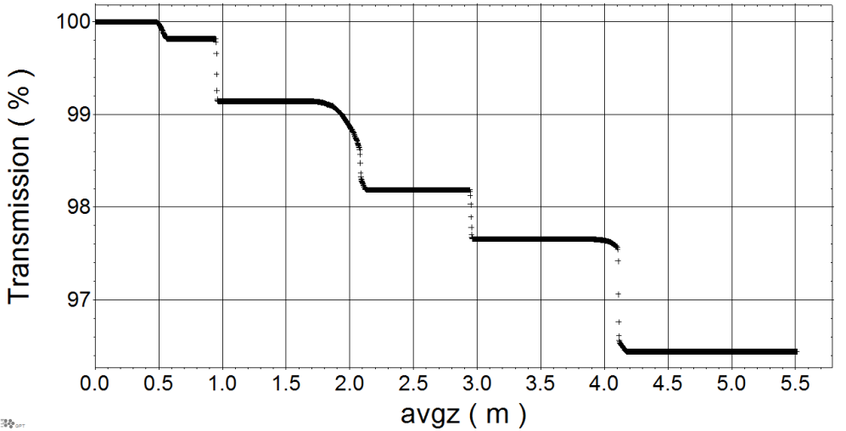

Slide 5
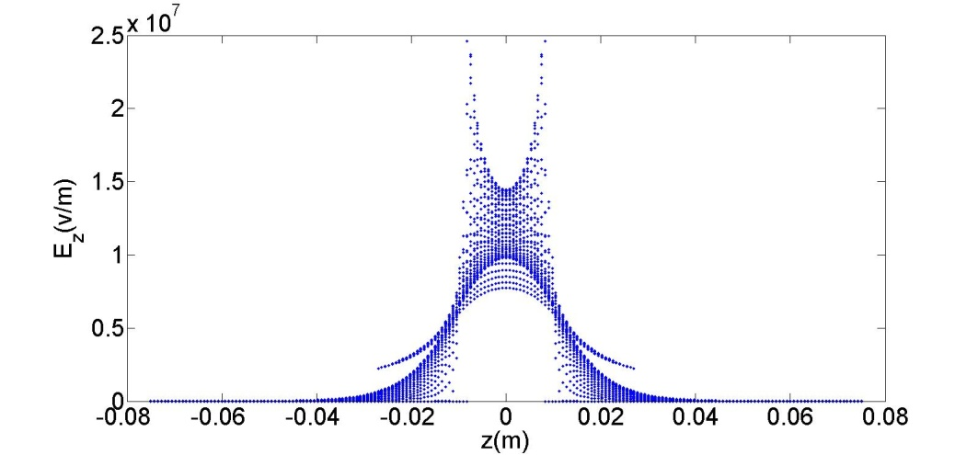
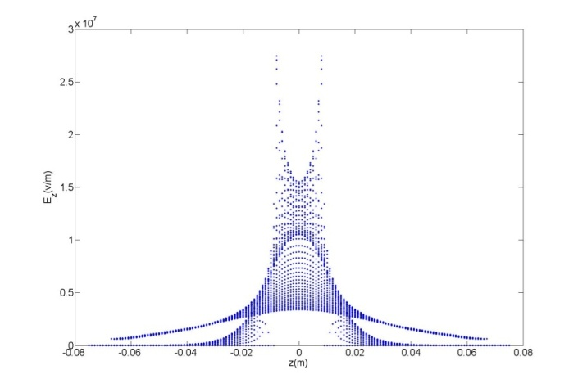
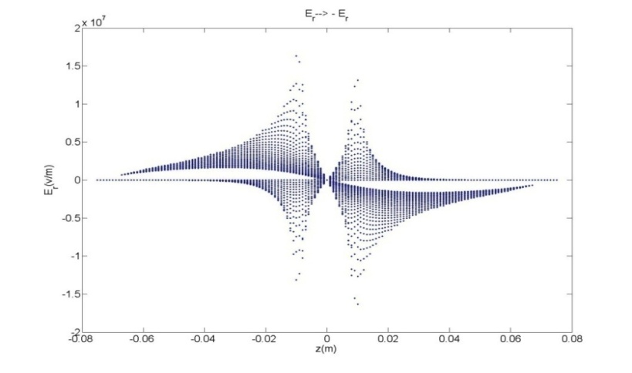
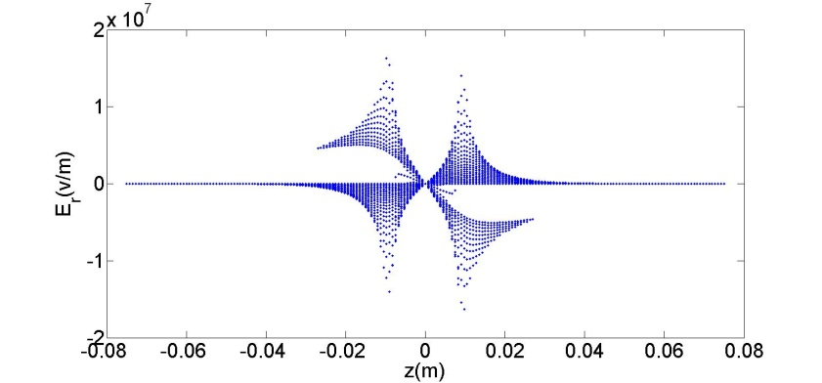
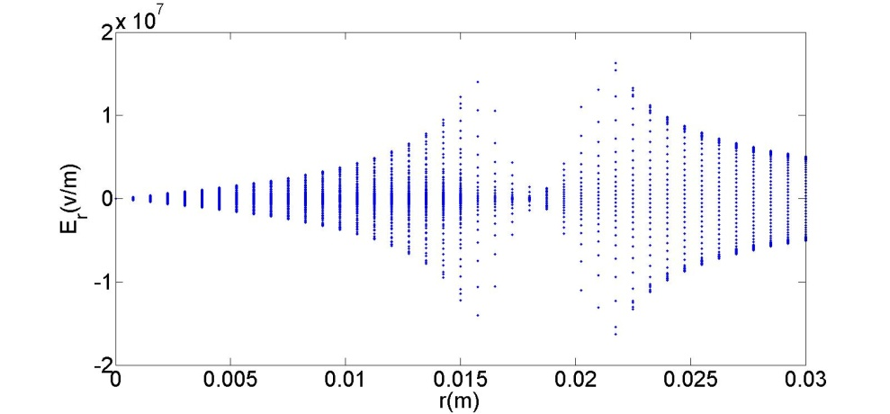
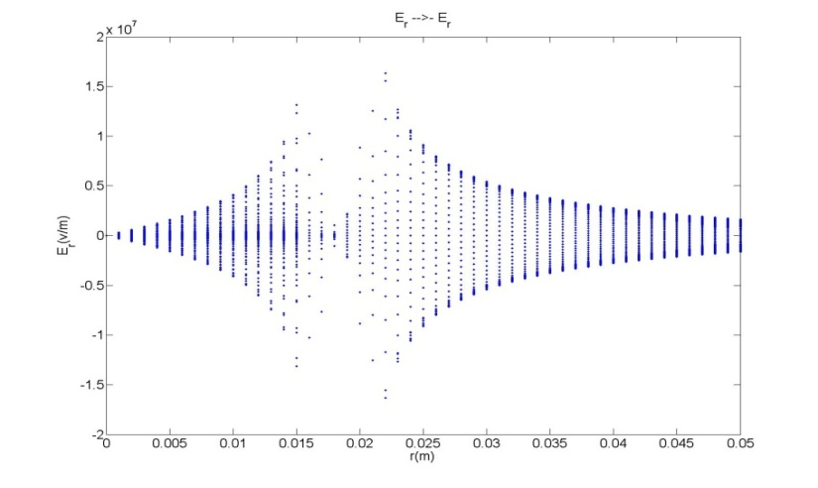
Alan field map using Gdf2a
My field map

Slide 6
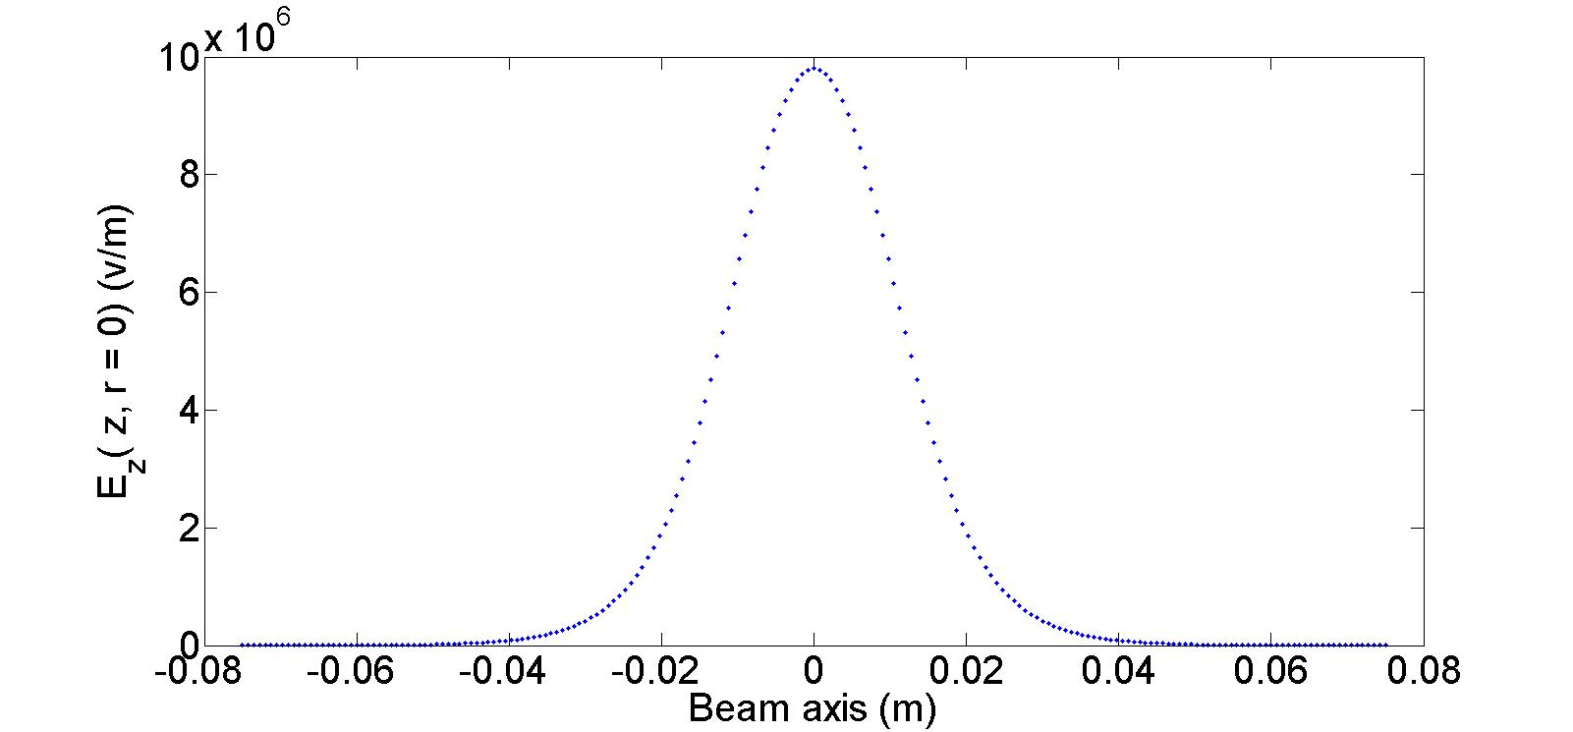

Slide 7
vaxial_poisson = ∫ E_{z}(z, r=0) = 2.755280474250000e+005
GPTscaling =0.61
vaxial= 1.680721089292500e+005
Shunt impedance per meter= 37.759e6 Ω/m
Cavity Length= 0.16 m
r = 6041440 Ω Shunt Impedance
p=vaxial²/r= 4.675e+003
p_final=p*1.25= 5.844e+003
In good agreement with results in the Juergen’s email:
12.57 kW *0.61^2*1.25 = 5.83 kW

