Slide 1
FETS Laser Status 17.04.2013
Alessio Bosco, Stephen Gibson, Christoph Gabor
Fibre laser has returned from Manlight, France and initial tests conducted this week at Royal Holloway to assess performance after repair.
Average power measured directly at output from laser and then after beam splitter while sampling pulses with a fast photodiode.
Pulses detected and measured by a 1 GHz bandwidth photodiode connected to a 4Gs/s scope
M² measured by a CCD camera on a translation stage. Laser focused by a lens with f=500mm
Photodiode
CCD
Lens f=500mm
Fibre from
laser
Laser head
Optical power meter

Slide 2
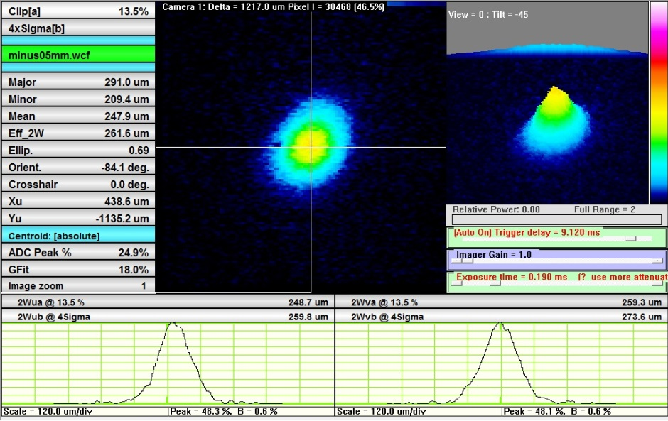
Transversal Mode Quality

Slide 3
Power Vs Duty Cycle
- Pump Current set at 55 A
- Pump modulation set at 5Hz (200 ms period)
- Pulse duration varied between 1 – 195 ms

Slide 4
Power Vs Duty Cycle
- Pump modulation set at 5Hz (200 ms period).
- Pump Current varied between 20 – 50 A.
- Pulse duration varied in order to keep the average current constant.

