Slide 1
R8 Waveguide Installation and Infrastructure

Slide 2
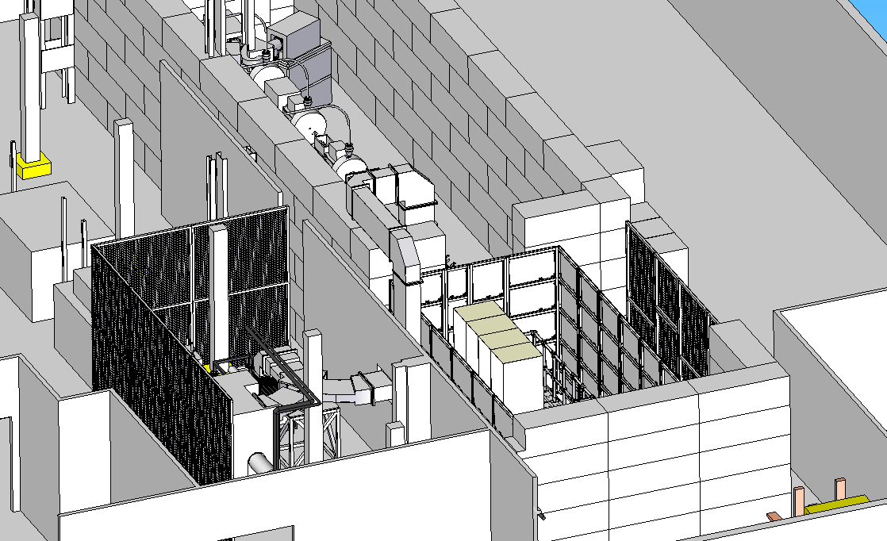
Wave Guide Route 1

Slide 3
Wave Guide Route 1 Requirements
Services on cage side of partition wall will need to be relocated
Access only through roof, not enough room for side entry (269mm between partition wall and shielding)
Klystron will need to move approx. 330mm to allow support frame and dummy load to fit between pillars. This will necessitate re-plumbing the water lines

Slide 4
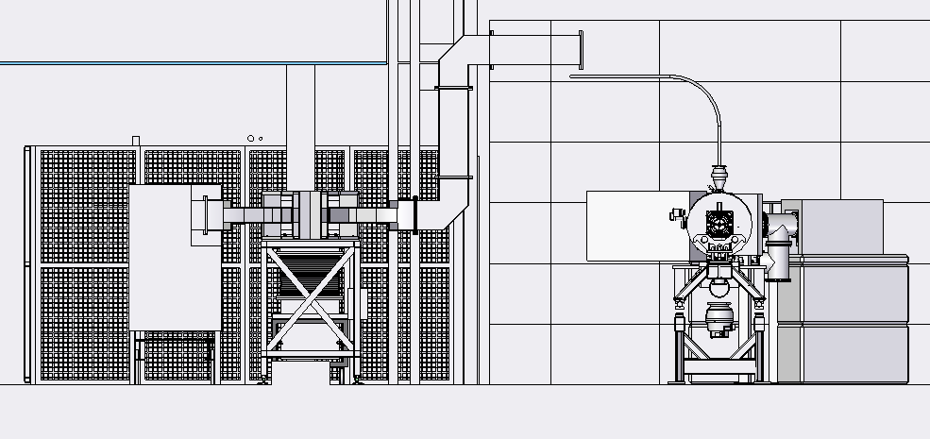
Wave Guide Route 2

Slide 5
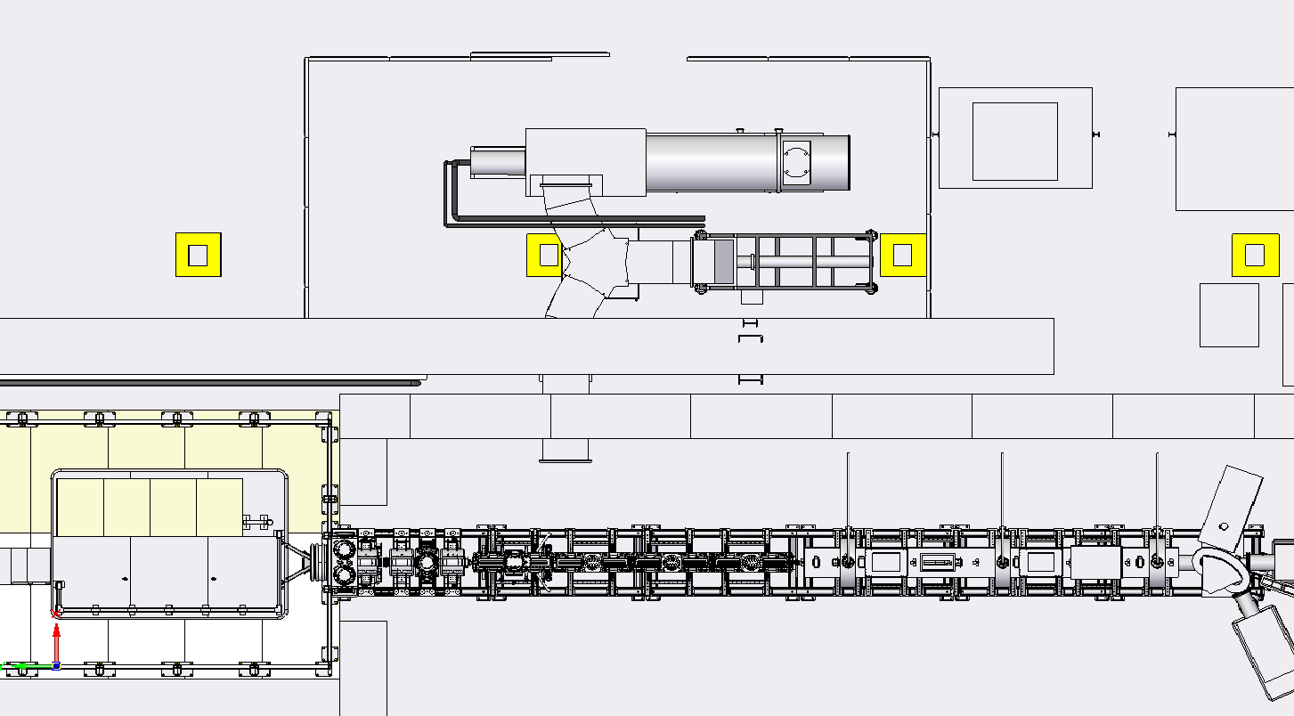
Wave Guide Route 2

Slide 6
Wave Guide Route 2 Requirements
No services will need to be relocated
Access only through side entry
Major re-location of Klystron will be required This may be offset by improved access into instrument
Partition wall section removed to allow for access to waveguide

Slide 7
Waveguide Questions
What is the best option for waveguide route
How will entry through shielding be achieved in either option, does this impact on NELCO’s Design
How will the transition from waveguide to RFQ be done, do we have the height?

Slide 8
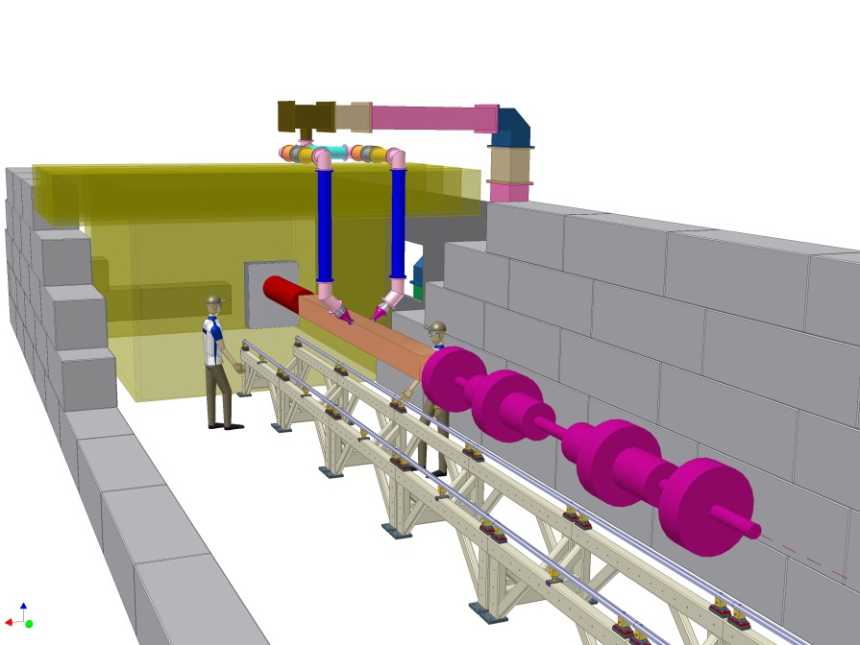
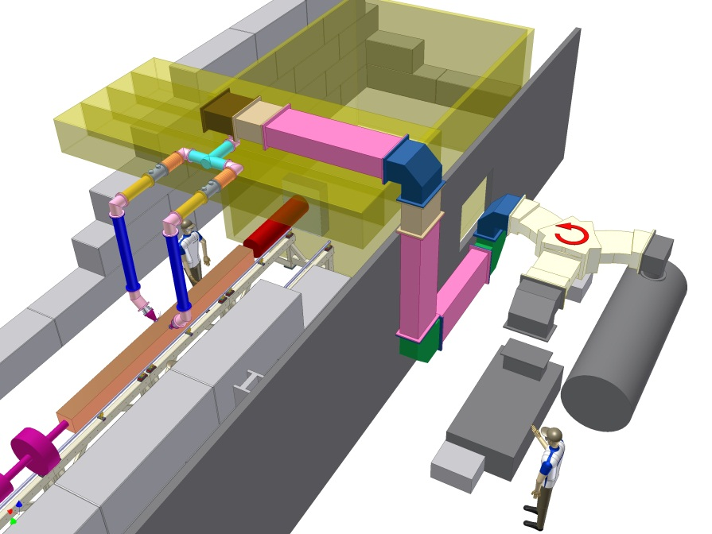
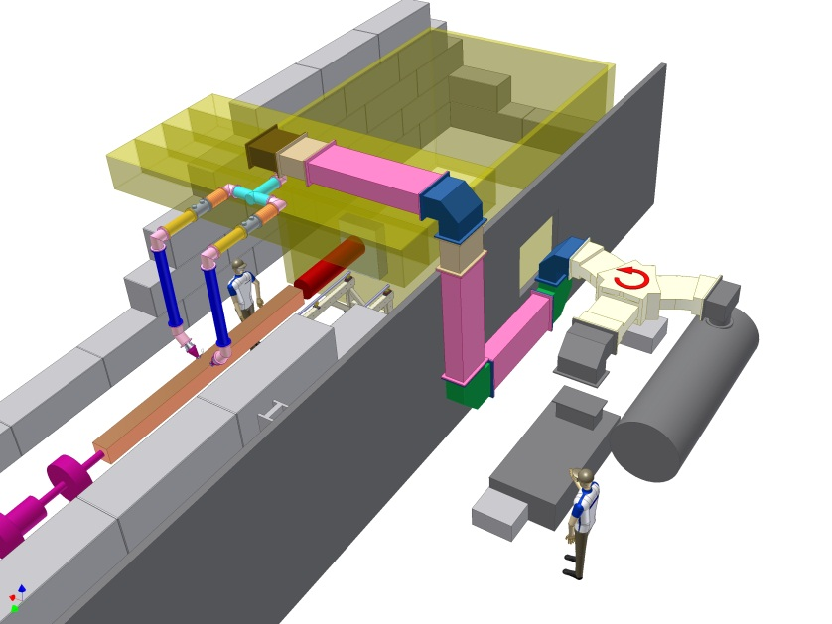
Waveguide route 3

Slide 9
Wave Guide Route 3 Requirements
Minimal Klystron move
No need for dummy load modifications
Waveguide run inside partition wall
Access through partition at shield roof level
Minimal / no coax run reducing RF losses
Transition between waveguide and Tee completed on roof reducing internal height
Two points of entry through shield incorporated in NELCO’s design

Slide 10
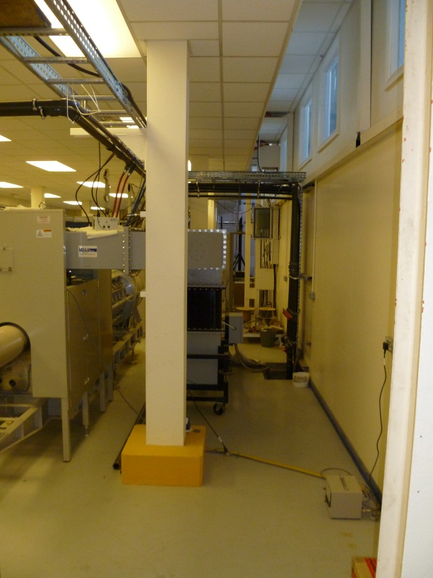
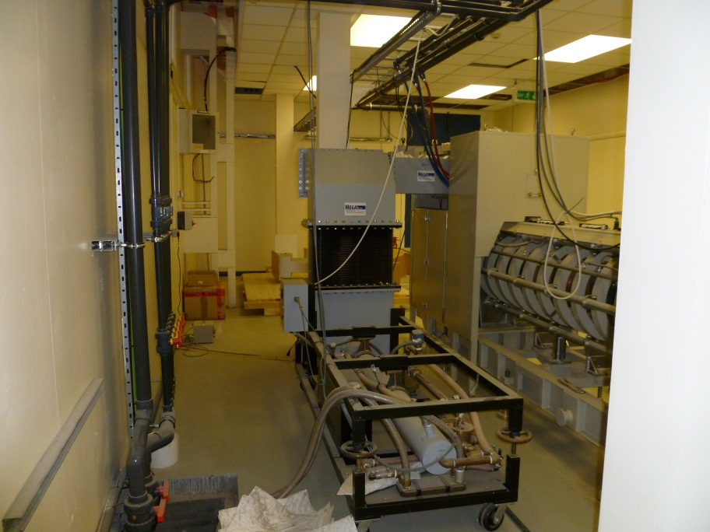
Possible Restrictions
Potential issues with internal roof space / height compared with external shield height
Decision to be made for access to beam line through shield roof
Modifications to Circulator stand and partition roof may be required
Possible Crane impact with waveguide

Slide 11
R8 Infrastructure
Producing detailed layout of Fet’s will allow us to plan as far in the future as possible. For example looking at the impact and restrictions the installation of the shielding could bring

Slide 12
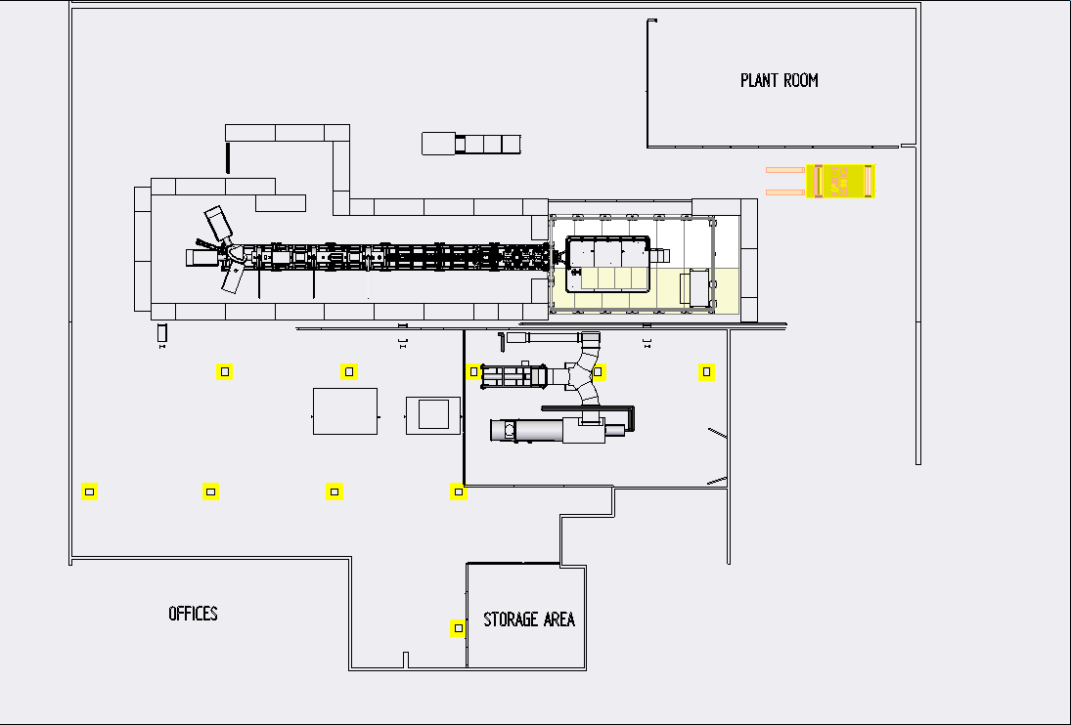

Slide 13
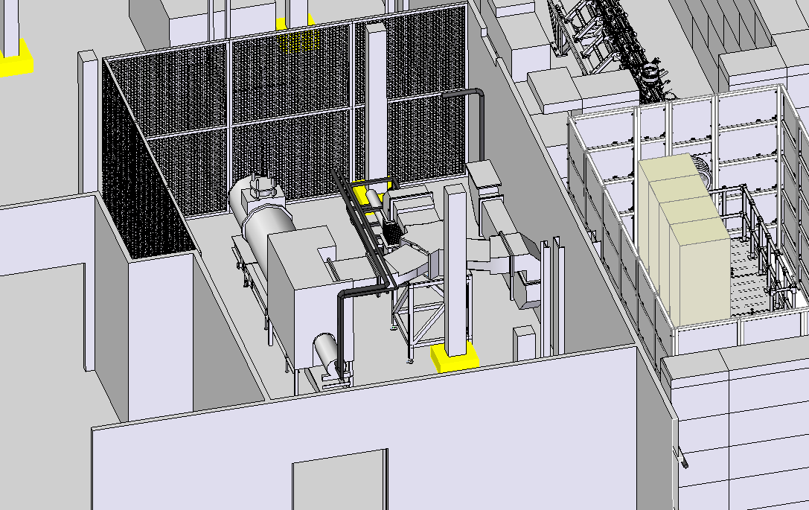

Slide 14
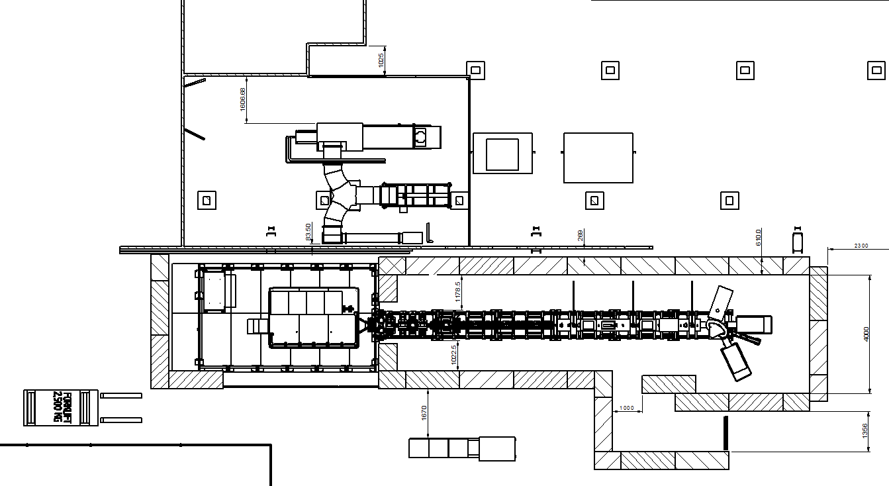

Slide 15
Shielding Questions
Coax Power supply entry for MEBT
Is current trench large enough for all services

Slide 16
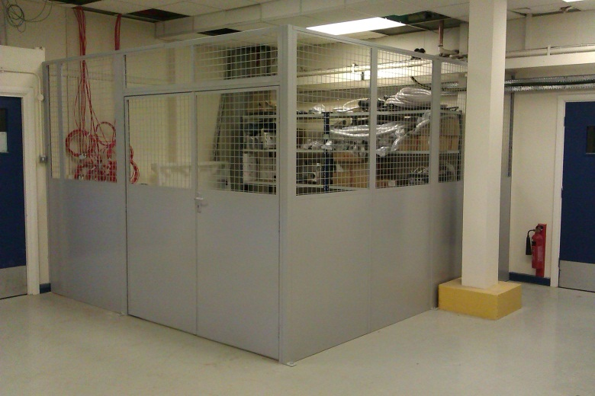
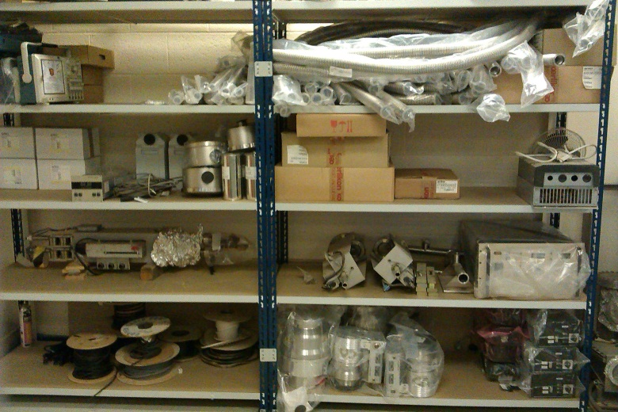
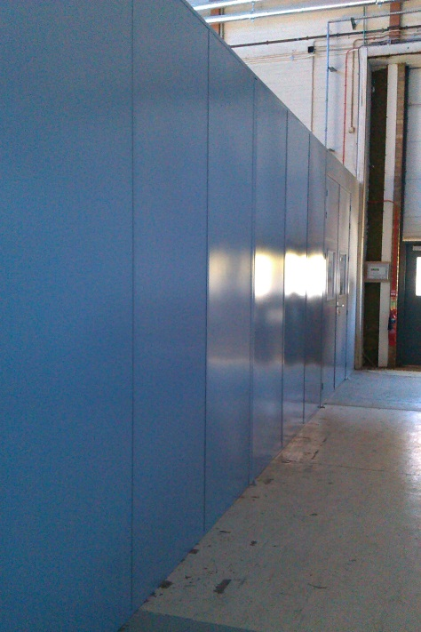
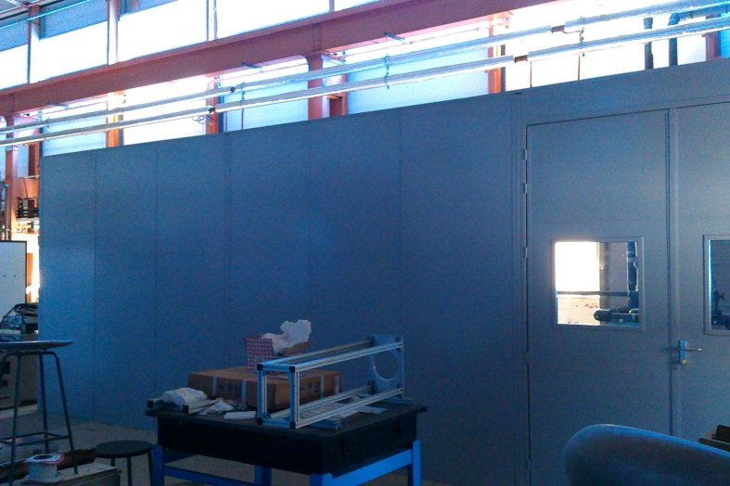
Store / Plant room

