Slide 1
MEBT Quadrupoles
Scott Lawrie
FETS Meeting, RHUL
23rd October 2013

Slide 2
Magnetic Design
Small Bore Quads
  20 Tm⁻¹ field gradient, 1.7 T integrated field
  43 mm bore diameter
  60 mm yoke length, 80 mm total length
Large Bore Quads
  9 Tm⁻¹ field gradient, 1.5 T integrated field
  64 mm bore diameter
  130 mm yoke length, 150 mm total length
Dipole Steerers
  12 mT centre field, 0.81 T.mm integrated field

Slide 3
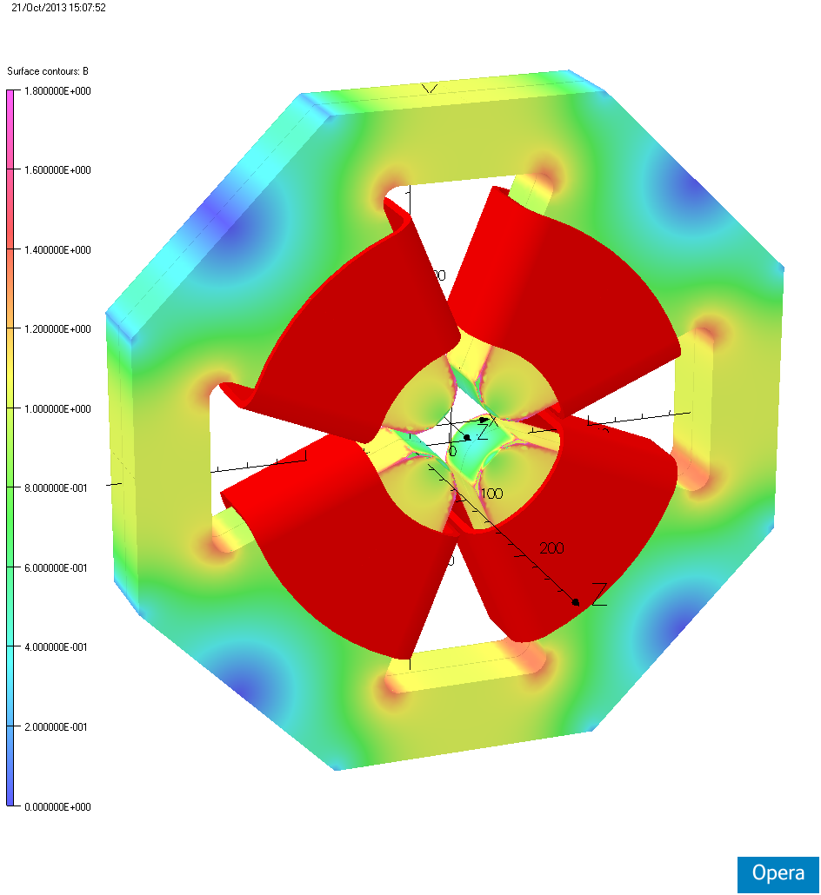
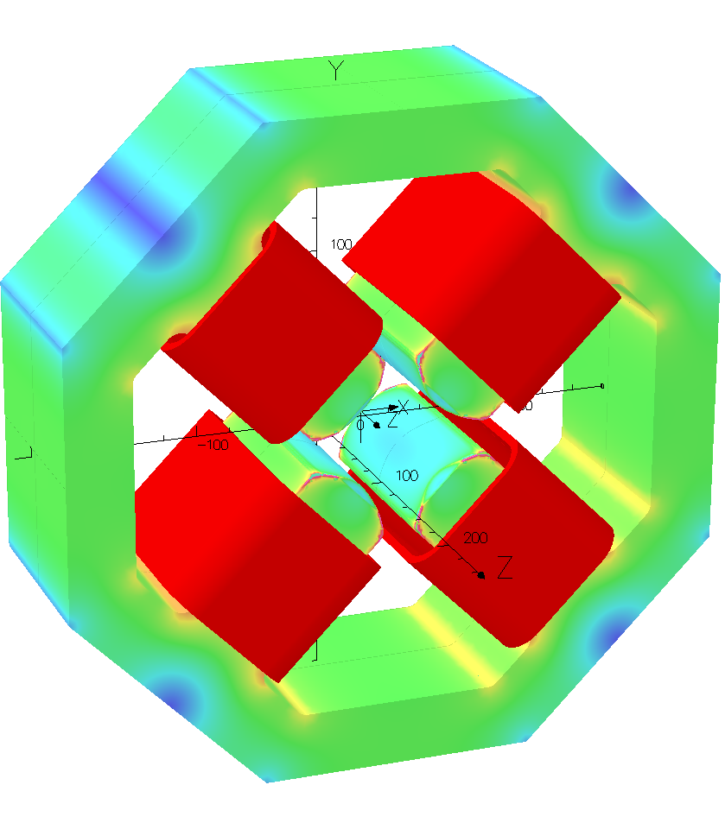
Yoke Fields
Small Bore
Large Bore

Slide 4
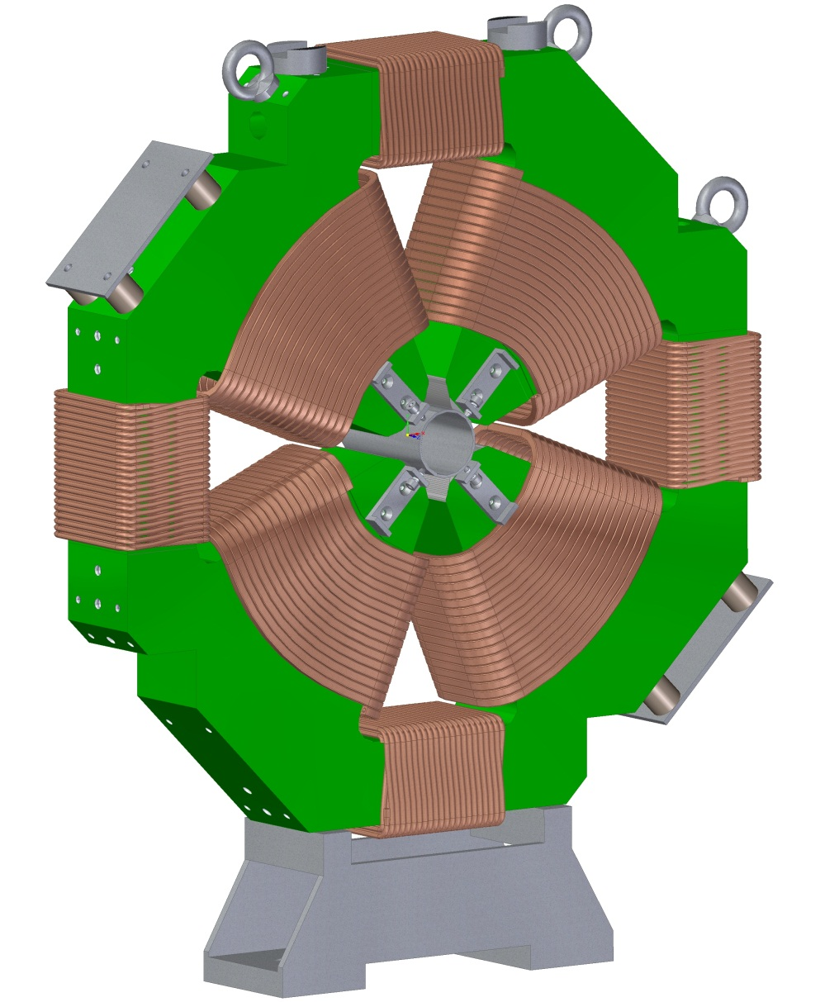
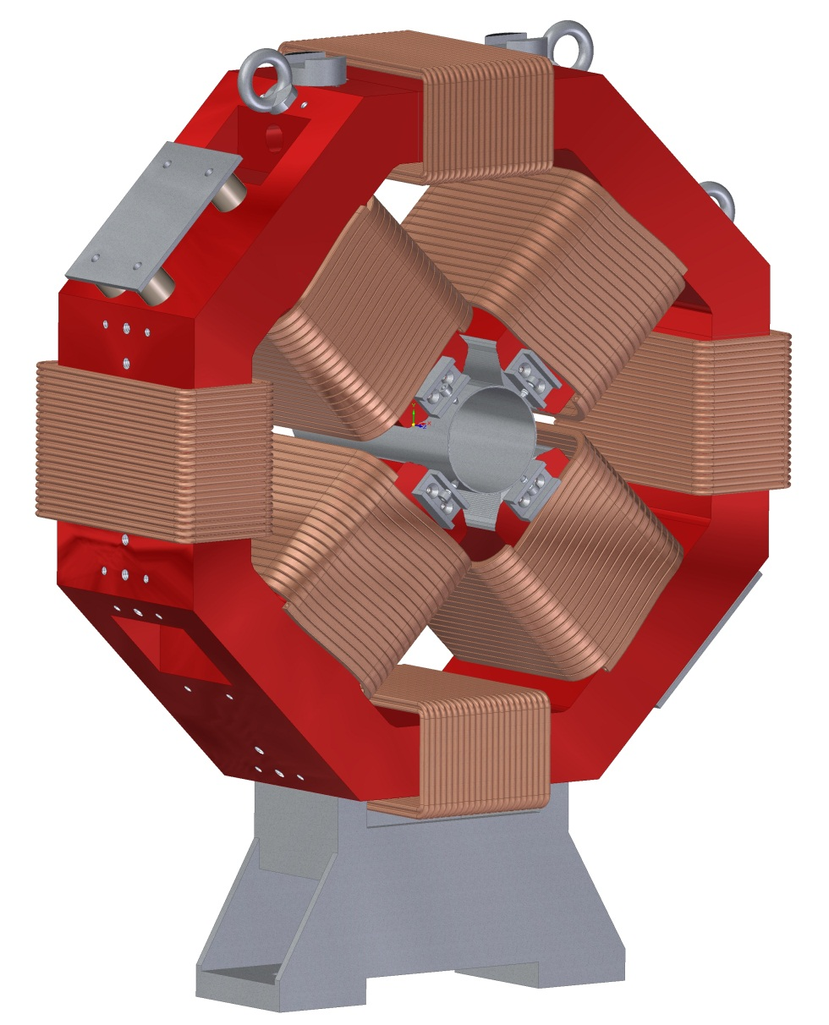
Mechanical Design
Small Bore
Large Bore

Slide 5
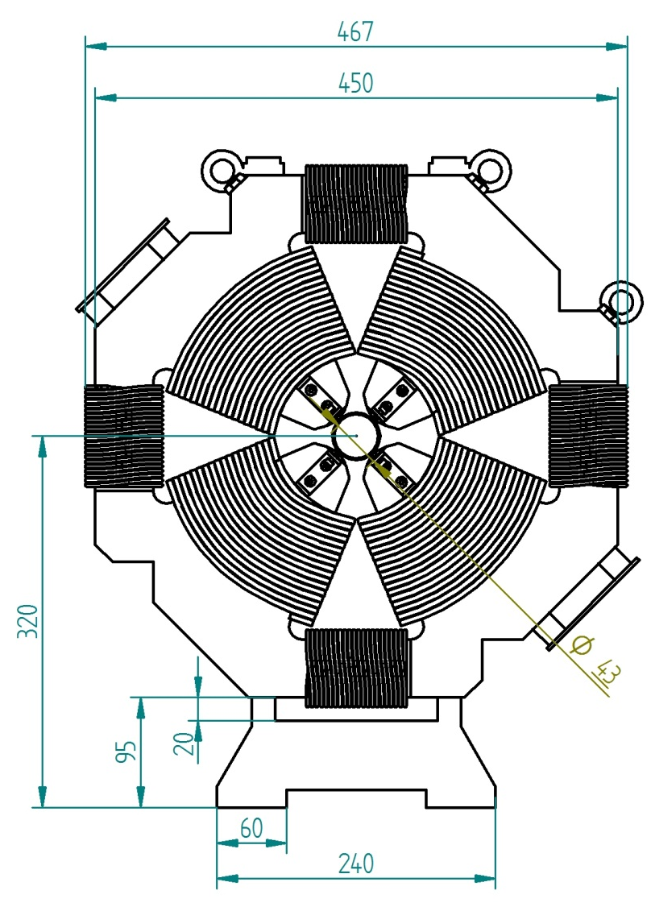

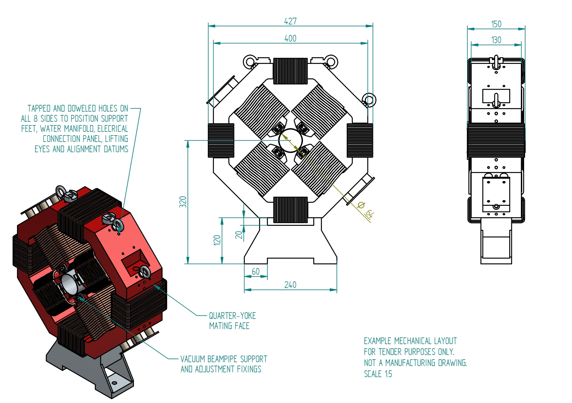
Mechanical Design
Small Bore
Large Bore

Slide 6
Mechanical Design Features
Separable for installation around beampipe
Alignment datums a fixed distance from centre
Support feet a fixed distance above rails
Services panels (electrical & water connections)
Horizontal & vertical dipole steering coils
Beampipe support clamps
Lifting eyes
Possibility of skew rotation
41 page technical specification prepared

Slide 7
List of Required Quadrupoles
# | Bore Diam [mm] | Field Gradient [T/m] | Required Current and Voltage | Power Supply
1 | 43 | -14.38 | 150 A, 5.2 V | 180 A, 8 V
2 | 43 | +17.25 | 180 A, 6.2 V | 220 A, 12 V
3 | 43 | -16.53 | 172 A, 6.0 V | 220 A, 12 V
4 | 43 | +12.59 | 131 A, 4.6 V | 180 A, 8 V
5 | 43 | -6.17 | 64 A, 2.2 V | 100 A, 6 V
6 | 43 | +7.52 | 79 A, 2.7 V | 100 A, 6 V
7 | 43 | -4.77 | 50 A, 1.7 V | 100 A, 6 V
8 | 64 | -1 to +6 | 139 A, 5.0 V | 180 A, 8 V
9 | 64 | -8 to +5 | 185 A, 6.7 V | 220 A, 12 V
10 | 64 | -5 to +2 | 116 A, 4.2 V | 180 A, 8 V
11 | 64 | -3 to +3.5 | 81 A, 2.9 V | 100 A, 6 V
12 | 64 | -4 to +5 | 116 A, 4.2 V | 180 A, 8 V
13 | 64 | -5 to +4 | 116 A, 4.2 V | 180 A, 8 V
Eff. Dipole Gap | Centre Field | Current & Voltage | Power Supply
81.5 mm | 12 mT | 8 A, 5 V | 10 A, 20 V

Slide 8
Power Supply Quotations
Supplier | Model | Price | QTY | Sum | Notes
TTi (Ametek) | XFR-12V-220A | £3,004 | 3 | £26,034 | Used on ONIAC.
 | XG-8V-200A | £1,882 | 6
 | XG-6V-110A | £1,433 | 4
 | HPD-30V-10A | £1,218 | 10 | £12,180
Glassman | LP-12V-220A | £2,880 | 3 | £23,730 | Used on ONAIC and extensively on ISIS. Excellent low ripple. Good relationship. Excellent servicing.
 | LPC-8V-187.5A | £1,597 | 6
 | LPC-6V-110A | £1,377 | 4
 | HM-30V-10A | £1,230 | 10 | £12,300
PPM (TDK-Lambda) | GEN-15V-220A | £2,530 | 3 | £20,466 | Used extensively on ISIS. Good low ripple. Good relationship. Modifications available. Z+ very compact unit.
 | GEN-8V-180A | £1,426 | 6
 | GEN-6V-100A | £1,080 | 4
 | Z+ 20V-10A | £773 | 10 | £7,730
ETPS | DSP-12.5V-240A | £1,870 | 3 | £15,070 | Not used on ISIS. Stories of poor reliability. Poor ripple.
 | DSP-8V-180A | £1,060 | 6
 | DSP-6V-100A | £775 | 4
 | DSP-40V-19A | £700 | 10 | £7,000

Slide 9
Summary
Possibility to reduce costs by:
Use ETPS power supplies despite risks
Reduce field range of large-bore quads
Remove large-bore quads entirely
Dipole coils only where needed
Power supply lead time ~8 weeks
Quads out for tender (£20k-£50k?)
  Quotes due end of October
  Aim for staged delivery & payments

