Slide 1
Progress on the VESPA:
The Road to a 100 mA Beam
FETS Meeting
13th February 2013

Slide 2
Vessel for Extraction and Source Plasma Analyses: VESPA
Purpose-built test stand to study and improve ISIS/FETS ion source
  Plasma
  Beam Transport
  Reliability/Longevity
Plasma and beam diagnostics
More efficient beam extraction optics

Slide 3
Two versions with different aims:
VESPA Mk 1
  Proof of principle: not optimal design
  Re-use existing vessel and parts: cost-effective
  Operating at present
VESPA Mk 2
  Built for purpose: optimised layout
  Multiple diagnostics
  Compatible with ISIS upgrade schemes
  In design at present

Slide 4
VESPA Mk 1
Vacuum Pump
B-Field
Faraday Cup Within Shield
-4 kV
Ion Source
Vacuum Window
-20 kV
0 kV
Platform Ground
–
+
Protection & ‘Scope
+16 kV Pulsed Extract Power
Laboratory Ground
–
+
-20 kV DC Platform Power

Slide 5
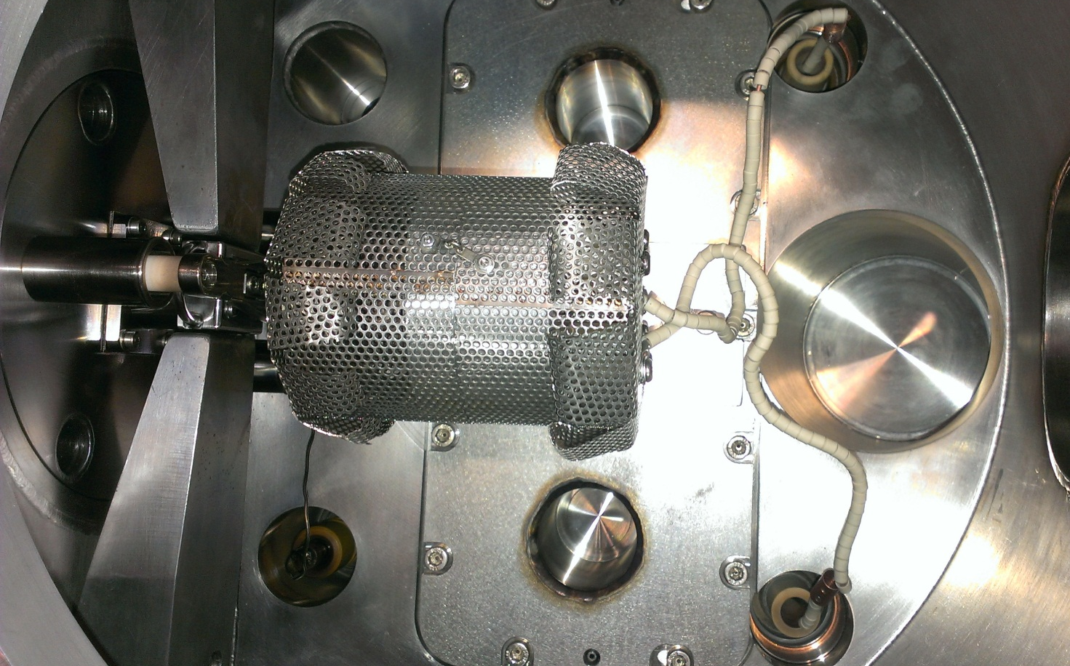
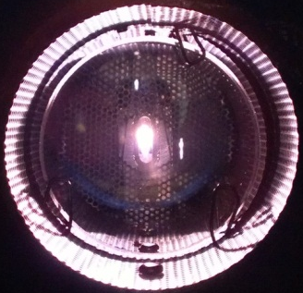
VESPA Mk 1 Internals

Slide 6
VESPA Mk 2
35 kV Insulator
View-ports
Emittance Scanners
Vacuum Gauges
Post-acceleration Electrodes
‘Top-loading’ Ion Source
Optical Monochromator
+20 kV Pulsed Extract Power
Retractable Faraday Cup
Vacuum Window
–
+
2000 L/s Vacuum Pump
–
+
-35 kV DC Platform Power

Slide 7
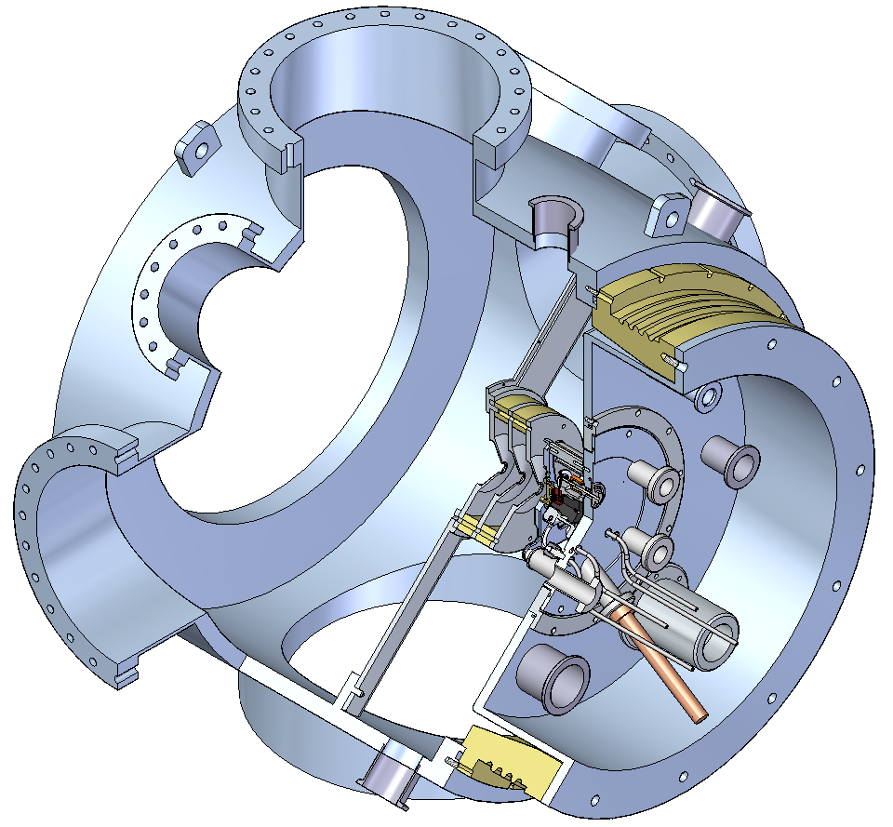
VESPA Mk 2 Present CAD Design

Slide 8
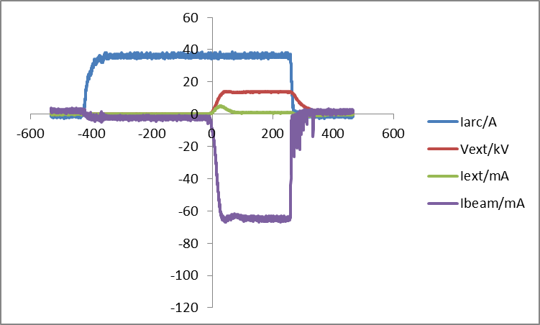
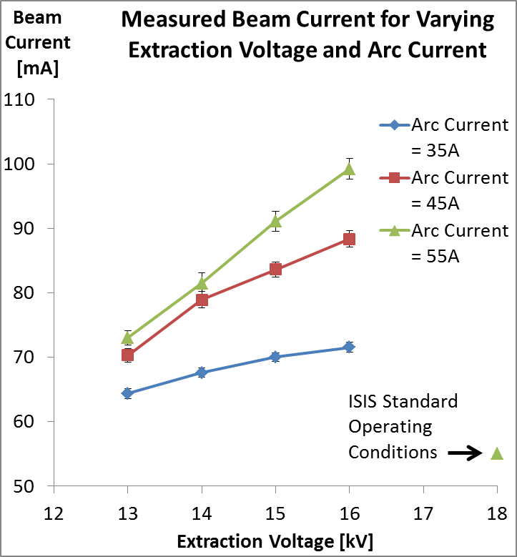
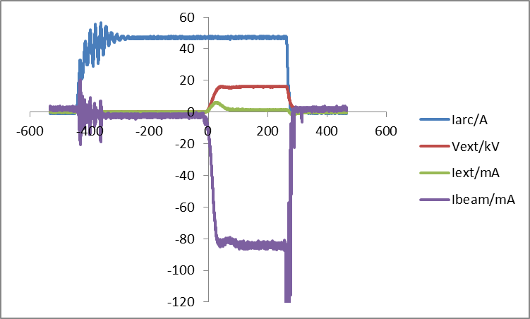
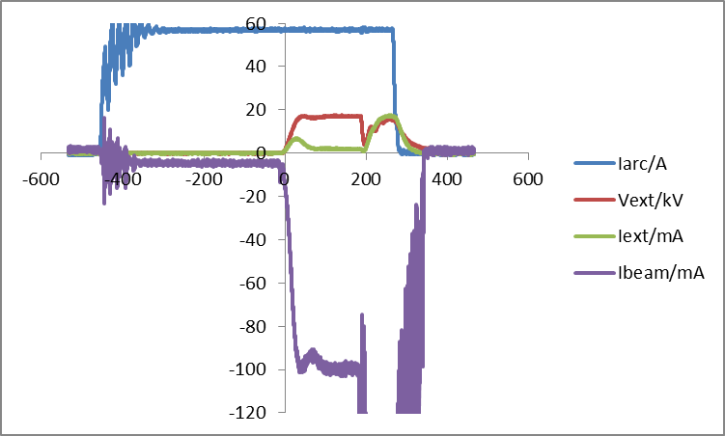
VESPA Mk 1 Results
100 mA of H–!
35 A arc
13 kV extract
45 A arc
15 kV extract
55 A arc
16 kV extract

Slide 9
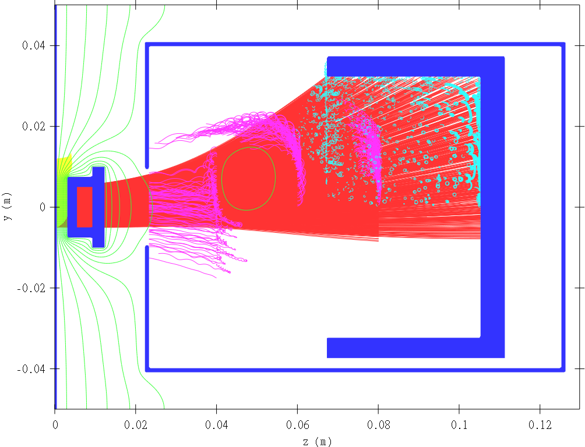
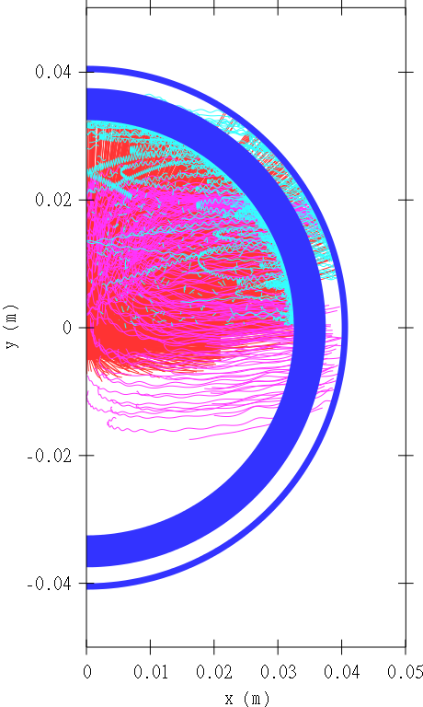
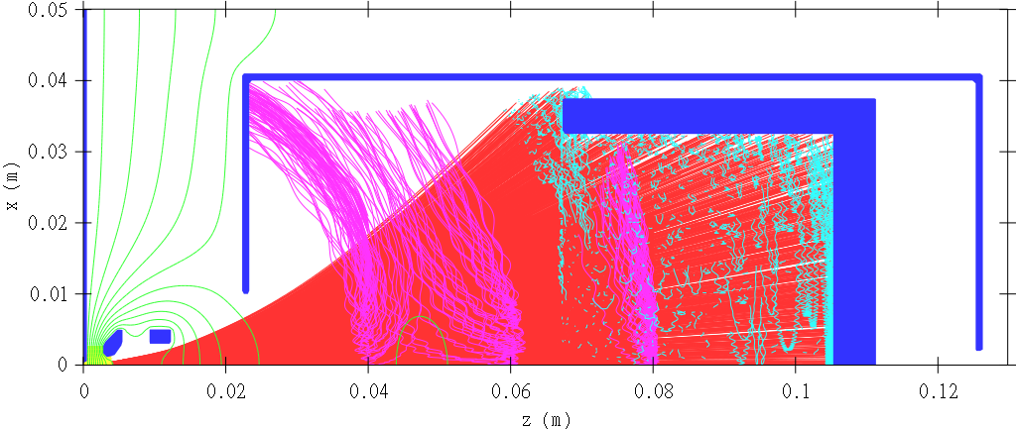
“What About the Electrons?”
Model Geometry
Equipotentials
Extracted H–
Extracted e–
Background e–
Secondary e–
+8 kV
-8 kV
0 kV
H– beam deflected by B-field
e– suppressed by E & B-fields
100 mA extracted H–
1000 mA extracted e–
93.5 mA H– to Faraday cup
2.4 mA e– to Faraday cup

Slide 10
To do…
Sort out sparking problem
Make definitely sure no e– measured
  Extractor negative relative to lab ground
  Dedicated magnetic deflector?
Confirm design of (and build) VESPA Mk 2
Design better extraction system
Clear out lab space

