Slide 1
Effect of vane modulation shape on RFQ frequency
Alan Letchford
31st July 2013

Slide 2
Motivation:
A conversation with Jim Stovall (ex of Los Alamos) in which he claimed that using the ‘two term potential function’ modulation shape results in a flat frequency RFQ design.

Slide 3
RFQ vane modulation.
For a generic vane shape which has no constraints other than the fundamental RFQ symmetries the potential can be expressed as
m+n=2p+1
m≥1
p=0,1,2,3,...
k=π/L_{c}
To approach the design analytically just the first two terms of the infinite sums are taken leading to the so called ‘two term function’ or TTF.

Slide 4
Two Term Function.
where
The TTF is completely defined by the modulation parameters a & m and the cell length.

Slide 5
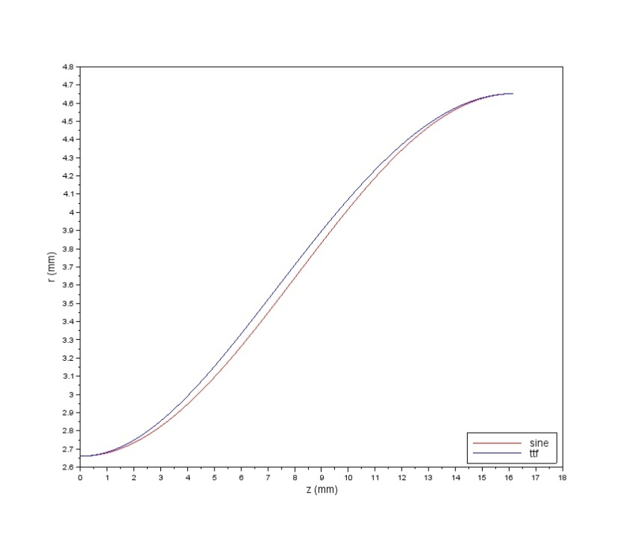
To achieve the TTF in practice requires RFQ vane tips which have a hyperbolic transverse section and a ‘sine-like’ longitudinal profile.
For the FETS RFQ the transverse section is circular and the longitudinal profile is sinusoidal.
Just how ‘sine-like’ is the TTF profile given by
Where the modulation depth is significant, the TTF gives a vane tip which is always further from the axis than the sine function.
This might be expected to effect the capacitance – but in the wrong way ie lower capacitance than the sine shape.

Slide 6
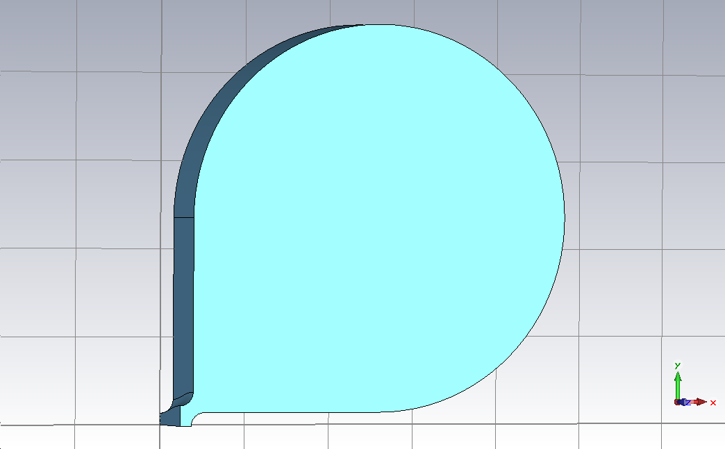
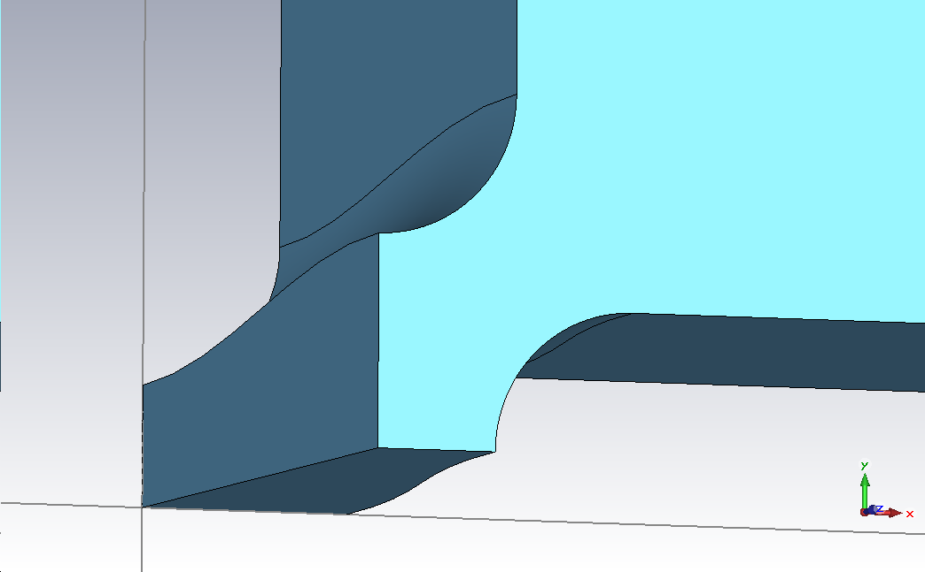
Effect on RFQ frequency.
The FETS RFQ design is ‘constant r₀’ where r₀ is the average vane tip position. For a sinusoidal curve this is just the mean of the modulation extents – a and ma.
The resonant frequencies of representative unit cells of a simplified RFQ were calculated using CST MWS for both the sine and TTF modulation shapes.

Slide 7
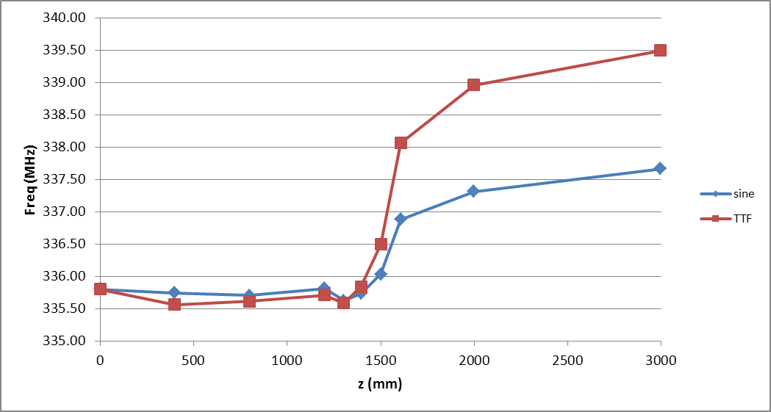
As anticipated, for fixed values of a and m and a circular transverse section the TTF gives an even larger frequency shift than the sine function due to the lower capacitance.

Slide 8
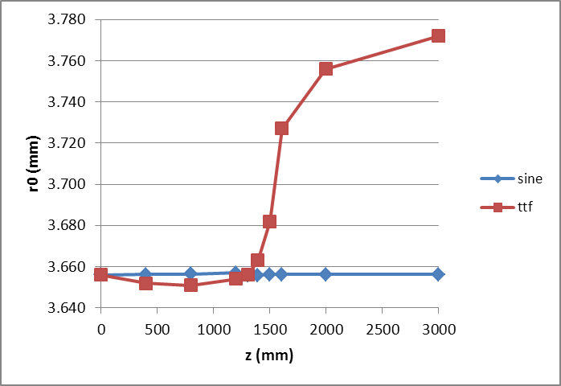
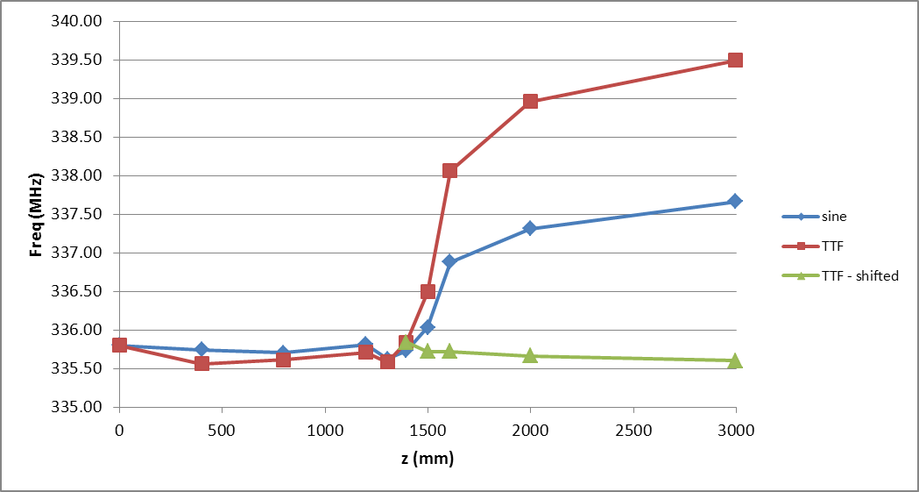
However the TTF shapes no longer results in a constant r₀ design if the same values of a and m are used.
What happens if the TTF shape is used and r₀ kept constant?
The frequency is flat!

Slide 9
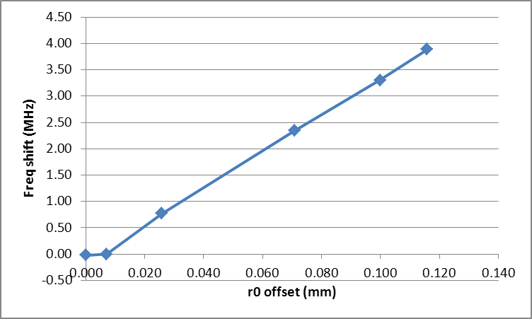
Sensitivity of vane tip position.
The amount that the vane tip has to be shifted to make the TTF shape constant r₀ and the corresponding frequency change is very linear:
This also shows that the vane tip alignment has a far greater impact on field flatness than it does on the beam dynamics.

Slide 10
Beam dynamics simulations of the two vane profiles show that the differences are very small.
The disadvantage of the TTF is that the vane position is not easily defined being the solution to
However using the polynomial expansion of the Bessel function
And taking just the first two terms results in
Which is within <1% of the TTF for practical values of a, m and L.

