Slide 1
BPM Processing - Update
FETS Meeting 28-08-2013
Gary Boorman RHUL

Slide 2
BPMs
Between three and six BPMs to be installed
Obtain beam position with 0.1mm resolution
and 0.1mm accuracy
Post-chopper fast BPM direct to fast scope (no processing)
Aim is to produce a BPM system that has the best
performance for the least cost

Slide 3
LINAC4 front-end electronics
LINAC4 BPM front-end electronics will do the job
(subject to IF and gain tweaks)
Design is already developed and debugged; v2 of card
is being produced (ground loop in v1)
CERN (via Rhodri) have offered to produce extra PCBs
which we can use, but populate ourselves

Slide 4
I/Q in FPGA & RT Processor
Obtain I in electronics; sample in one channel; get Q in FPGA code
Sample at four times IF – sample N (I) is equivalent to
sample N-1 as Q…
Code was developed for FPGA over the summer
Testing using signal generator will start next week
Sample clock (40.5MHz)
PXI-bus
IF (10.125MHz)
DMA
x4
RT
processor
FPGA
Dig.
NI-5752
PXI-7954R

Slide 5
Mean of I, Q, -I, -Q Signals
4N samples
Sum (I)
Sum (Q)
Sum (-I)
Sum (-Q)
/ N
/ N
/ N
/ N

Slide 6
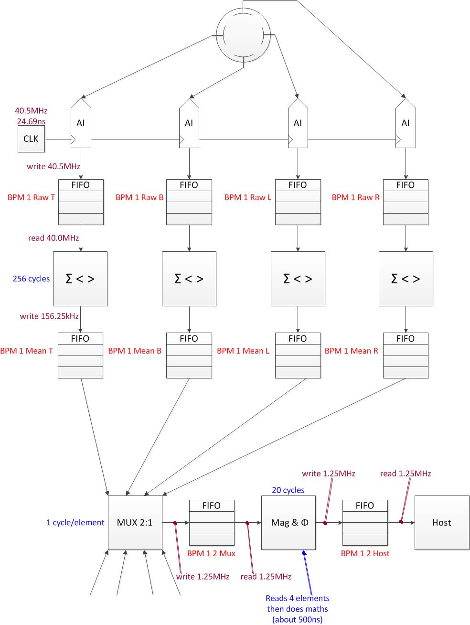
Outline of FPGA Processing

Slide 7
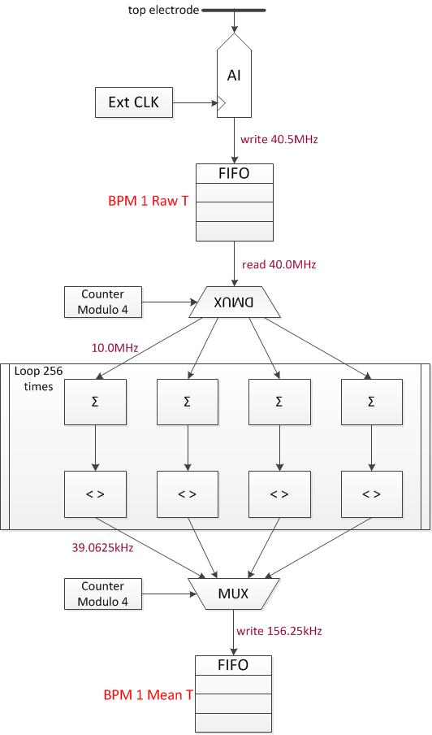
One BPM Electrode Processing

Slide 8
FPGA Timing
External trigger starts the acquisition of BPM signals
4N samples into FPGA mean of I, Q, -I, -Q :1024 samples is 25.6µs
The Magnitude and Phase calculation takes 625ns
For one BPM the Mag /φ takes 2.5µs
The position calculation takes 600ns
Total processing time for one BPM: 3.1µs – so process BPMs in
series to reduce FPGA resource usage
The acquisition/mean and calculations are performed in parallel
This gives a BPM position every 25.6µs, with a latency of 3.1µs x
BPM number

Slide 9
Next Steps…
Start testing the FPGA HW using RF source (asap)
Obtain PCBs from CERN, populate and test using RF source
(autumn 2013)
Test the electronics and FPGA together (autumn 2013)
RD and GB to use test-jig at CERN, with a CERN BPM, to test
the ‘real’ system – required for position constant (end 2013
or early 2014)

