Slide 1
MCNPX Simulation of FETS Beam Dump
Jordan Taylor
1st Year PhD Student
IIAA (International Institute for Accelerator Applications)
University of Huddersfield

Slide 2
Update
The simulation of the beam dump has been completed in FLUKA and MARS for FETS
  Neutron production unsuccessful for aluminium because of cross-section issues
  MCNPX will be used to see if this issue occurs
Since the FETS meeting in May I have been learning MCNPX
I have successfully simulated FETS in MCNPX

Slide 3
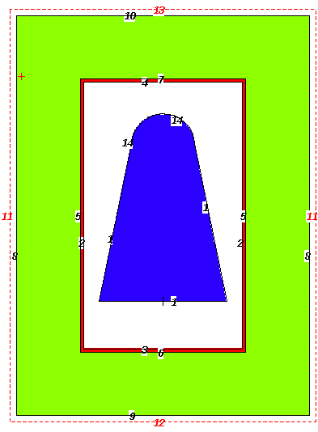
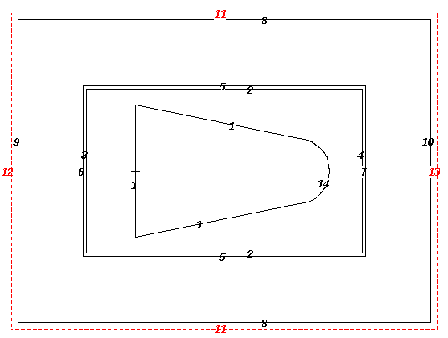
FETS Geometries
Air 20cm cylinder
15cm
10cm
5cm
1cm
Steel
Beampipe
20cm
Beam dump target
9.9cm
50cm
20cm
26cm
20cm
19.8cm
20cm
Vacuum 25cm cylinder

Slide 4
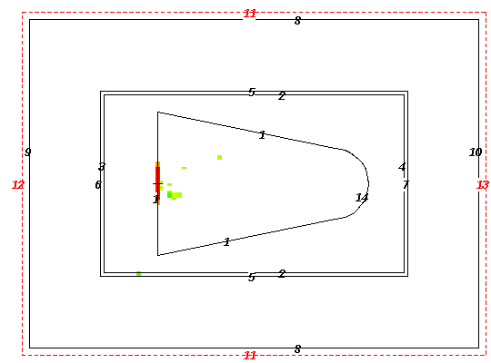
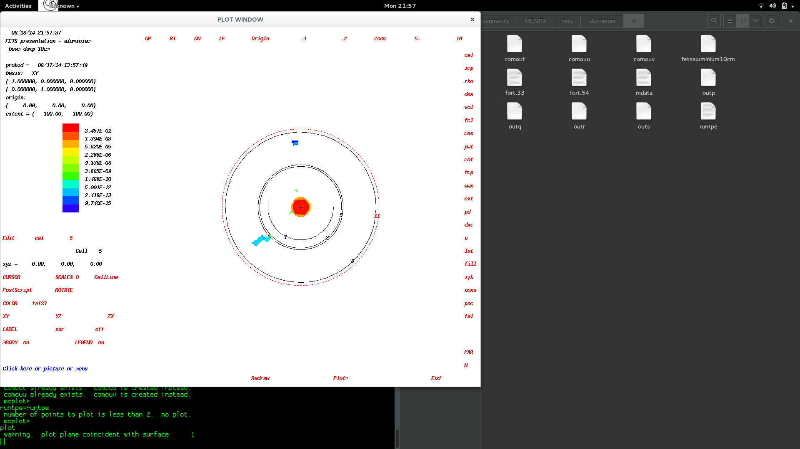
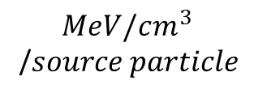
Aluminium Target
Energy deposition plot
Beam parameters
  1 million particles simulate
  3MeV proton beam
  5cm radial beam
  Source 10cm away from target
ZX plane
$$MeV/cm^{3}$$
/$source particle$
XY plane

Slide 5
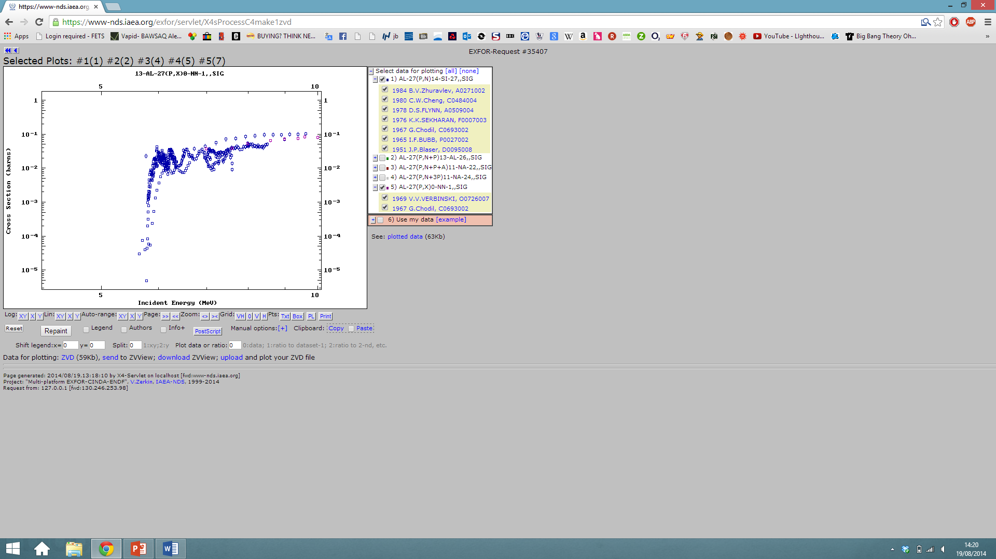
Aluminium Target
Neutron Flux
Beam parameters
  1 million particles simulate
  3MeV proton beam
  5cm radial beam
  Source 10cm away from target
https://www-nds.iaea.org/exfor/exfor.htm
Cross section data from Exfor for p,xn reactions for aluminium.

Slide 6
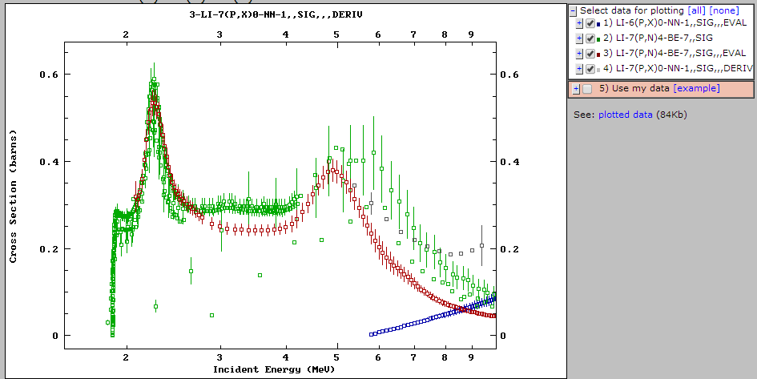
Lithium Cross section

Slide 7
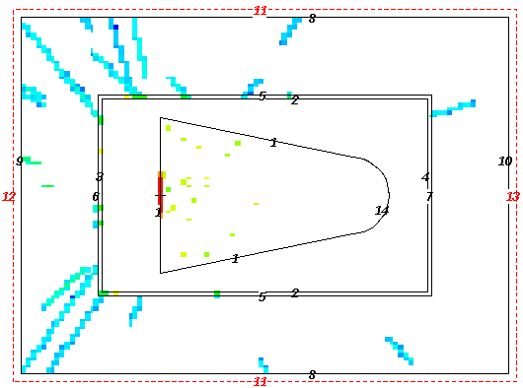
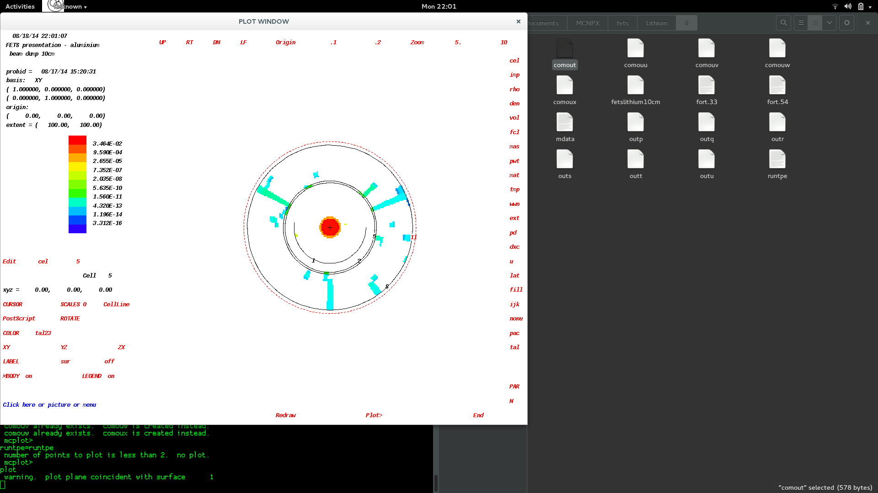
Lithium Target
Energy deposition plot
Moved to Lithium because of known cross section data
Beam parameters
  1 million particles simulate
  3MeV proton beam
  5cm radial beam
  Source 10cm away from target
ZX plane
$$MeV/cm^{3}$$
/$source particle$
XY plane

Slide 8
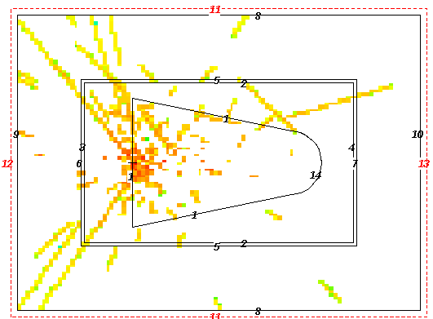
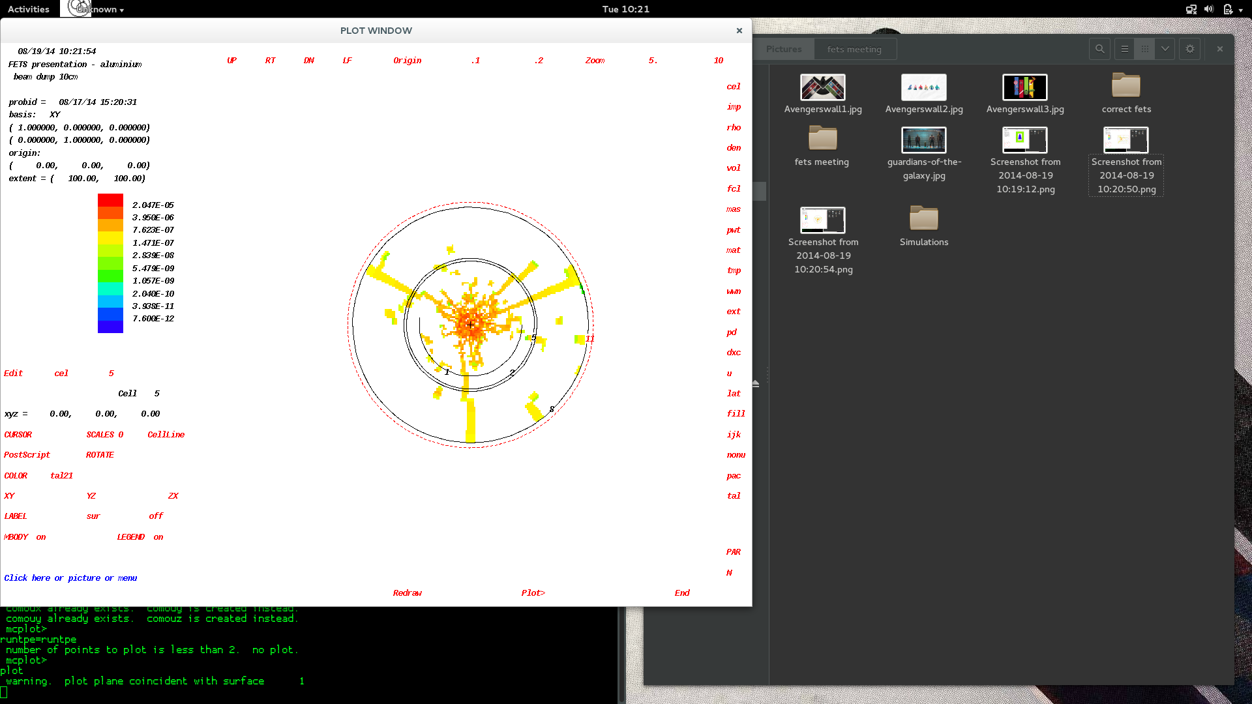
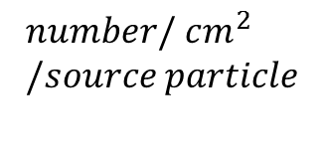
Lithium Target
Neutron Flux plot
Beam parameters
  1 million particles simulate
  3MeV proton beam
  5cm radial beam
  Source 10cm away from target
ZX plane
$$number/ cm^{2} \\ /source particle$$
XY plane

Slide 9
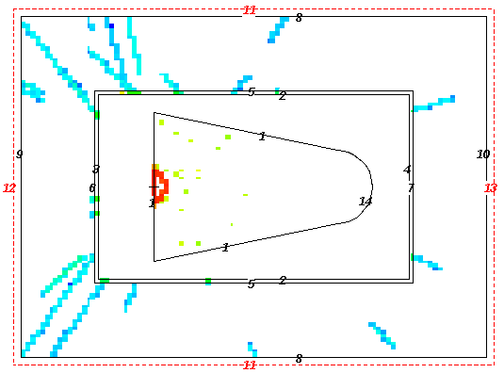
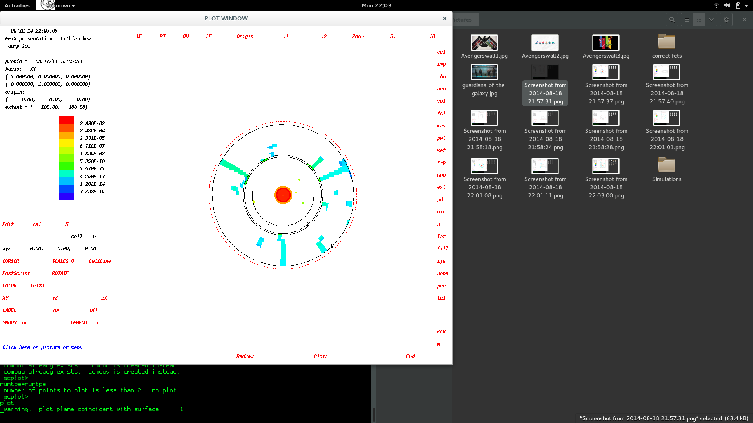
Lithium Target
Energy deposition plot
Beam parameters
  1 million particles simulate
  3MeV proton beam
  5cm radial beam
  Source 2cm away from target
ZX plane
$$MeV/cm^{3}$$
/$source particle$
XY plane

Slide 10
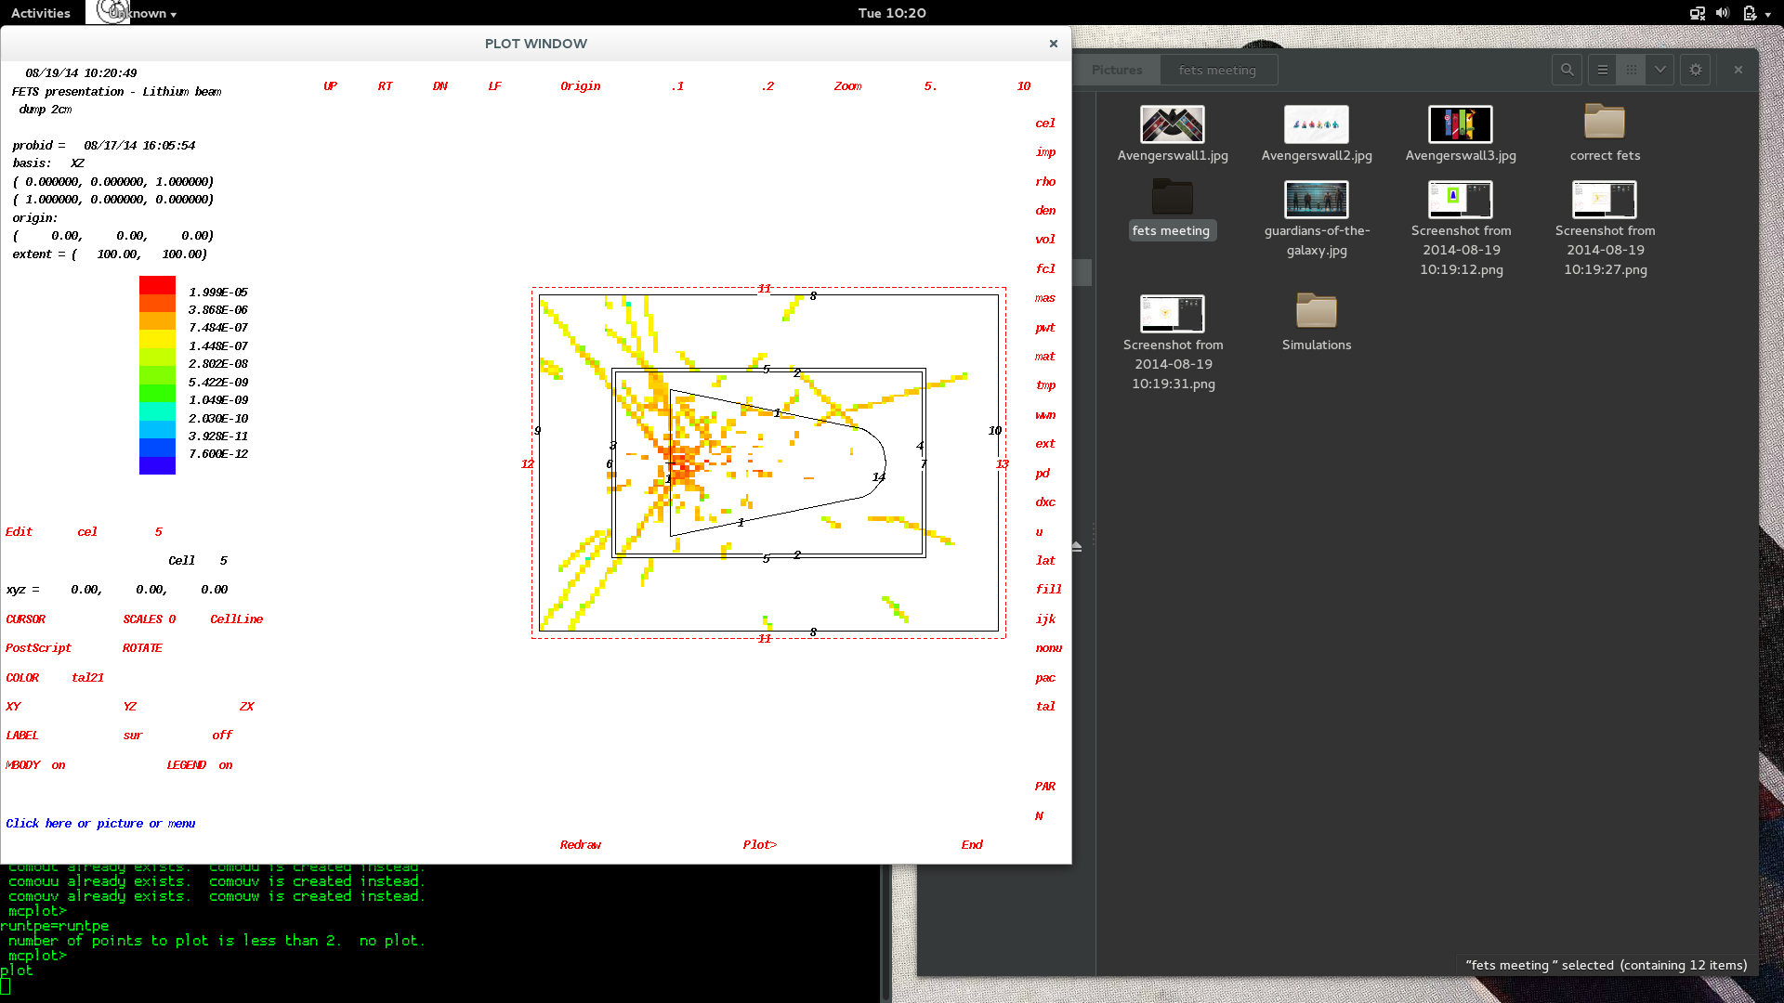
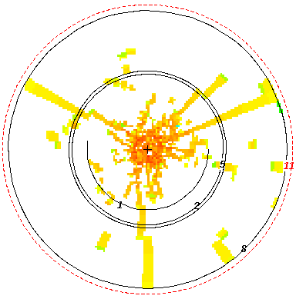
Lithium Target
Neutron Flux plot
Beam parameters
  1 million particles simulate
  3MeV proton beam
  5cm radial beam
  Source 2cm away from target
ZX plane
$$number/ cm^{2} \\ /source particle$$
XY plane

Slide 11
Next steps
Displacement per Atom (DPA) calculation on lithium plots
  Can be done in MCNPX but uncommon
2 different methods I have found for calculation
  Brian Linn - Rensselaer Polytechnic Institute, MANE6960, December 2013
  David Wootan - Pacific Northwest National Laboratory, Radiate Workshop, April 2014
I have tried to follow the example set by Linn, and am currently working on this
I was unsuccessful following Wootan’s Method
I will also look to compare the Lithium yields produced with known data
http://www.ewp.rpi.edu/hartford/~linnb/FWLM/Projeect%20Files/Linn%20-%20Radiation%20Damage%20Modeling.pdf
http://www-radiate.fnal.gov/meetings/WootanDPA.pdf

Slide 12
Next steps
Suggestions from Chris Densham – Radiation Damage facility
  Significant DPA values could be of use
  Irradiation facility looking at thin sheets of materials
    steel for reactor lifetimes
    Materials for target
Any suggestions for other interesting things to look at are welcome

Slide 13
