Slide 1
MEBT Quadrupoles
Scott Lawrie
FETS Meeting, RAL
17th December 2014

Slide 2
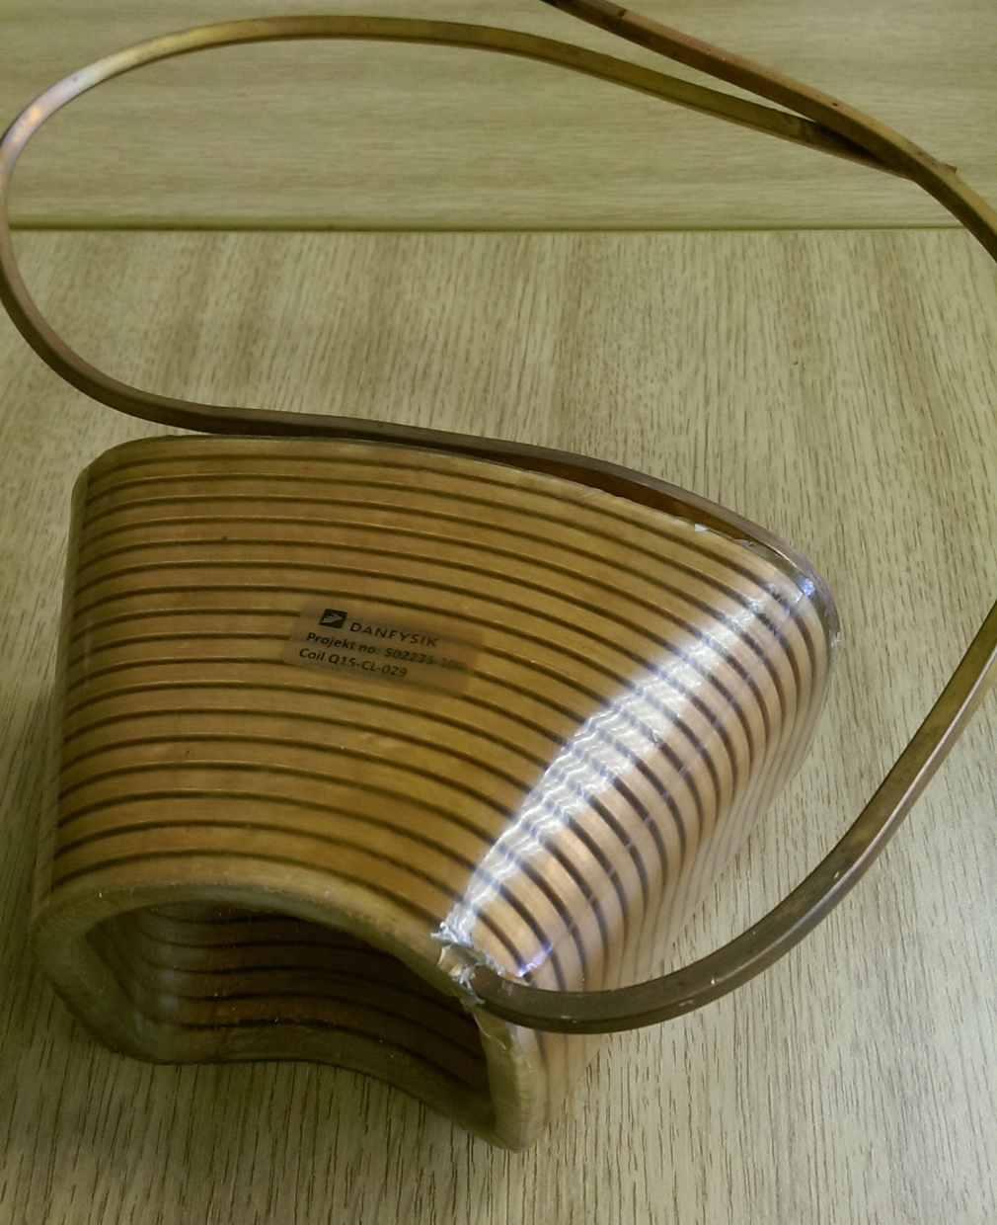
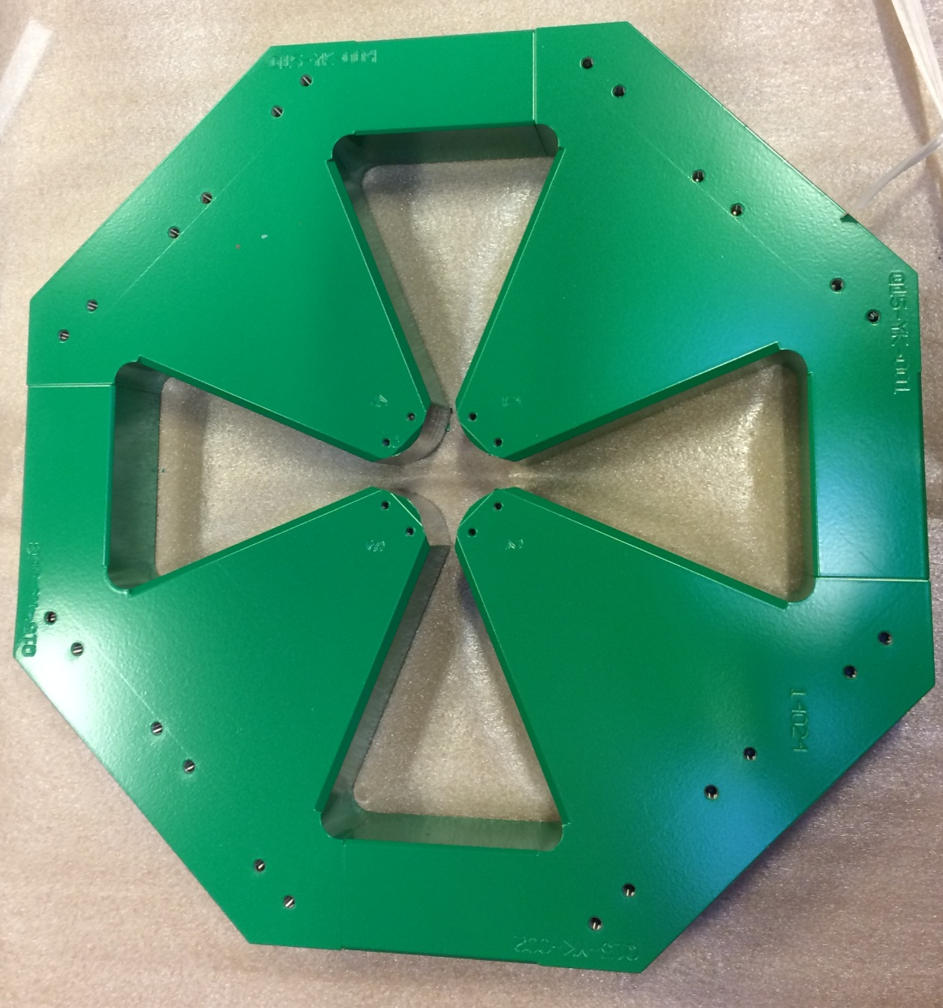
Yoke and Coil
September
October

Slide 3
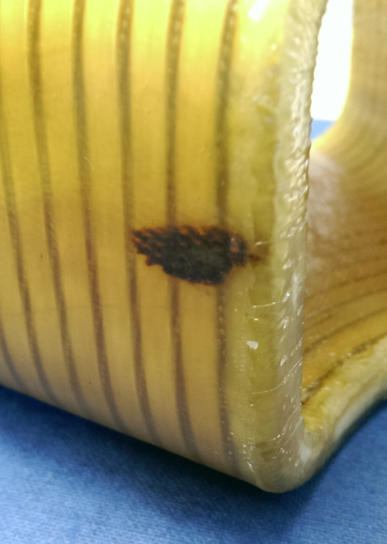
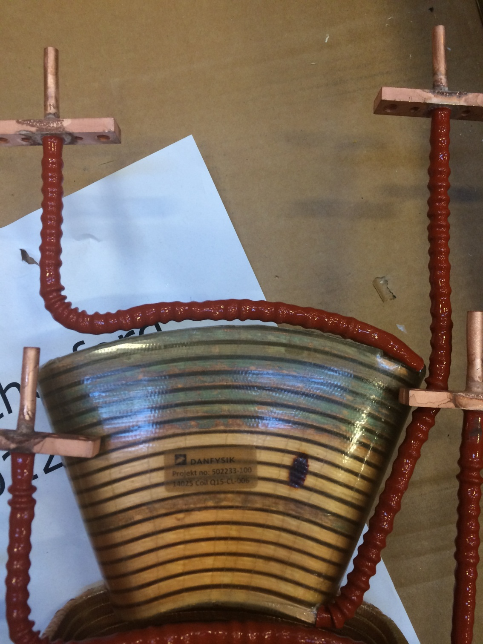
Visual Inspection
Some copper badly discoloured, but apparently does not affect voltage holding
Discolouration of a dab of superglue when resin heated in curing process

Slide 4
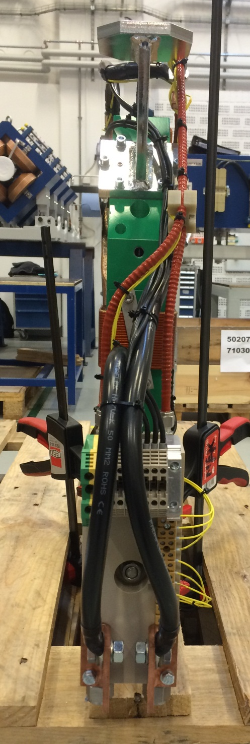
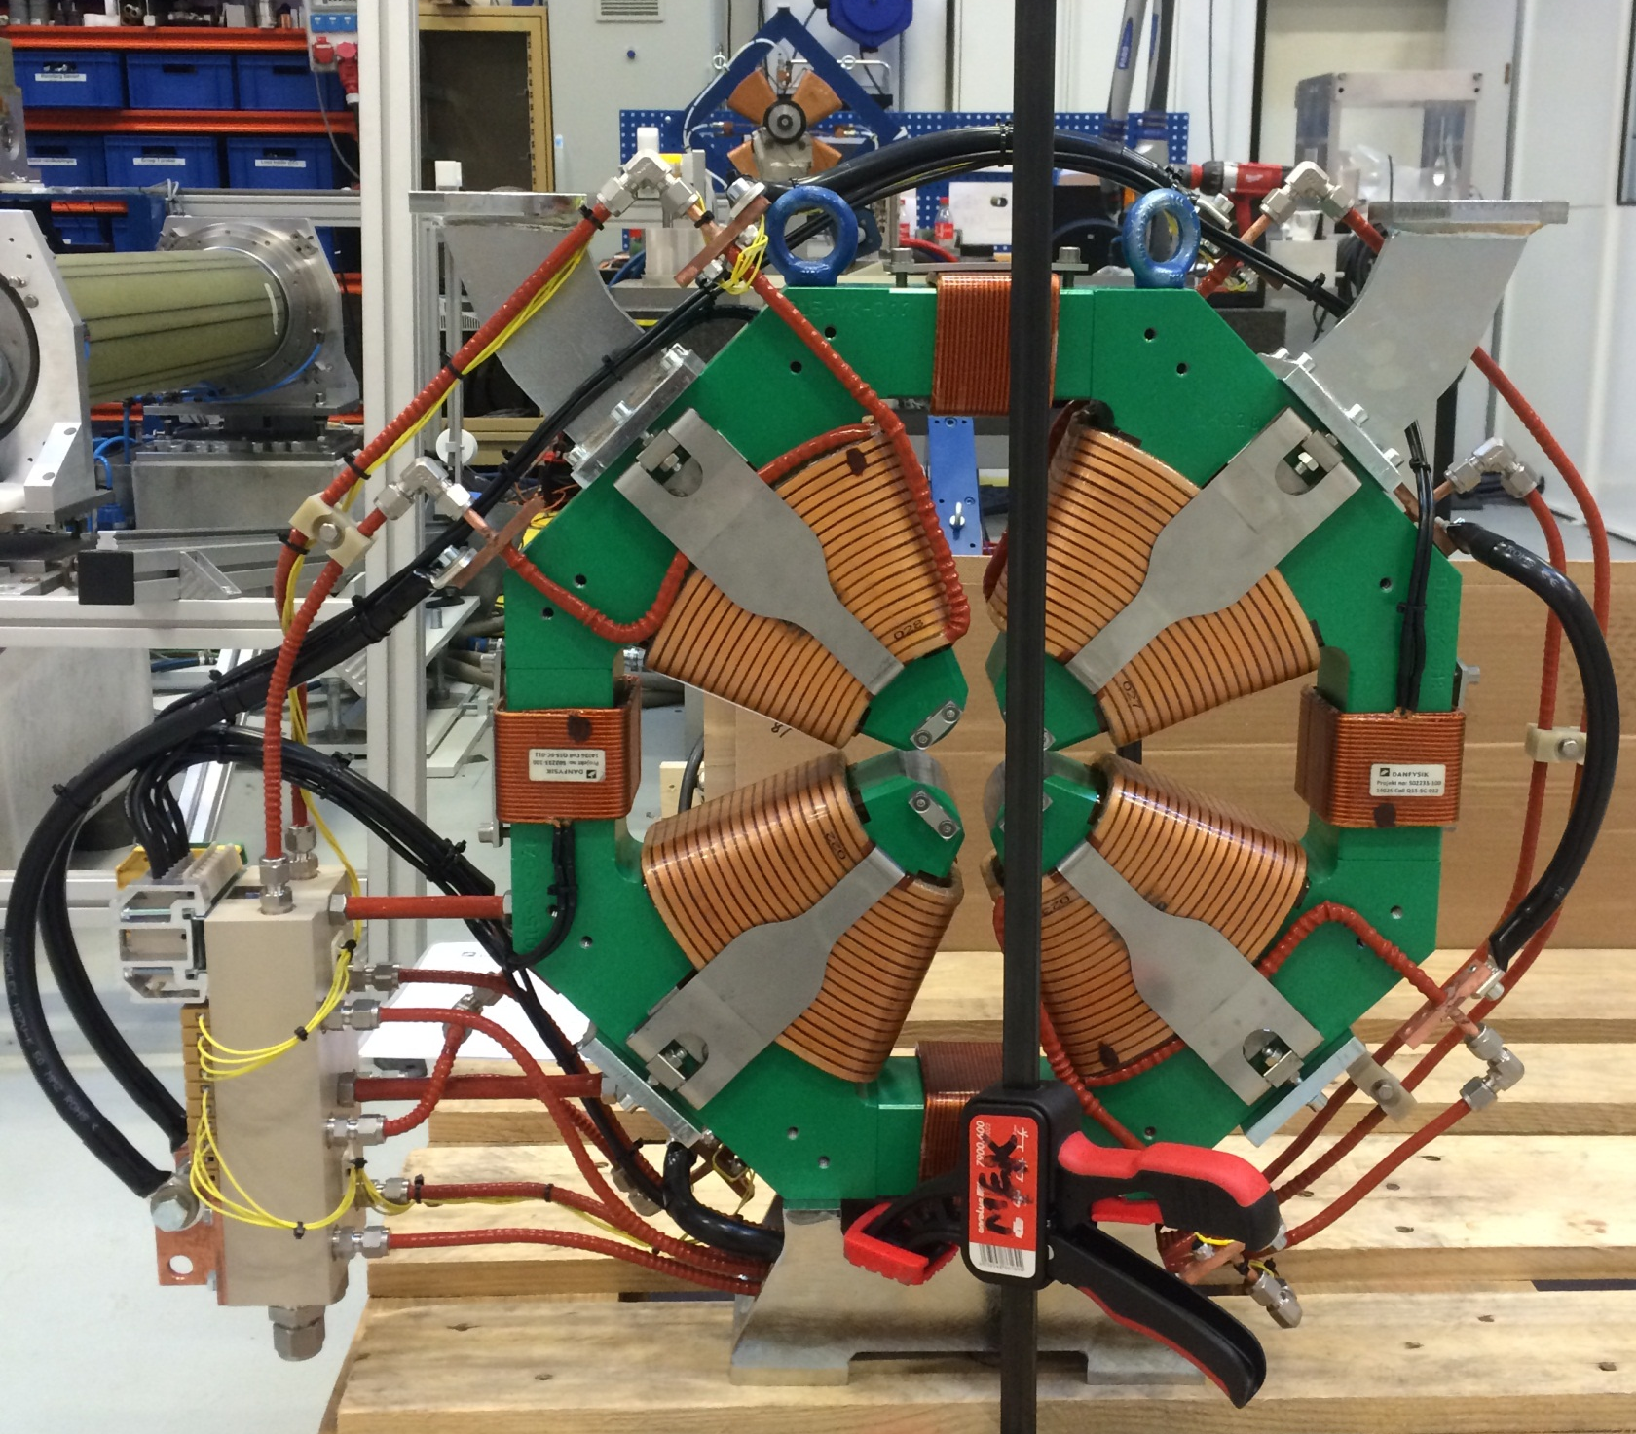
First Completed Assembly
November

Slide 5
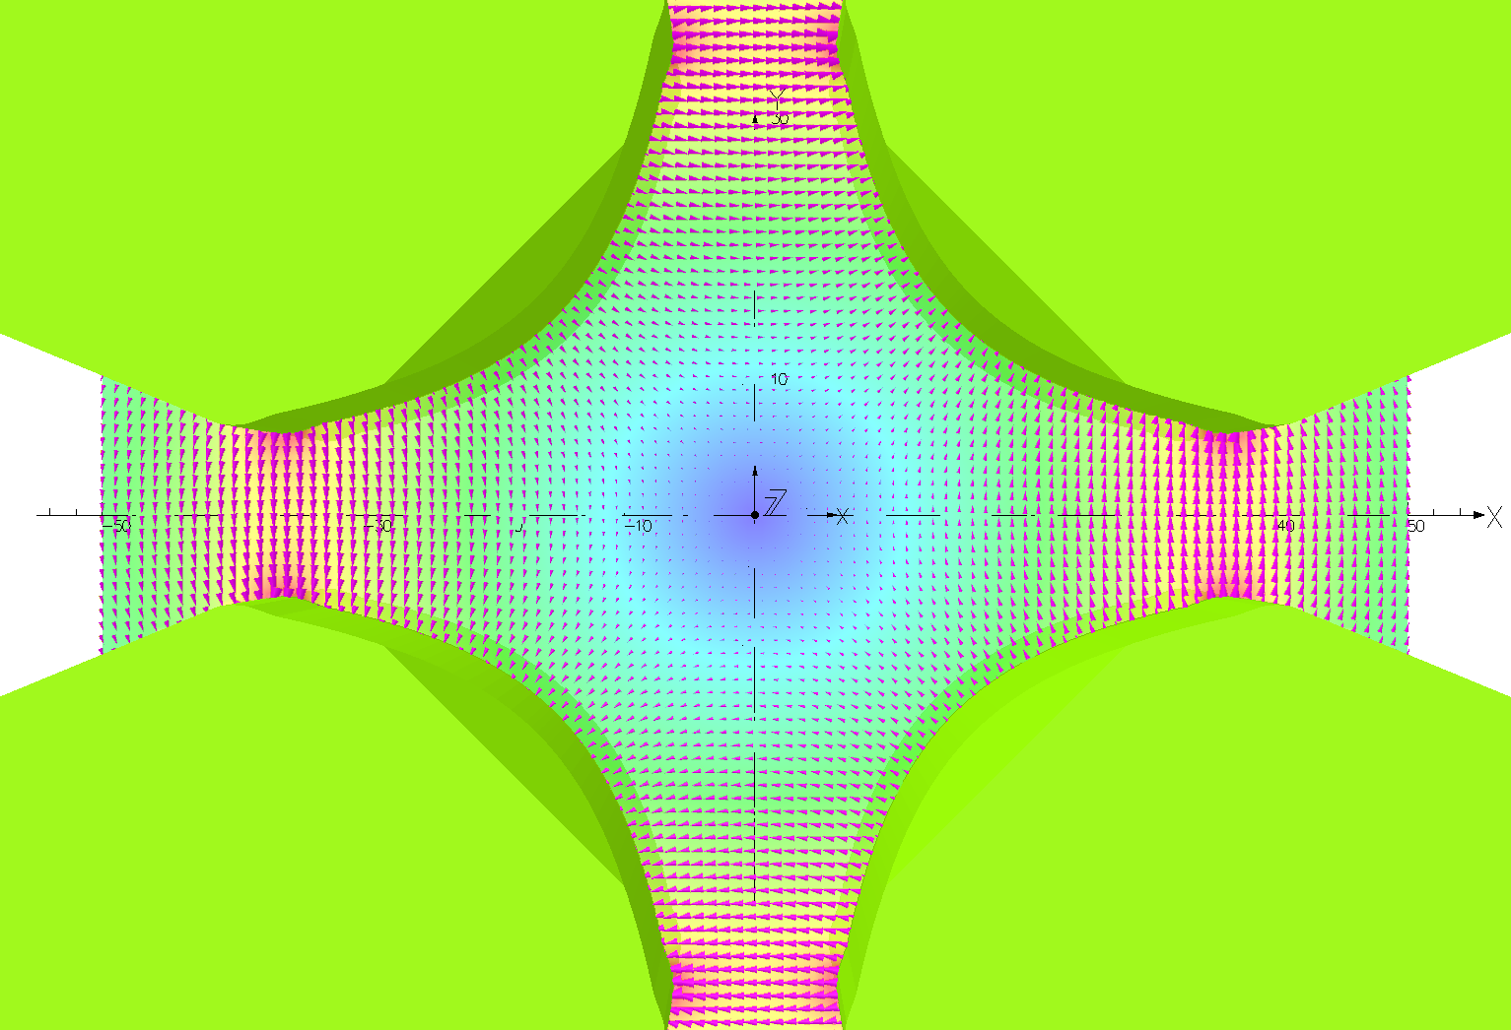
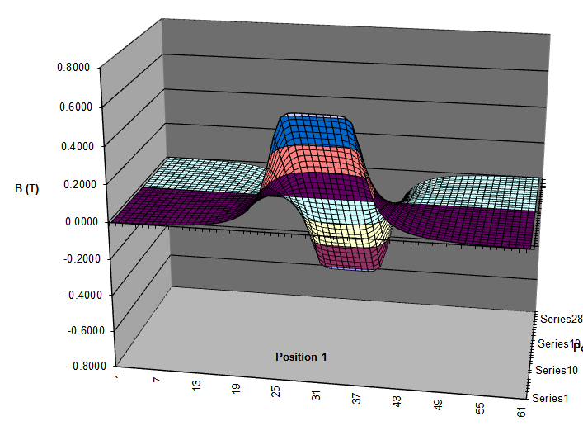
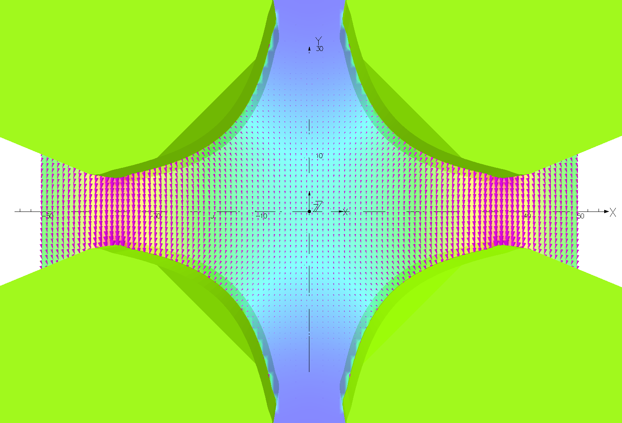
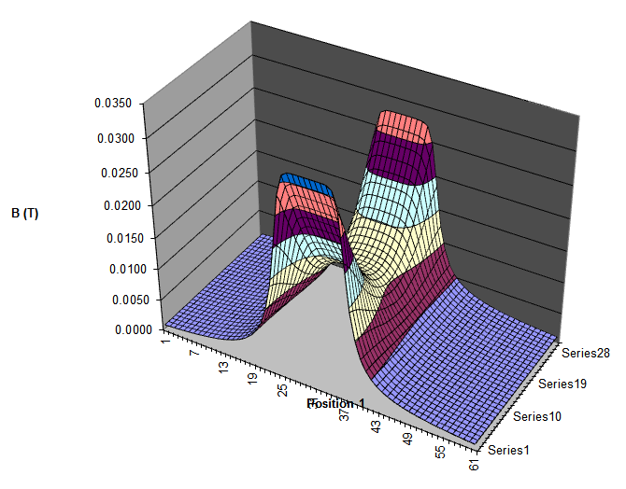
Magnetic Field Mapping
Quadrupole
Dipole
December

Slide 6
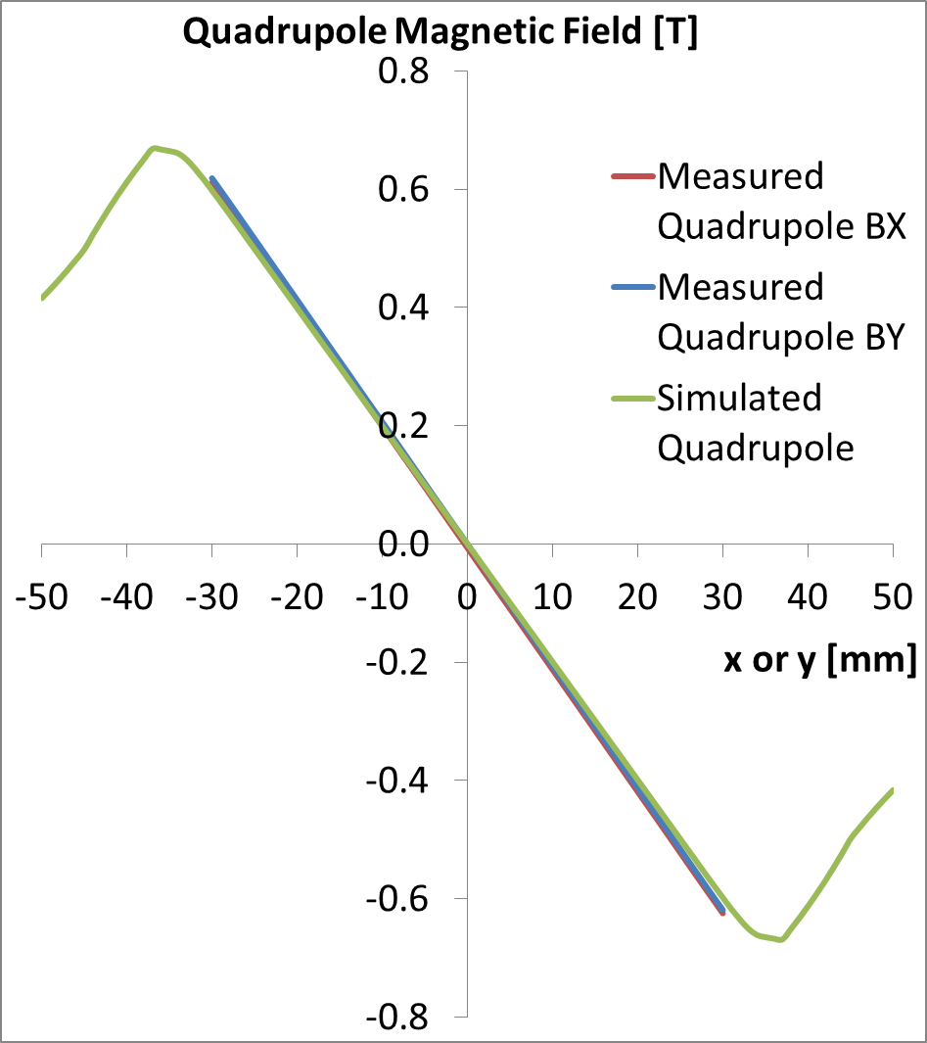
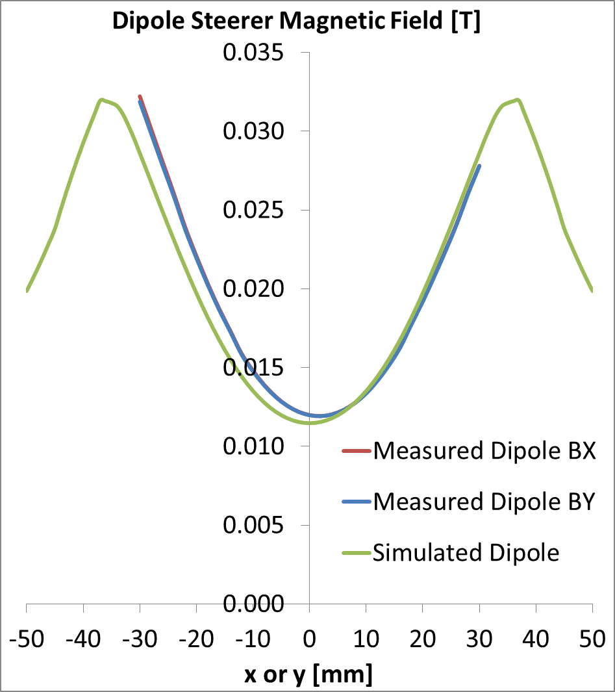
Magnetic Field Mapping

Slide 7
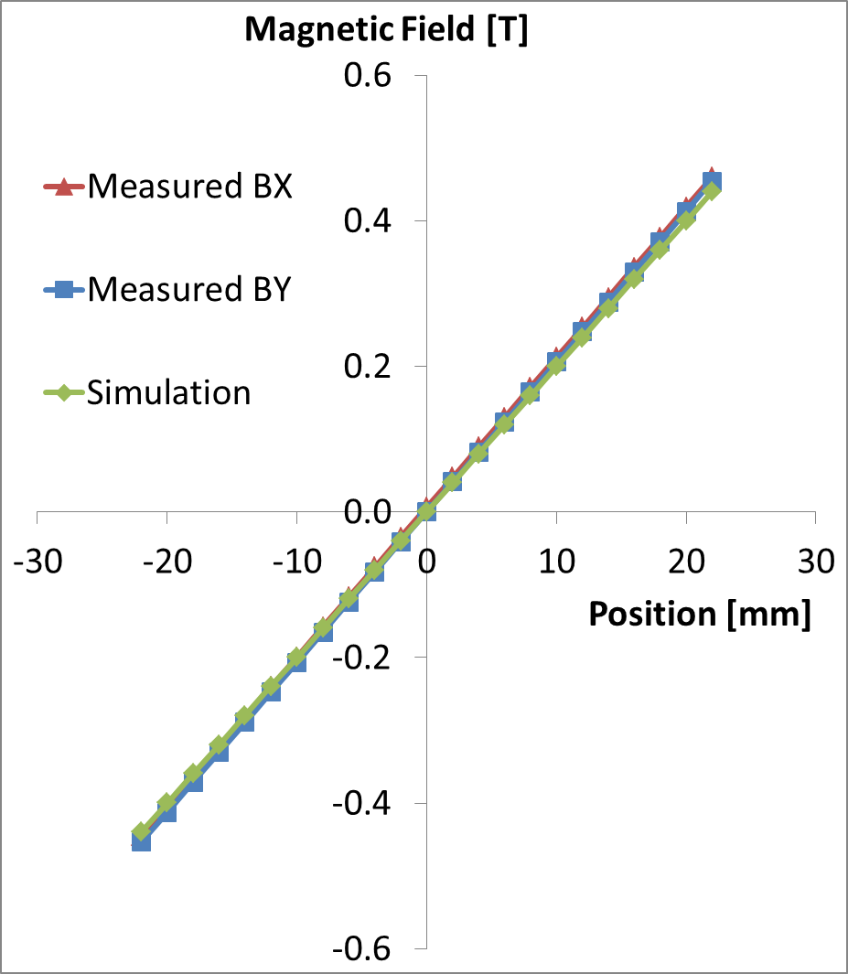
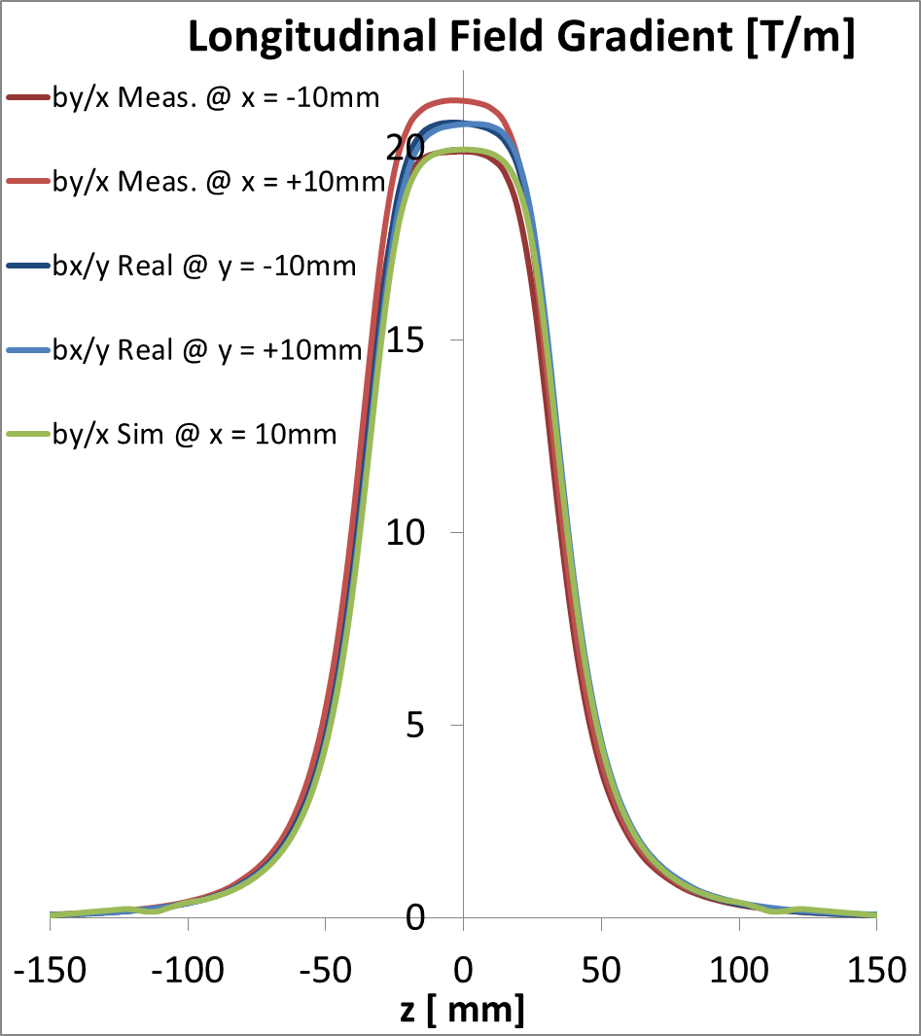
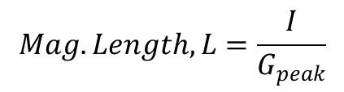
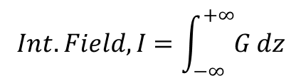
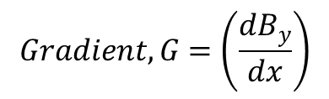
Field Homogeneity
Magnetic Length = 83.0 mm
Gradient
= 20.6 T/m
Linear to 0.2%
$$Gradient, G=\left(\frac{dB_{y}}{dx}\right)$$
$$Int. Field,I=\int_{−∞}^{+∞}{G dz}$$
$$Mag. Length,L=\frac{I}{G_{peak}}$$

Slide 8
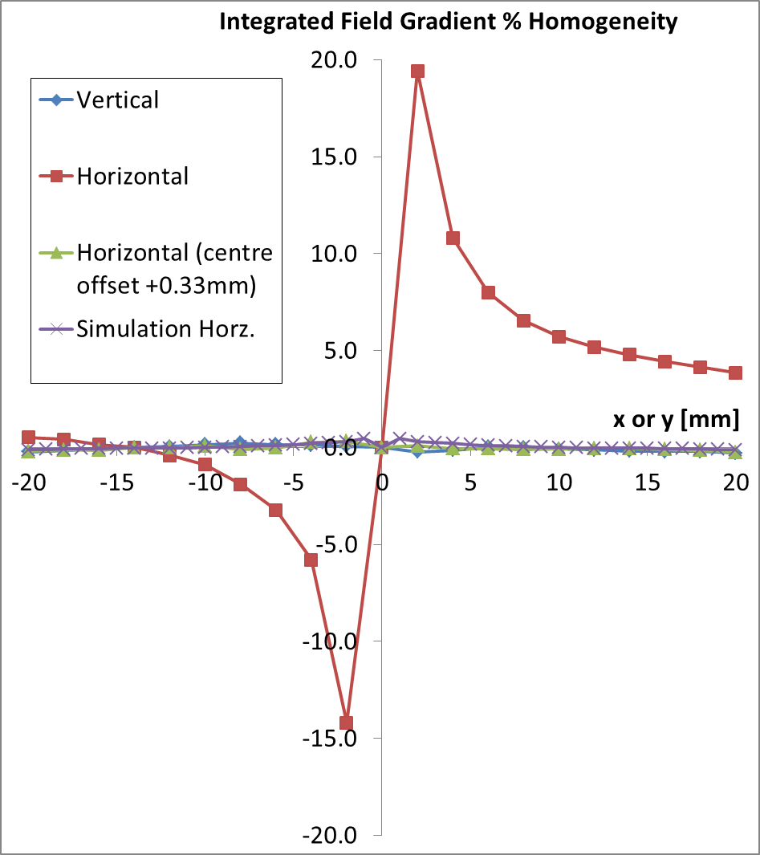
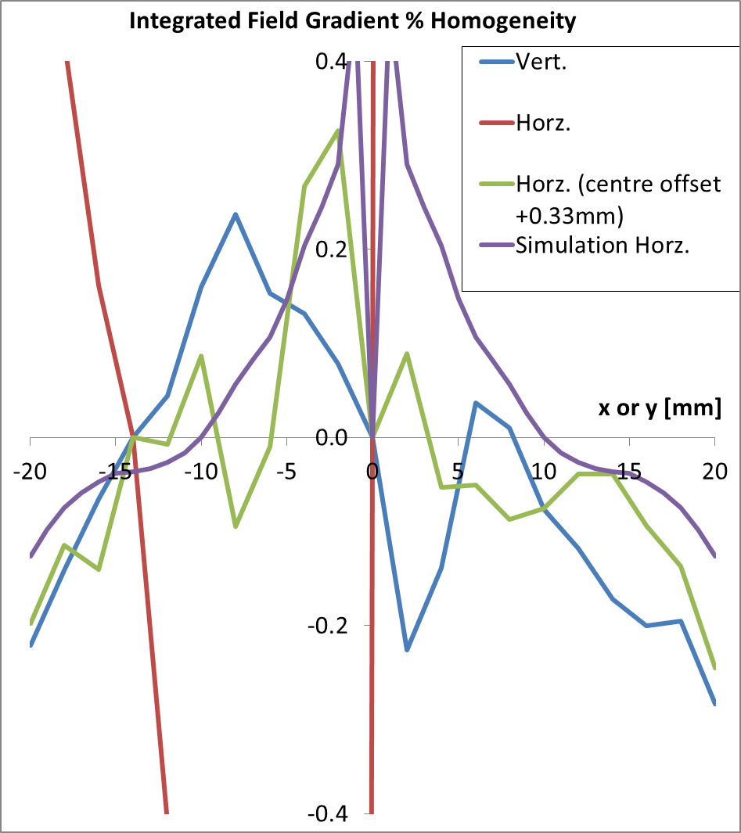
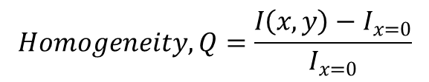
Field Homogeneity
Bad horz. hom. → not correctly centred!
Homogeneity = 0.2%
$$Gradient, G=\left(\frac{dB_{y}}{dx}\right)$$
$$Int. Field,I=\int_{−∞}^{+∞}{G dz}$$
$$Homogeneity, Q=\frac{I\left(x,y\right)−I_{x=0}}{I_{x=0}}$$

Slide 9
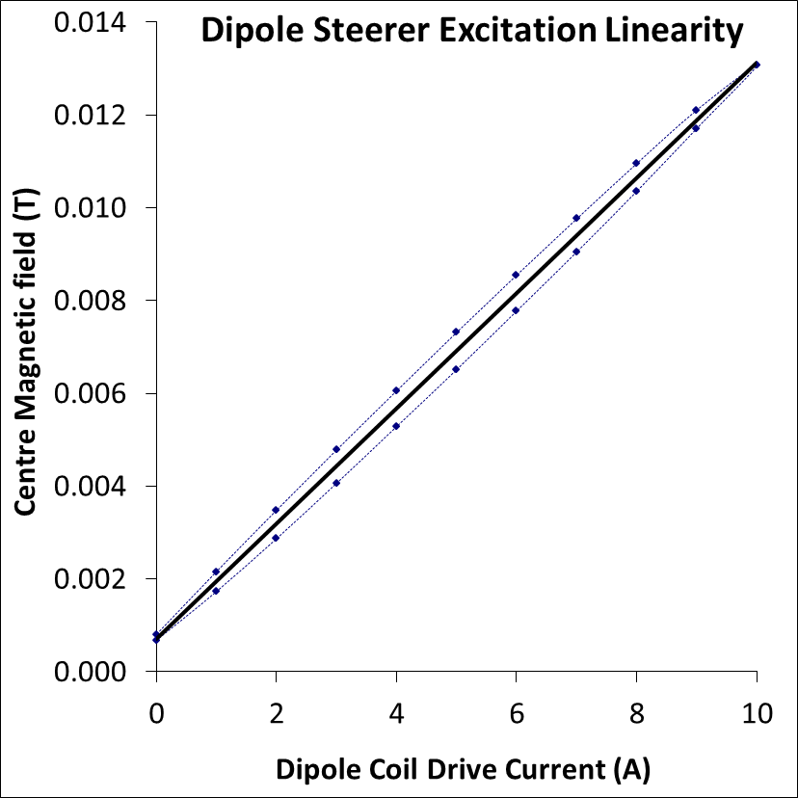
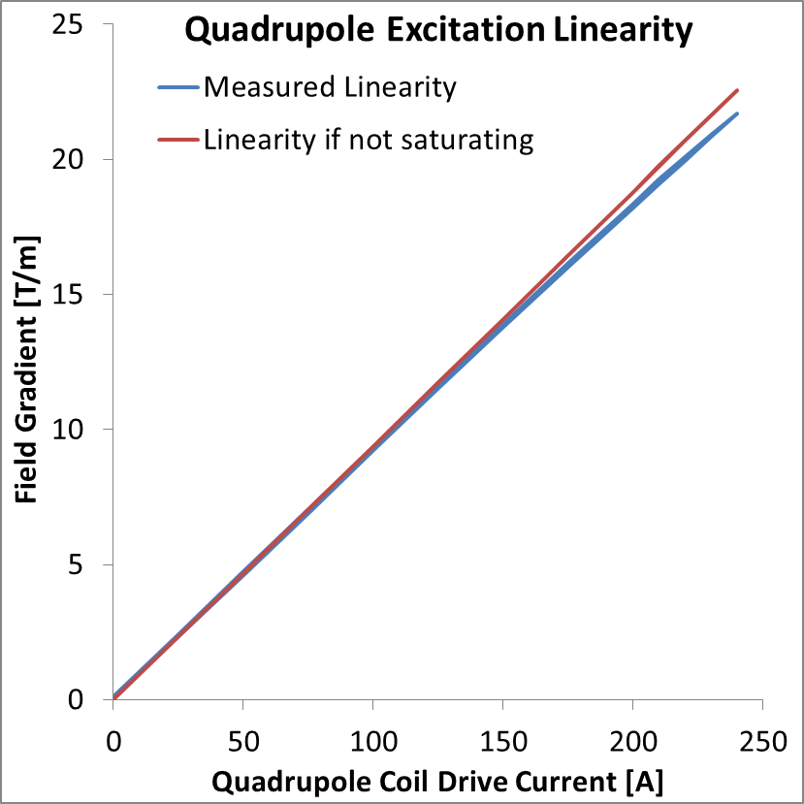
Excitation Linearity

Slide 10
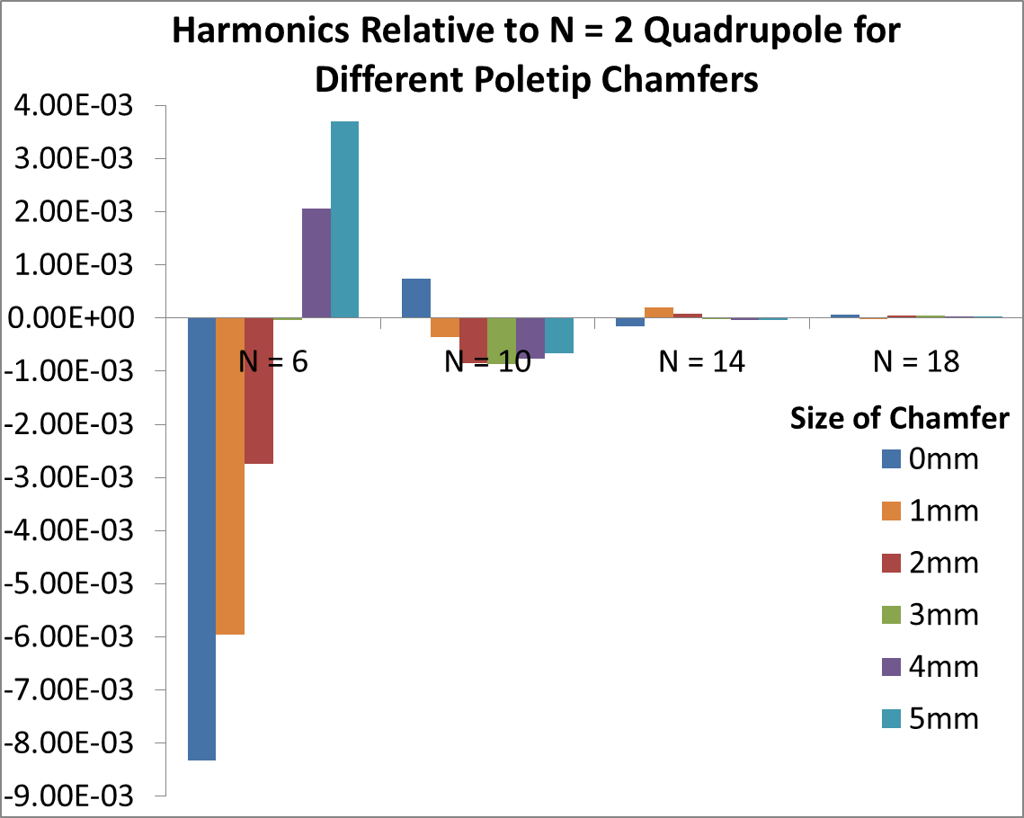
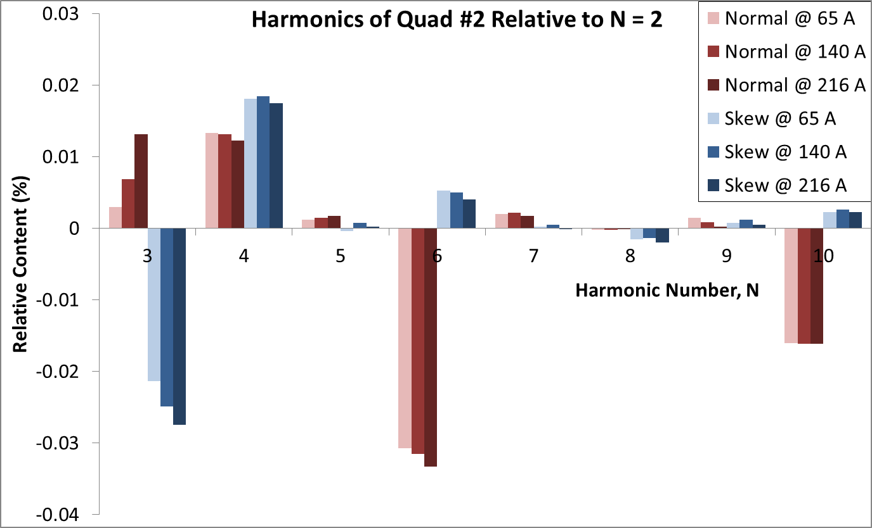
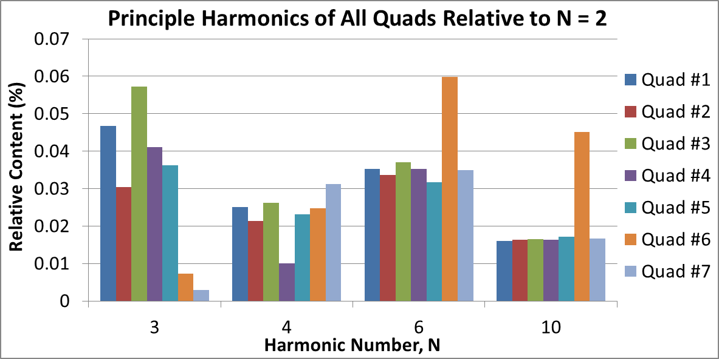
Harmonic Content
Optimisation Simulations
Measurements of Quad #2

Slide 11
Summary Statistics
Property | Requirement | Measured
Quadrupole Gradient | 20.0 T/m @ 210 A | 20.6 T/m @ 216 A
Dipole Centre Field | 12 mT @ 8.5 A | 12 mT @ 9.0 A
Integrated Field | 1.70 T | 1.71 T
Magnetic Length | 85 mm | 83 mm
Gradient vs. Current Linearity | 1% saturation at 20 T/m | 3% saturation at 20 T/m
Integrated Field Gradient Homogeneity | 0.5% both planes | 0.2% both planes, (assuming corrected horizontal centre)
Harmonic Content | <0.1% all harmonics | <0.06% all harmonics
Next Steps: - All test documentation collated this week
- Packaged up for Santa’s delivery next week

