Slide 1
MEBT Status
FETS meeting
Morteza Aslaninejad
RAL
3 July 2013

Slide 2
MEBT simulations based on the following stuff:
1-Beam input distribution(10k particles).
2-Quad field maps from Scott.
3-Cavity field map from Alan (Morteza).
4-Aperture radius 19 mm, at most places.
5- Space charge included.
Aim at this meeting:
To show some results and get prepared for a dedicated meeting in the next couple of weeks to compare the two lattices.

Slide 3
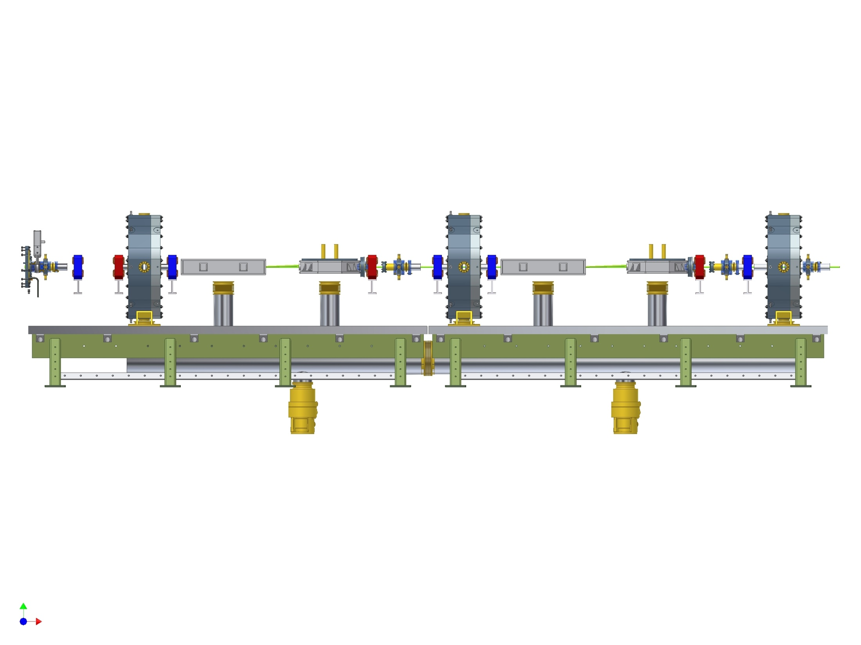

Slide 4
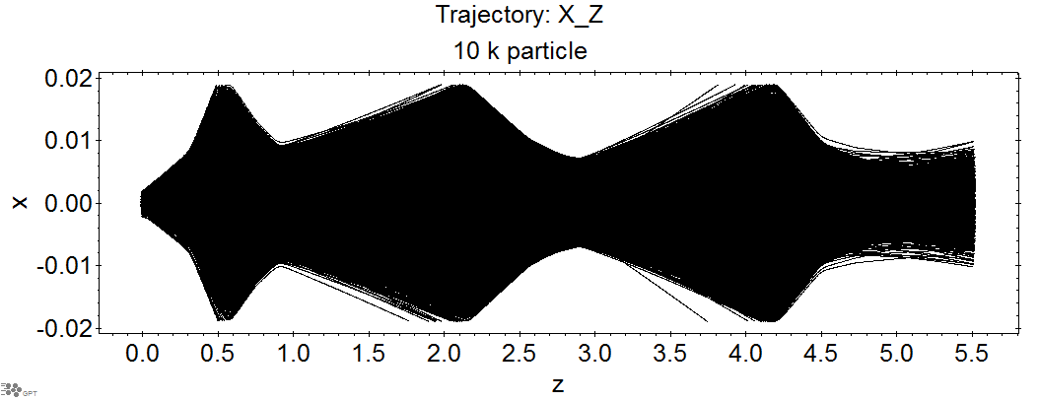

Slide 5
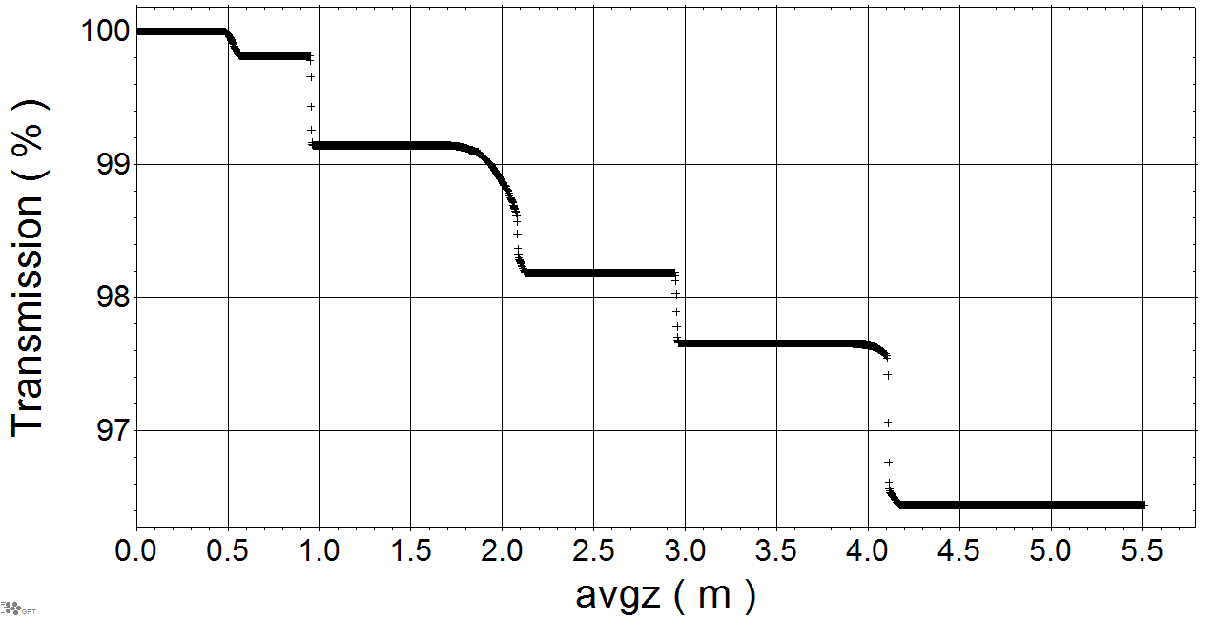
The same scale in the transmission

Slide 6
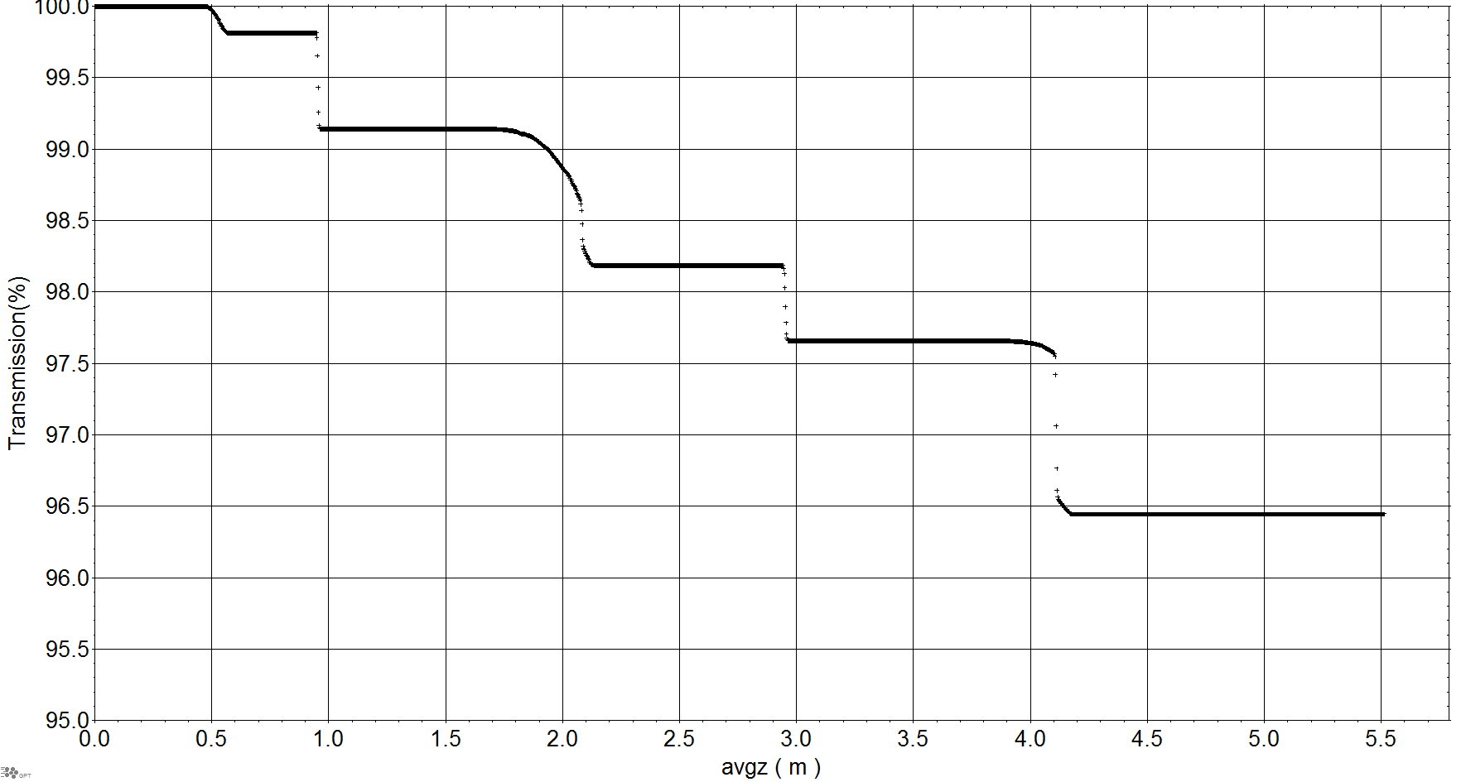

Slide 7
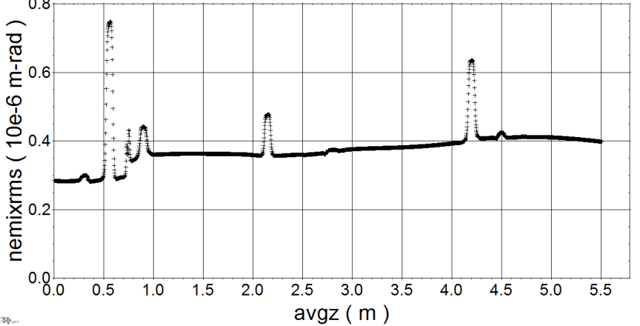
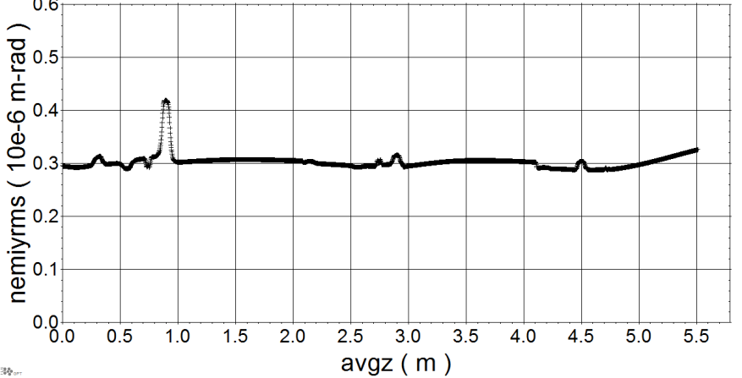
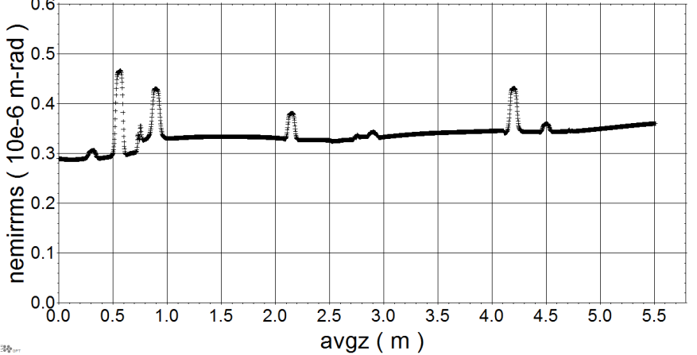

Slide 8
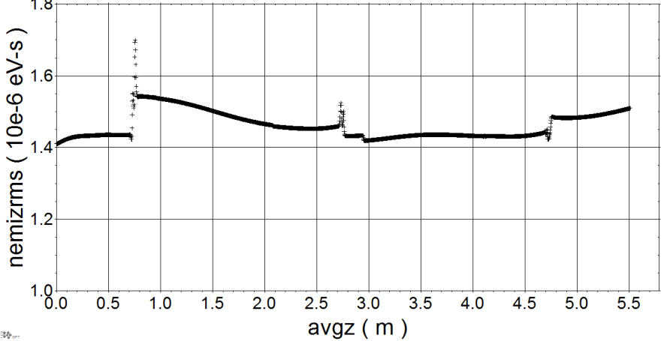

Slide 9
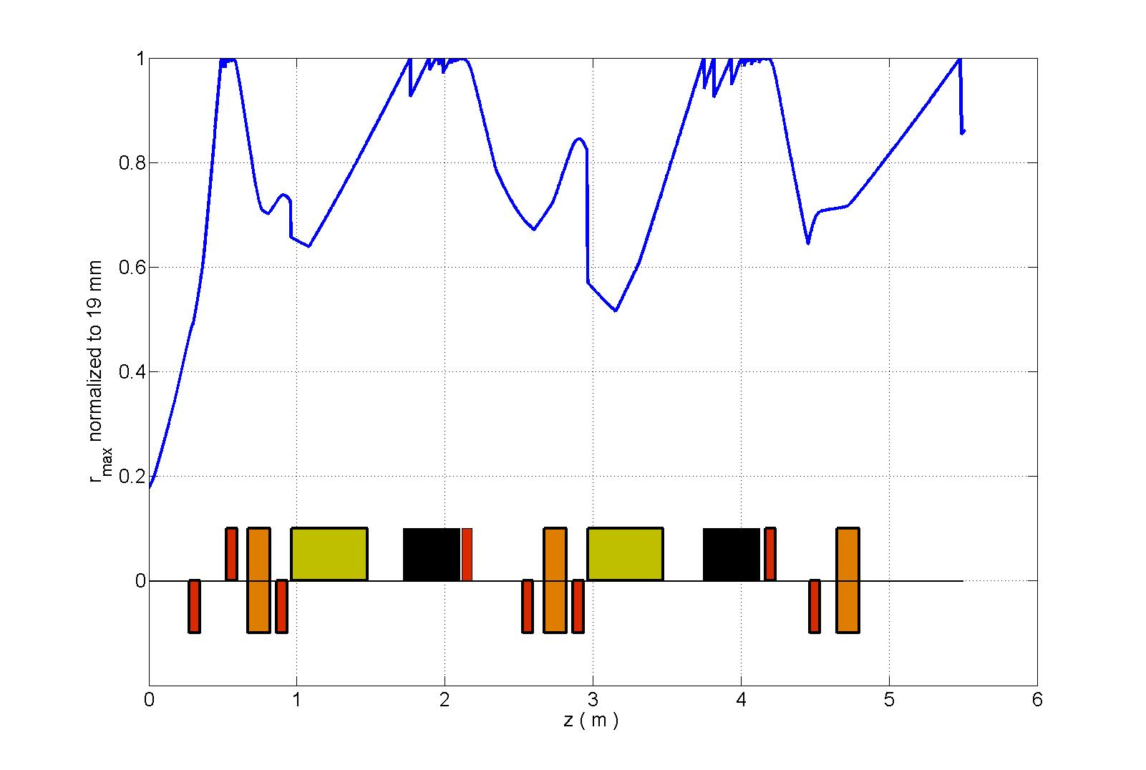

Slide 10
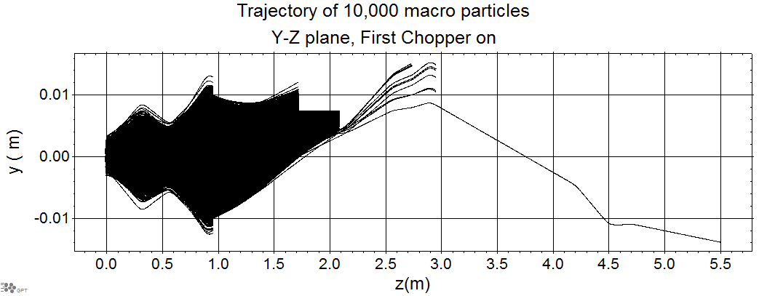
Will be lost anyhow
13 particles
0.14% un chopped

Slide 11
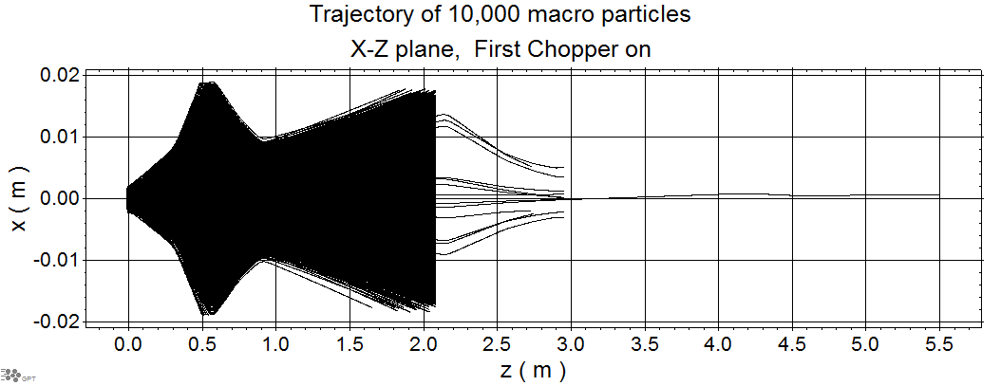
13 particles, 0.14 % un-chopped

Slide 12
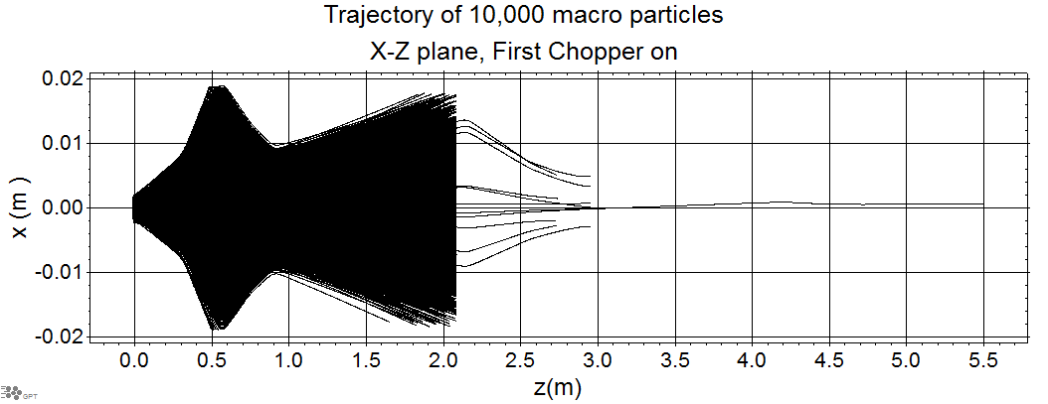
13 particles, 0.14 % un-chopped

Slide 13
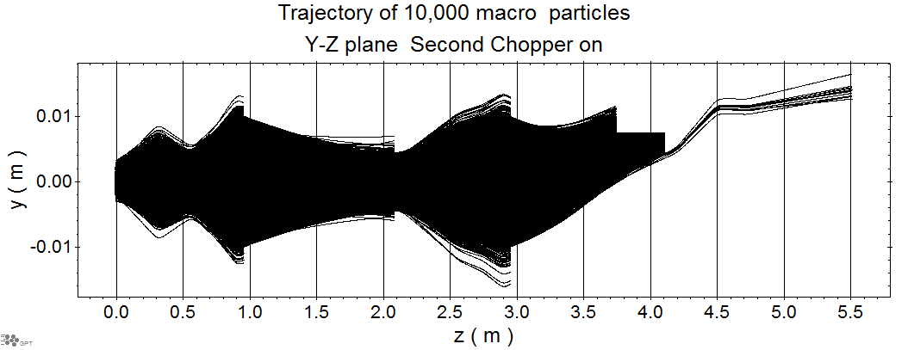
12 particles, 0.12 % un-chopped

Slide 14
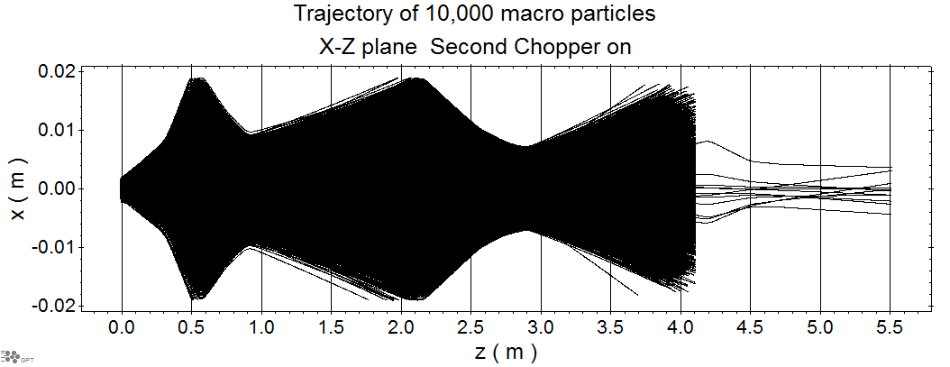
12 particles, 0.12 % un-chopped

Slide 15
Some to do tasks:
1-play around with the phase and the position of the first cavity to avoid the irreversible emittance jumps at the position of the first cavity.
2- shift quadrupole 4 a bit to right to make more space.
3-shift the aperture of the second dump a bit to the right to lose particles not chopped.
4-calcualiton of power absorbed by the dumps.

